Slide 1
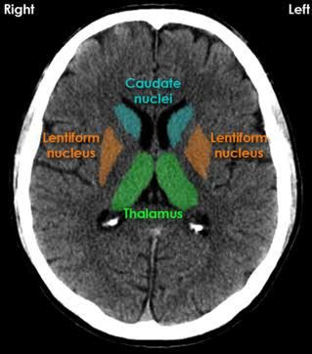
Radiological Features of Caudate Nucleus
Karthik Krishnan

Slide 2
Introduction
Basal Ganglia comprises of several deep grey matter nuclei within forebrain, midbrain and diencephalon.
Caudate Nucleus and Putamen makes up the Corpus Striatum
Globus Pallidus
Subthalamic Nucleus
Substantia Nigra

Slide 3
Caudate Nucleus
Caudate nucleus is a paired C-Shaped subcortical structure which lies deep inside the brain near the thalamus.
Each caudate nucleus is composed of a large anterior head, a body and a thin tail that wraps anteriorly, thereby visible in the same coronal cut.
It combines with the putamen to form the striatum.
It’s has various functions, such as planning the execution of movement, as well as learning, memory, reward, motivation, emotion and romantic interaction.

Slide 4
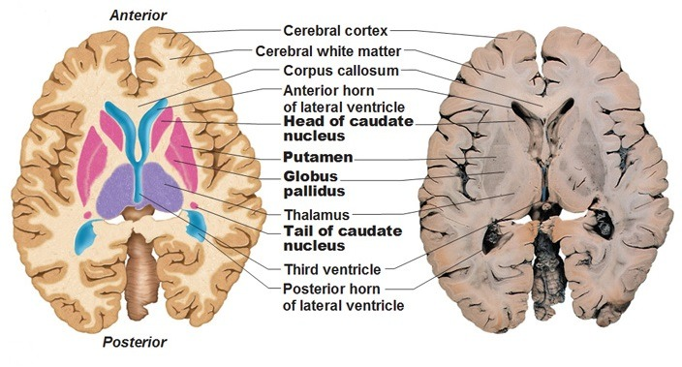
Landmarks
Made up of Head, Body and Tail
Head of Caudate nucleus indents the anterior horn of the lateral ventricle.
It’s body curves upwards and posteriorly from the head, following the contour of the body of the lateral ventricle.
The tail which comes to lie immediately superior to the temporal horn of the lateral ventricle.

Slide 5
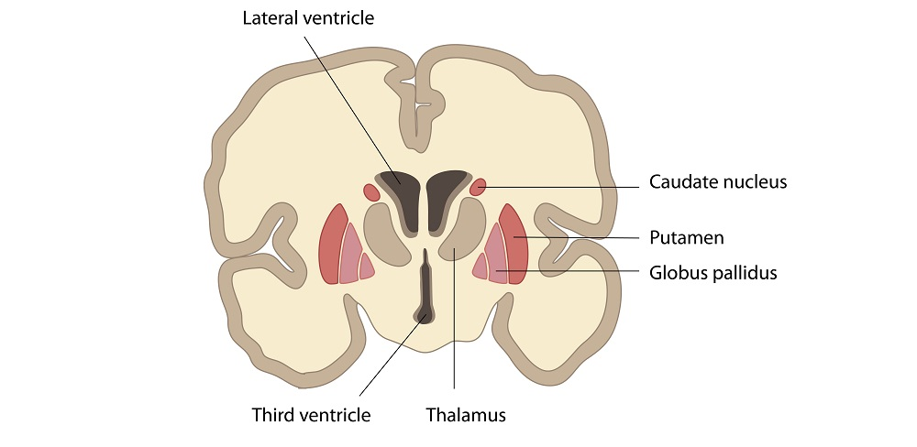
Surrounding Structures
Medially, Superomedially – Frontal Horn of Lateral Ventricle
Laterally – Anterior Limb of Internal Capsule
Inferiorly – Thalamus

Slide 6
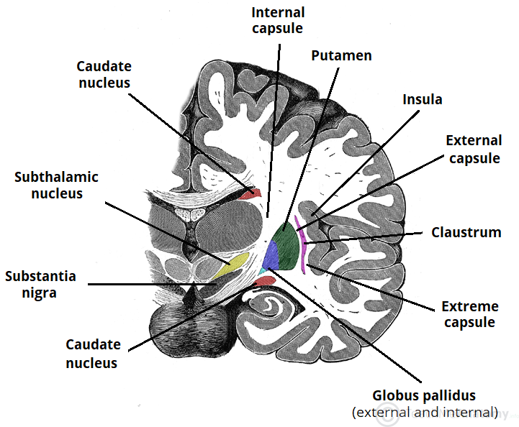
Structure of Caudate Nucleus
Lies near the thalamus in the center of the brain.
The head of caudate nucleus forms the lateral wall of the lateral ventricle.
Body lies lateral to the body of the lateral ventricle
Tail lies above the temporal horn of the lateral ventricle.

Slide 7
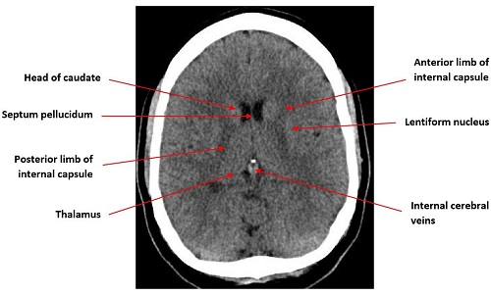
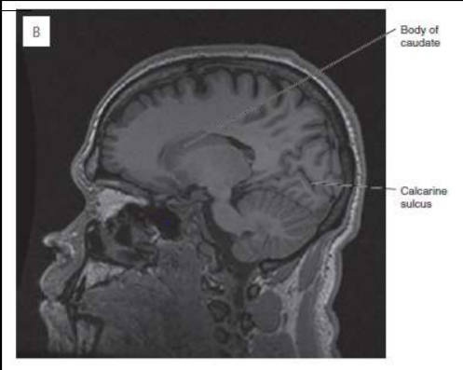
Imaging

Slide 8
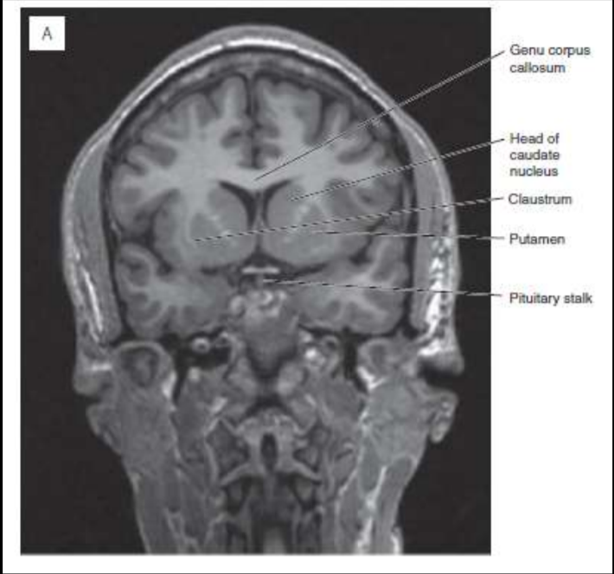
Imaging

Slide 9
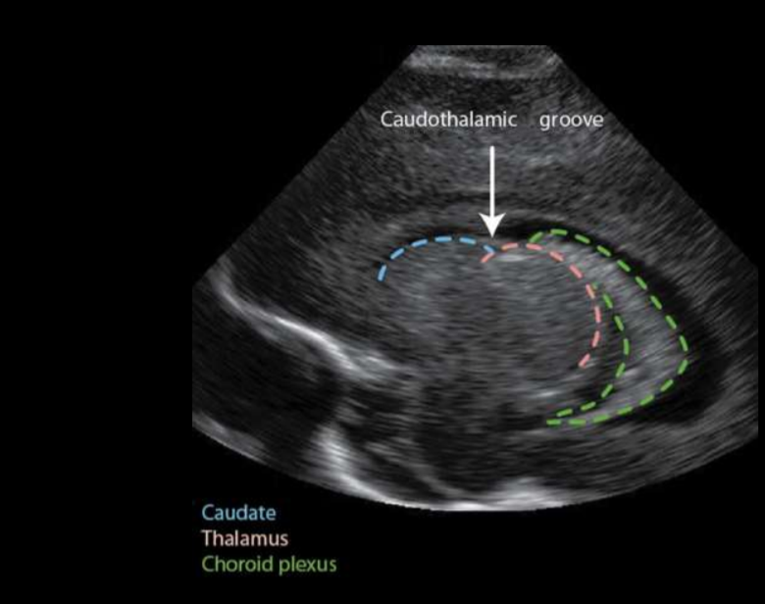
USG

Slide 10
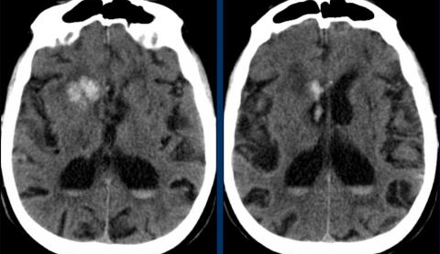
Haemorrhage
Haemorrhage in basal ganglia is typically seen in hypertension. Typically occurs in elderly patients and usually in a central location.
Differentiates with hypertensive bleed from patients with cerebral amyloid angiopathy which is more peripheral.
Here, head of caudate nucleus receives blood supply from Heubner’s artery and lenticulostriate arteries.
The presence of IVH is considered poor prognostic factor due to obstruction to CSF with hydrocephalus and raised ICP

Slide 11
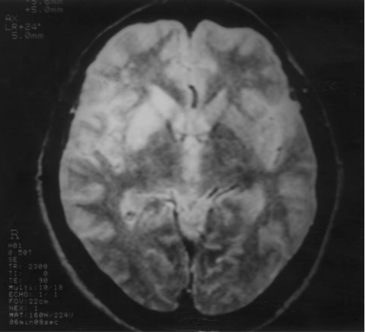
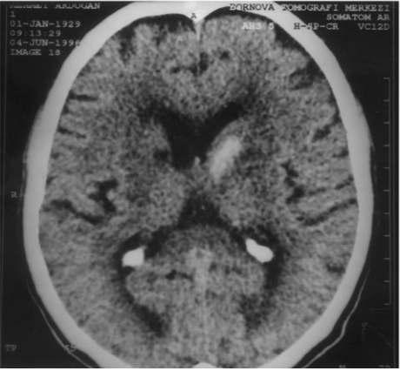
MRI
Right infarct in the territory of lateral lenticulostriate arteries involving caudate nucleus
Left caudate hemorrhage involving caudate nucleus and right old caudate infarct.

