Slide 1
B. Karthik Krishnan A/L Balakrishnan
P-UM0080/18
MMed Surgery Y4

Slide 2
Content
Dissertation
Academic Progress
Supervisor Report
Logbook Summary

Slide 3
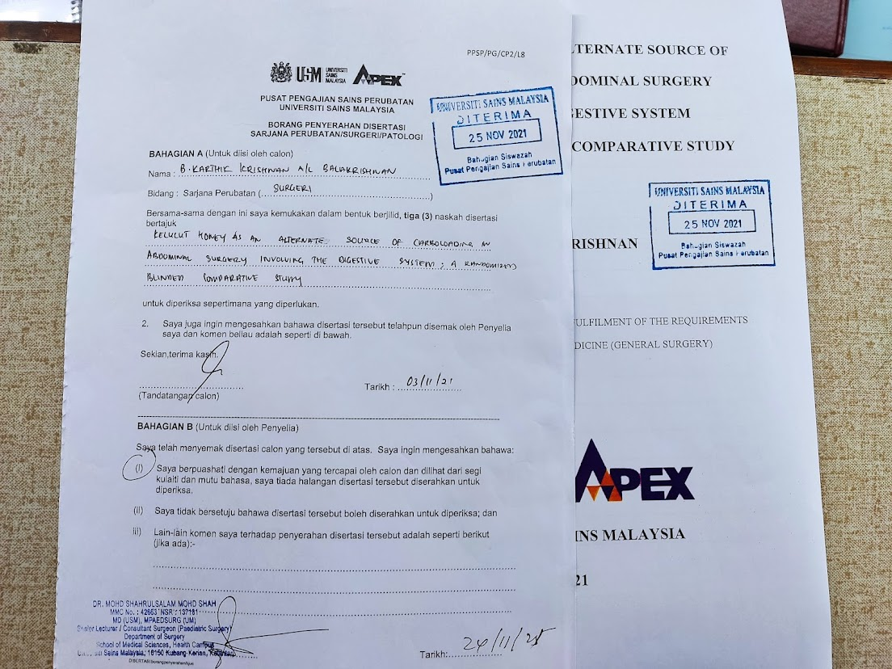
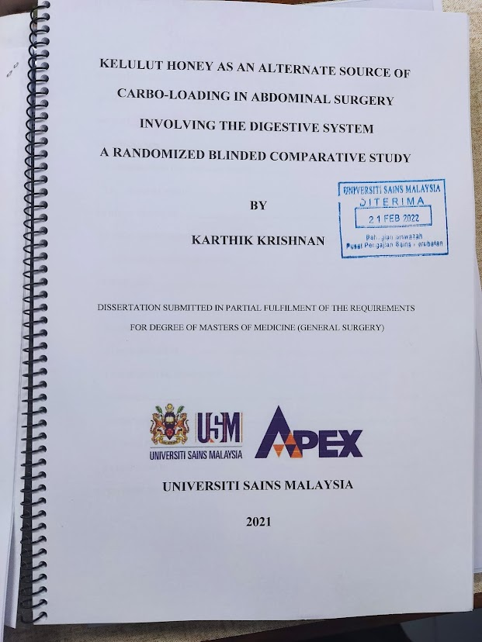
Dissertation
First Submission: 25/11/21
Correction and Resubmission : 21/02/22

Slide 4
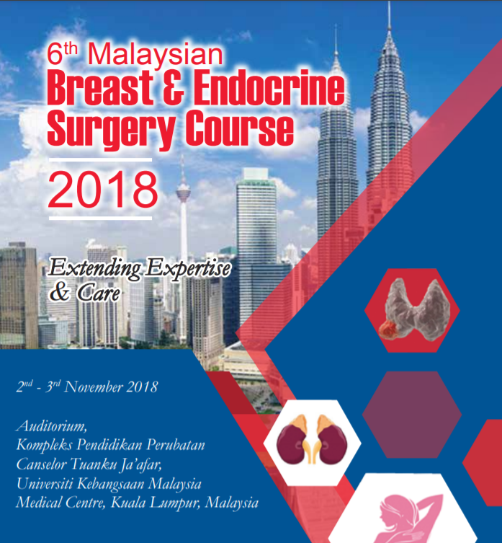

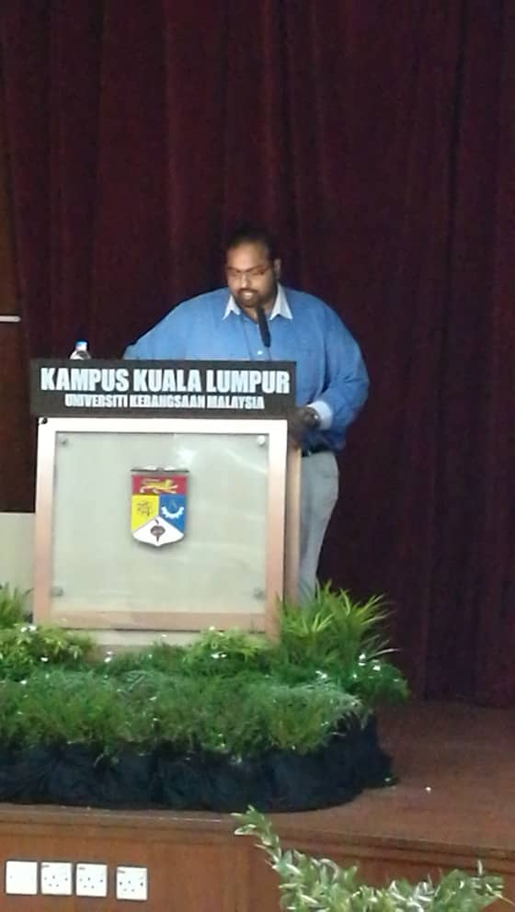
Academic Progress – Oral Presentation

Slide 5

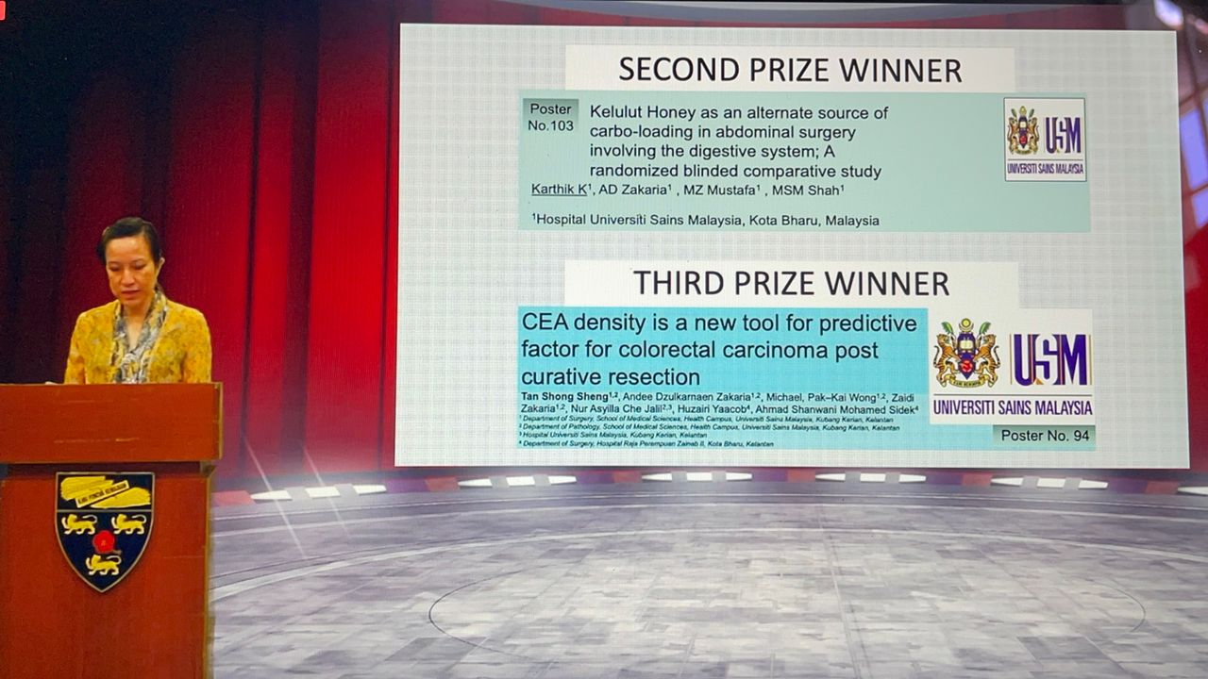
Academic Progress – Oral Presentation

Slide 6
Publications
# | Title | Type | Journal | Status
1 | Tailgut Cyst | Image of Interest | BIMJ | Published
2 | A rare extra-gonadal Germ Cell Tumour mimicking Ischaemic Heart Pain | Case Report | BMC Surgery | Under Review FEE Waiver granted
3 | Blood Donation – A peculiar cause of traumatic ulnar artery thrombosis causing ischaemia | Case Report | SAGE Vascular | Under Peer-Review
4 | Carcinoma En Cuirasse; A rare breast cancer manifestation | Image of Interest | BIMJ | Under Review

Slide 7
Case Reports and Pending Publications
# | Title | Type | Status
1 | Atypical Presentation of Yolk Sac Tumour | Case Report | Awaiting Correction for Submission – Prof Ikhwan
2 | Kelulut Honey as an alternate source for carbohydrate loading | RCT | Awaiting edits for Submission – Prof Andee
3 | A rare manifestation of Breast Cancer; Carcinoma En Cuirasse | Case Report | CSAMM

Slide 8
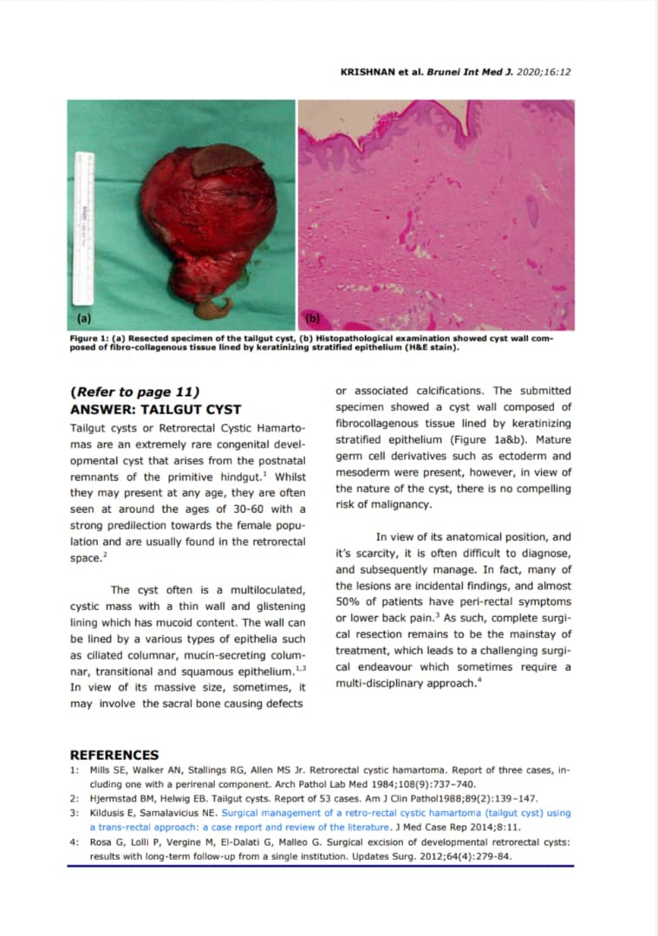
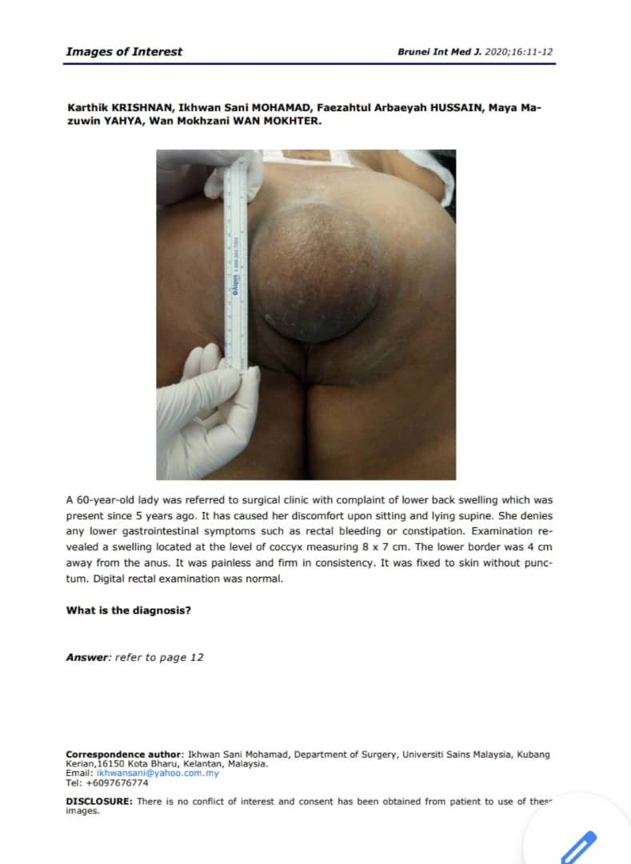
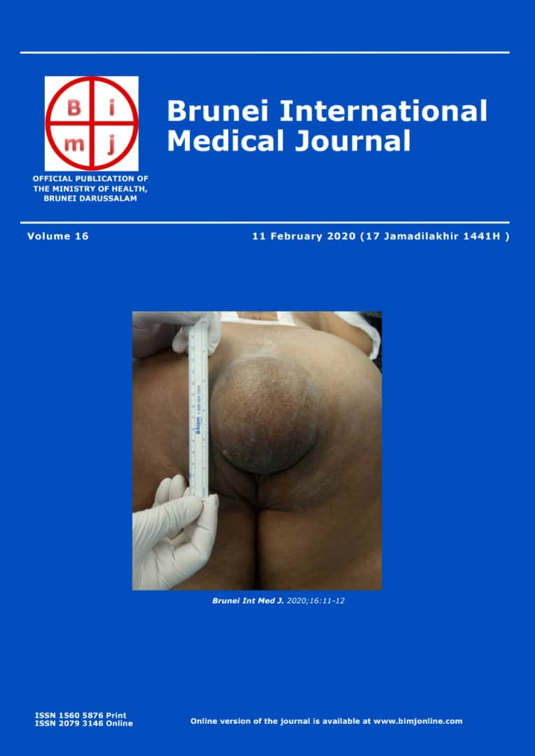

Slide 9
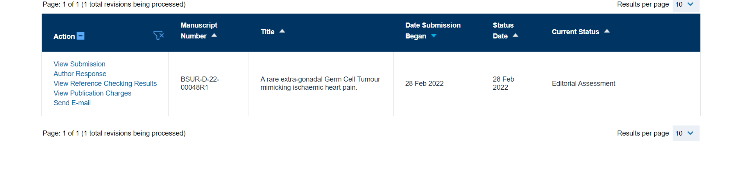
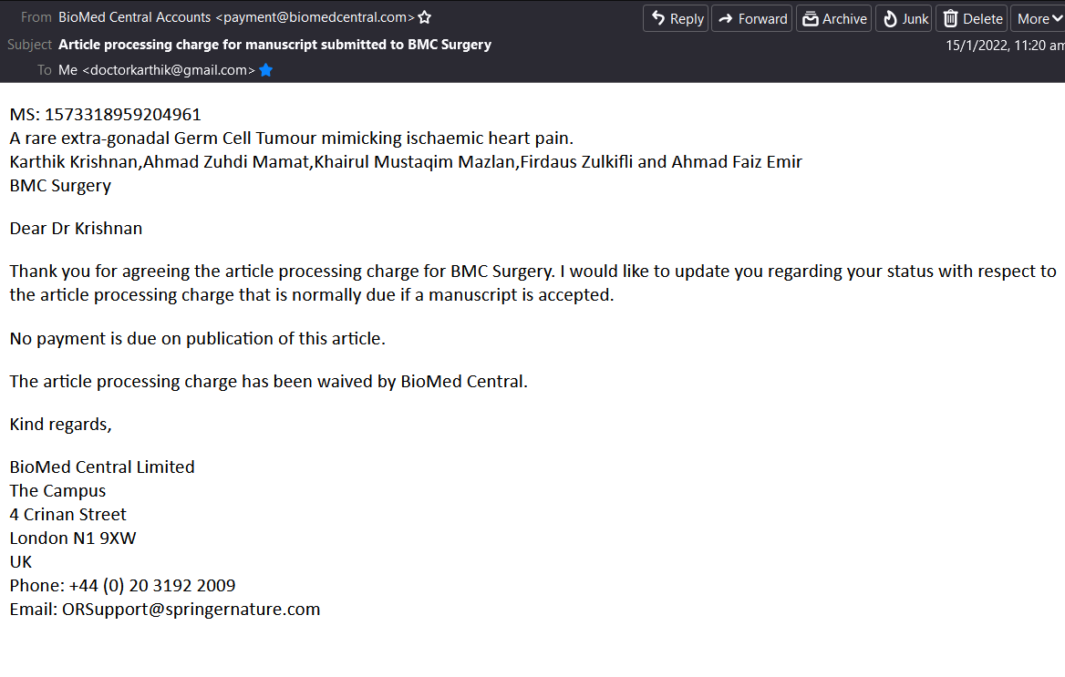
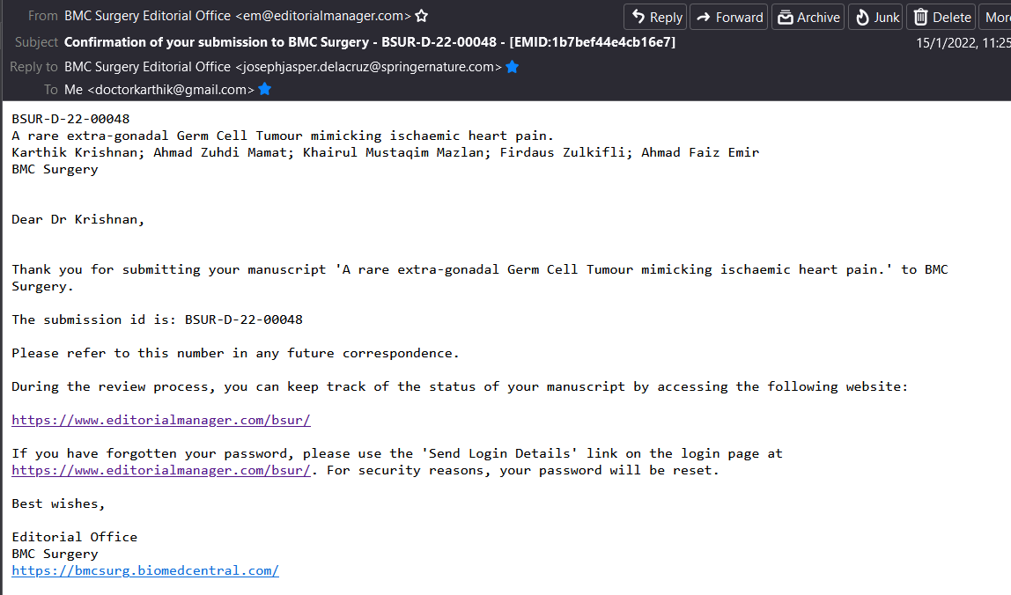
BMC Surgery

Slide 10
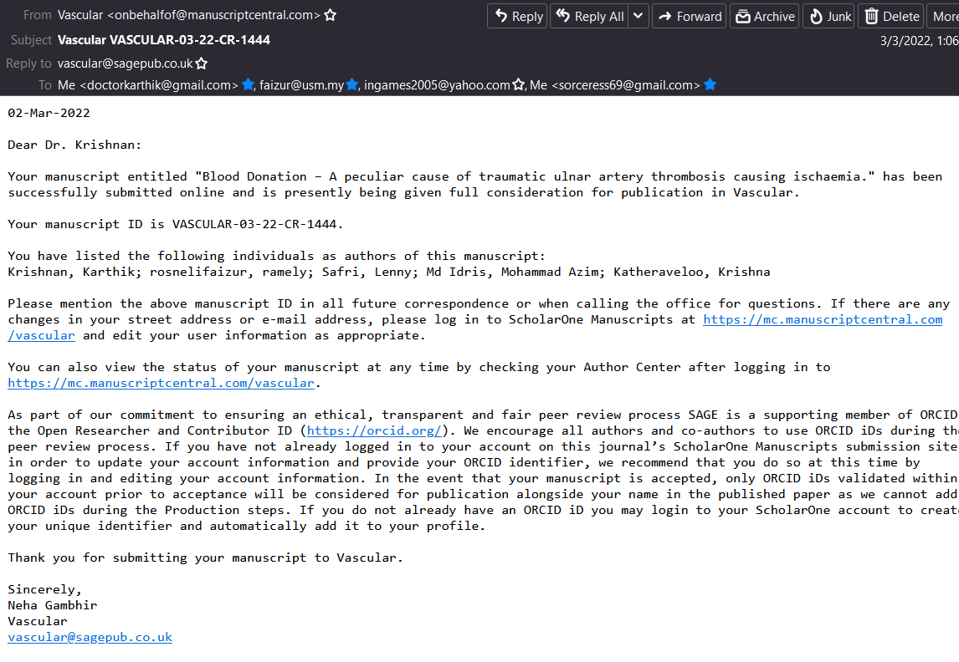
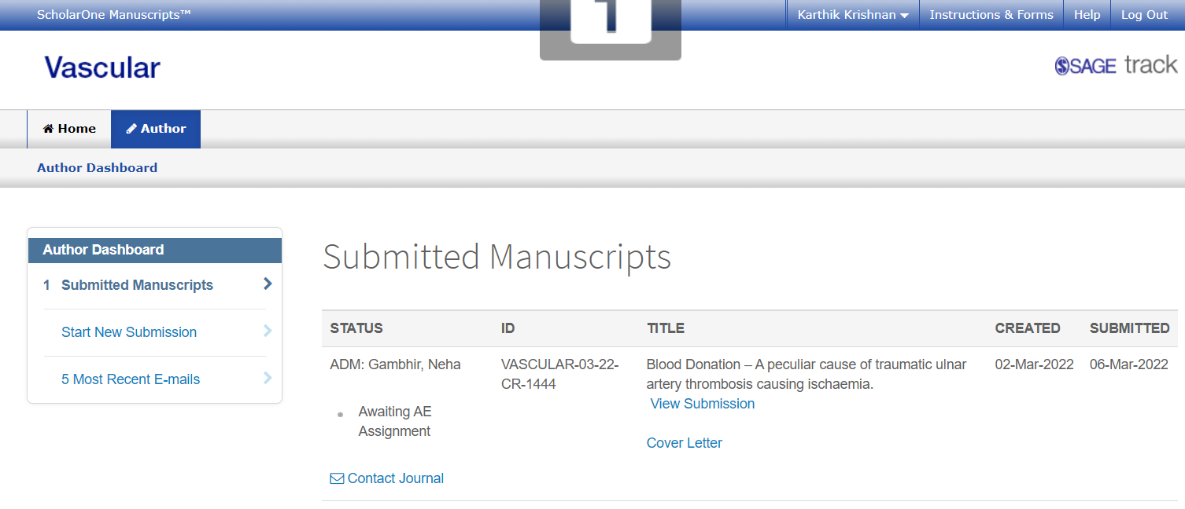
SAGE Vascular

Slide 11
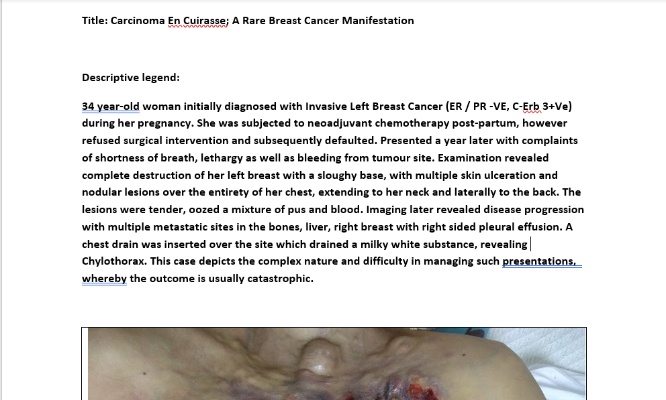
BIMJ Image of Interest

Slide 12
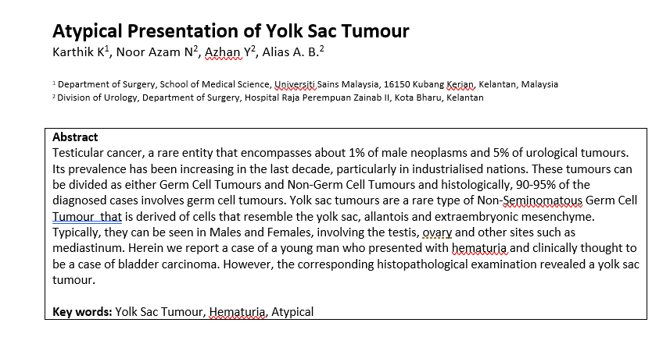
Yolk Sac Tumour

Slide 13

Carcinoma En-Cuirasse Case Report

Slide 14
Supervisor Report
Num | Date | Posting | Supervisor Report
1 | June 2018 – Aug 2018 | Surgery (Team A) | Submitted
2 | Sep 2018 – Nov 2018 | Surgery (Team A) | Submitted
3 | Dec 2018 – Feb 2019 | Surgery (Team B) | Submitted
4 | March 2019- May 2019 | Surgery (Team B) | Submitted
5 | June 2019 – Aug 2019 | Surgery (HRPZ) | Submitted
6 | Sep 2019 – Nov 2019 | Paeds Surgery (HUSM) | Submitted
7 | Dec 2019 – Feb 2020 | Urology (HRPZ) | Submitted
8 | March 2020 – May 2020 | Vascular (HUKM) | Submitted
9 | June 2020-Aug 2020 | Vascular (HUKM) | Submitted
10 | Sep 2020– Nov 2020 | Upper GI (HSAJB) | Submitted
11 | Dec 2020 – Feb 2021 | Neurosurgery (HUSM) | Submitted
12 | March 2021- May 2021 | CTS (HUSM) | Submitted
13 | June 2021-Aug 2021 | Surgery (Team A) | Submitted
14 | Sep 2021– Nov 2021 | Surgery (Team A) | Submitted
15 | Dec 2021– Feb 2022 | Surgery (Team B) | Submitted

Slide 15
Logbook Summary
Individual Rotation Summary is in the Student File for each rotation.
HUSM Endoscopy
1
Num | Procedure | Performed
1. | OGDS | 37
2. | ENET | 2
3. | Dilatation | 1
4. | Sigmoidoscopy | 3
5. | Colonoscopy | 35

Slide 16
Laparoscopic Cases
Num | Case | Number
1. | Laparoscopic Appendicectomy | 36 + (9 Open)
2. | Laparoscopic Cholecystectomy | 26 (Assisted to varying degrees)
3. | TAPP/TEP | 11
4. | Bariatric (Roux En-y, Sleeve Gastrec) | 2
5. | Lap. Assisted Colostomy | 2
Thyroid Surgery
Num | Surgery Type | Numbers
1. | Total Thyroidectomy | 8
2. | Hemithyroidectomy | 3
3. | Parathyroidectomy | 3

Slide 17
Laparotomy
Num | Procedure | Numbers
1. | Hemicolectomy | 5
2. | Anterior Resection | 2
3. | Pelvic Exenteration | 1
4. | Small Bowel Resection | 8
5. | Cholecystectomy | 7
6. | Pancreatectomy | 3
7. | Liver Resection | 2
8. | Laparostomy | 4
9. | Splenectomy | 3
10. | PDU/PGU | 3

Slide 18
Breast
Num | Procedure | Number
1. | MAC | 9
2. | WLE | 8
3. | HWL | 4
LA
Num | Procedure | Number
1. | AVF Creation | 3
2. | AVF Ligation | 2
3. | AVF Exploration | 2
4. | Chemoport | 11

