Slide 1
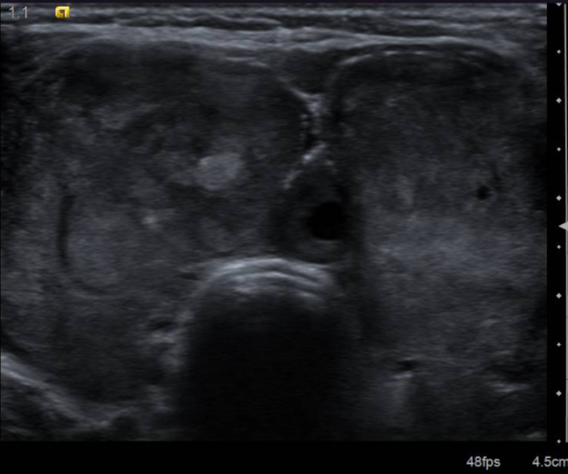

Case Discussion
Karthik krishnan
Department of general surgery
Hospital universiti sains Malaysia
6th Malaysian Breast & Endocrine Surgery Course 2018

Slide 2
Madam R.
48 Year Old Female, Underlying Hypertension
C/O Neck Swelling for over a year duration
Eventually presented herself to the local Klinik Kesihatan as she started developing symptoms
~ Hand Tremors
~ Palpitations
~ Heat Intolerance
Their initial investigation noted a Goitre, with Hyperthyroidism (T4 60.87, TSH <0.005)
She was started on Carbimazole and subsequently referred to us.

Slide 3
SOPD Visit
We noted that she had a multinodular mass over the anterior neck. It was about 15 cm x 15 cm. The mass was firm, non tender and fixed. No lymph nodes were palpable. The lower border of the thyroid is felt. Otherwise, no obstructive symptoms.
She was subjected to an Ultrasound; with findings as follows;
Enlarged Thyroid Gland. Heterogenous in echogenicity with multiple nodular lesions, varying in sizes. Largest nodule is a mixed nodule predominantly solid, seen at the left thyroid lobe, measuring 3.9 cm x 1.9 cm x 5.0 cm. Most of the nodules are hyperechoic with no internal vascularity.
Diffuse Enlarged Thyroid Gland With Multinodular Nodules

Slide 4
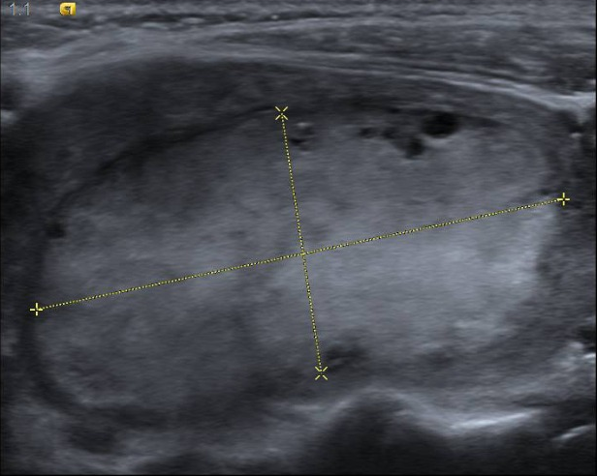
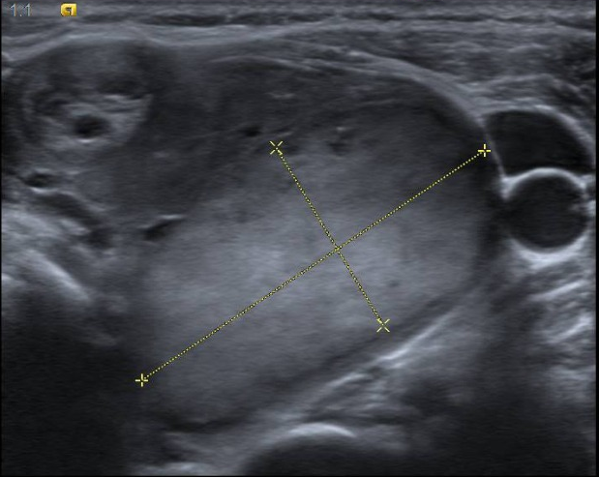
Ultrasound Neck

Slide 5
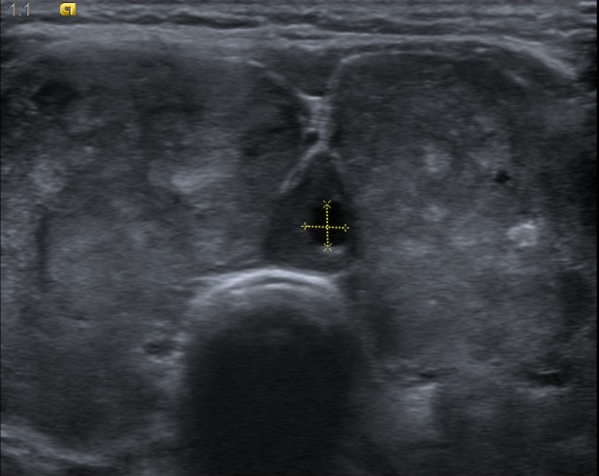
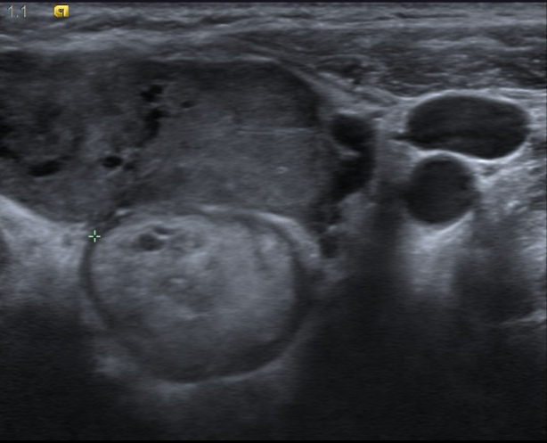
Ultrasound Neck

Slide 6
Plan
After having reviewed the ultrasound findings, the patient was counselled for a total thyroidectomy, when she is euthyroid.
She was subjected to a routine IDL, which was found to be normal.
As part of her preoperative assessment, she was subjected to a Chest X-Ray

Slide 7
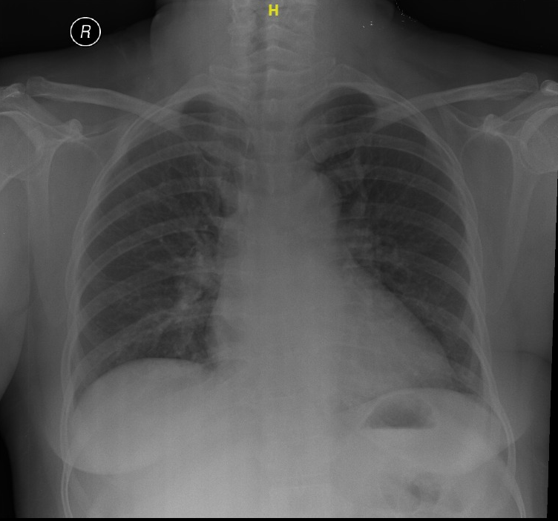
Presence of Homogenous Opacity at lower neck region, trachea deviated to the right due to mass effect,

Slide 8
Surgery
Intraoperatively, she was noted to have an enlarged thyroid 6cm x 4cm with a 1cm x 1 cm x 1 cm mass anteriorly and also at the inferior margin in the left lower lobe of the thyroid gland.
Noted a single superior mediastinal mass, about 5cm x 4 cm x 3 cm, non nodular, with a smooth surface, located posterior and inferior to the thyroid. The mass is suprasternal in it’s entirety and was able to be removed from the neck with Cardiothoracic Surgery Backup.
1 Enlarged ?lymph node posterior to the single mass at the level of T2 excised.
Both recurrent laryngeal nerves identified and confirmed with nerve monitoring.

Slide 9
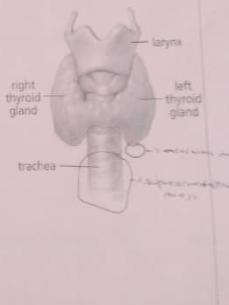
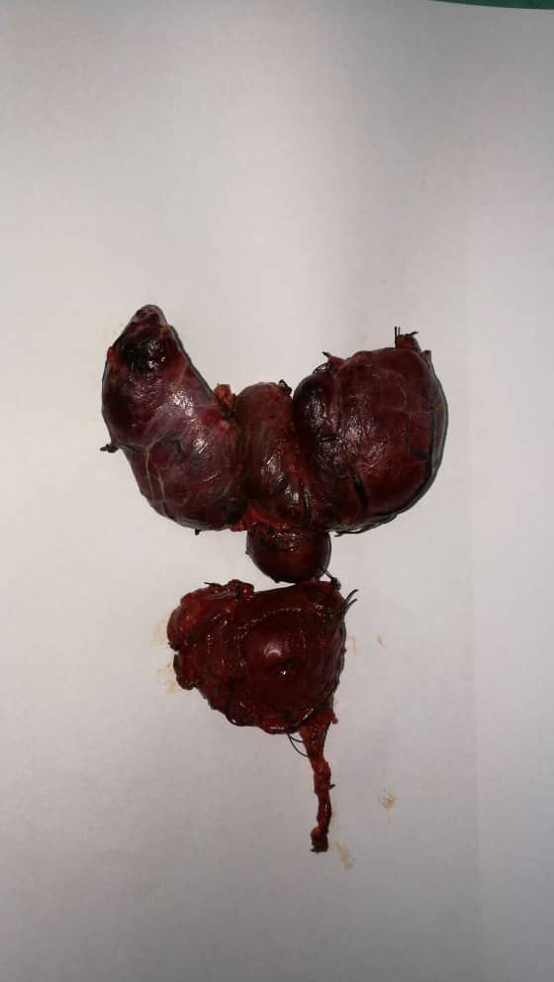

Slide 10
Histopathological Examination
Total Thyroidectomy Specimen
Sections from the right lobe and isthmus shows multifocal (4 foci) of papillary thyroid carcinoma, with the largest tumour diameter of 7mm. Malignant cells are arranged in papillary configuration with some are in compact microfollicles.
Multifocal Papillary Thyroid Carcinoma pT1a pNX (TNM 8TH Edition, 2016)
Mediastinal Mass and Nodule are composed of Thyroid Tissue with features of Nodular Hyperplasia and Degenerative Changes. No features of Malignancy.
Toxic / Hyperfunctioning Nodular Hyperplasia
The ?lymph node excised turned out to be composed of thyroid tissue as well.

Slide 11
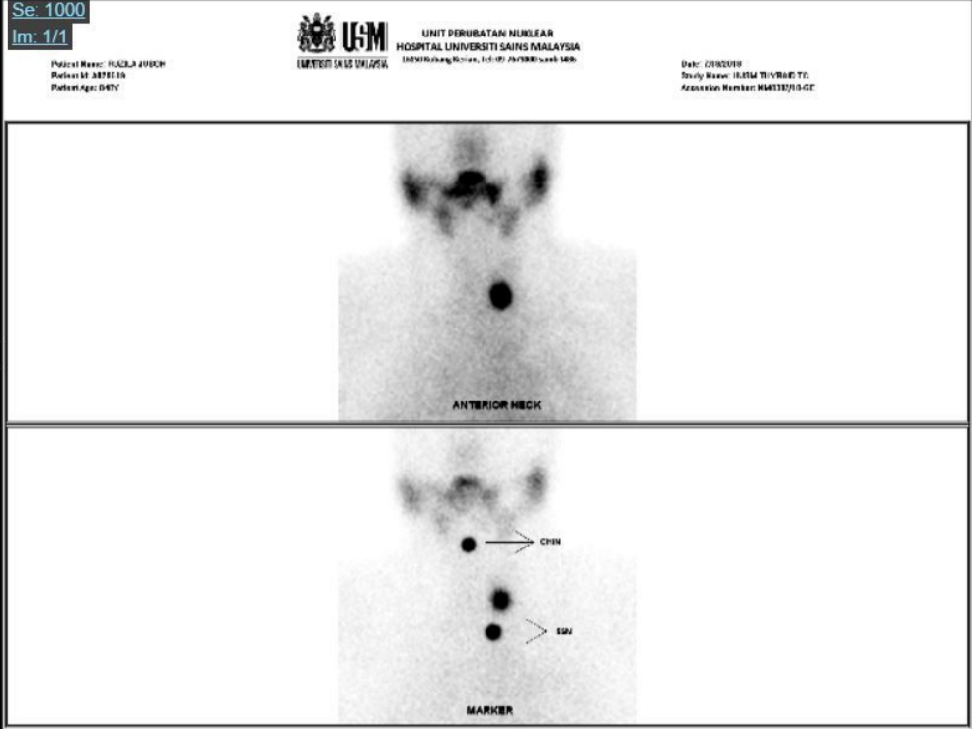
Thyroid Scan
Having reviewed the Histopathological Report, and given the Mediastinal Ectopic Thyroid Mass, it was imperative to identify if there were thyroid tissue elsewhere.
We had subjected her to a TC-99M Pertechnetate Scan
Focal Increased Tracer Uptake is seen in the left lower neck, adjacent to the trachea at C7 Vertebra level with corresponding soft tissue lesion measuring 1.4 cm x 1.2 cm x 1.4 cm.
Scan evidence of remnant of thyroid tissue at left lower neck.

Slide 12
Discussion
How Do We Proceed? What is the Prognosis?
Surely we cannot Re-explore the hostile neck environment?
How do we manage this patient?

Slide 13
RISK STRATIFICATION
Malaysian Consensus Guidelines On Screening, Diagnosis, Treatment and Follow-Up of Well-Differentiated Thyroid Cancers – Malaysian Endocrine & Metabolic Society
The Malaysian Consensus Guidelines described three groups of risk stratification; 1) Low-Risk 2) Intermediate-Risk 3) High-Risk₅
Based on this stratification, our patient is deemed to be in the low-risk group.
Should we plan for Radioactive Remnant ablation, whereby it is administered for the destruction of residual tissue as the patient has had prior toxic status.
The Malaysian Consensus describes three levels of indication for post-operative RAI 1) No Indication (Low Risk Patients) 2) Definite Indication (High-Risk Patients) 3) Uncertain Indications (Intermediate-Risk Patients)
Our patient falls under the uncertain indication subgroup, due to the extrathyroidal extension, which dictates Selective Use of Radioactive Remnant Ablation
MACIS Score 6.05 with 20-Year Survival Rate of 89%.

