Slide 1


KELULUT HONEY AS AN ALTERNATE SOURCE OF CARBO-LOADING IN ABDOMINAL SURGERY INVOLVING THE DIGESTIVE SYSTEM
A RANDOMIZED BLINDED COMPARATIVE STUDY
CLINICALTRIALS.GOV : NCT04438590

Slide 2
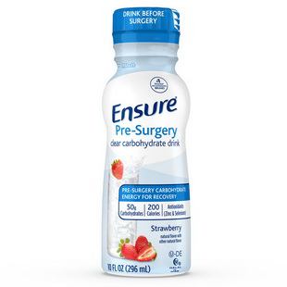
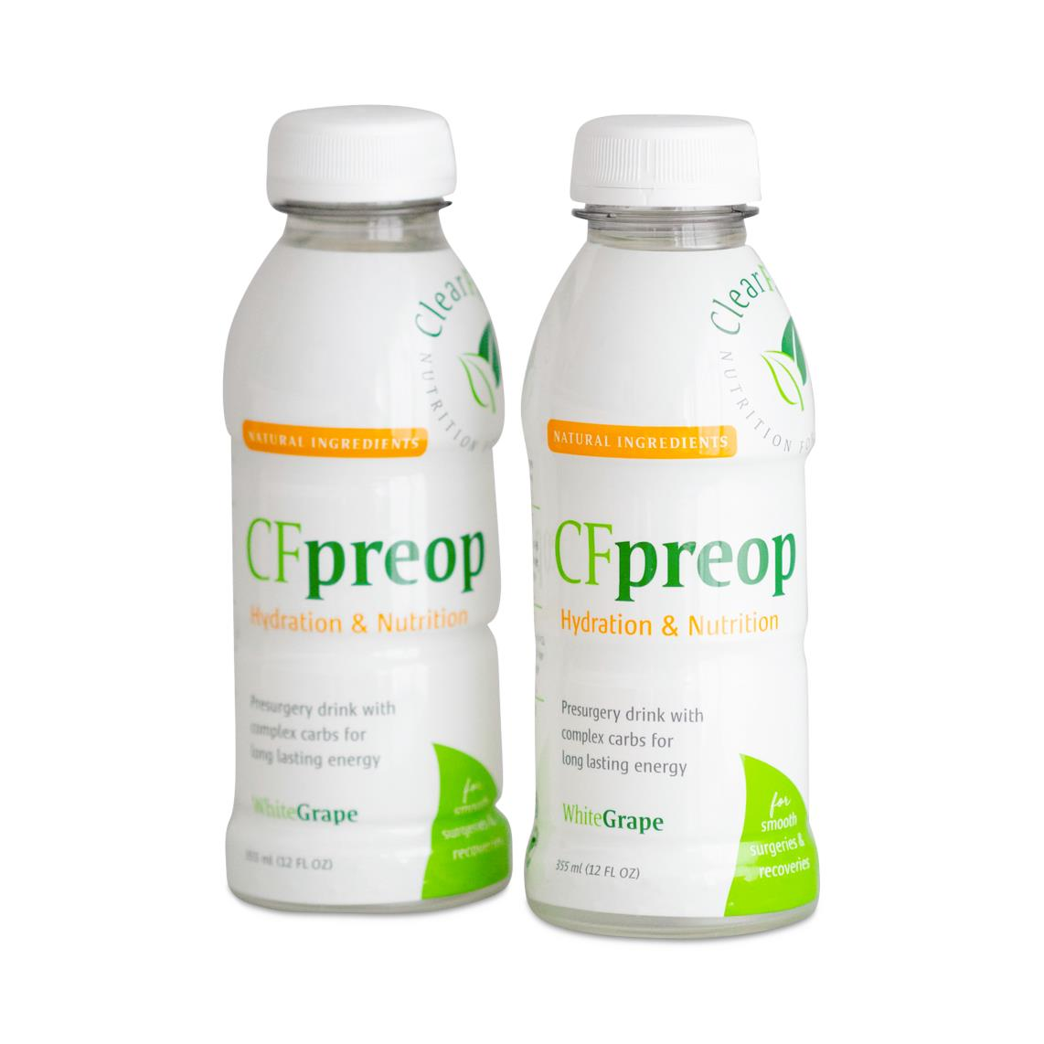
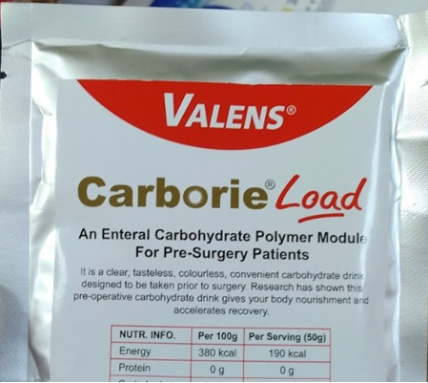
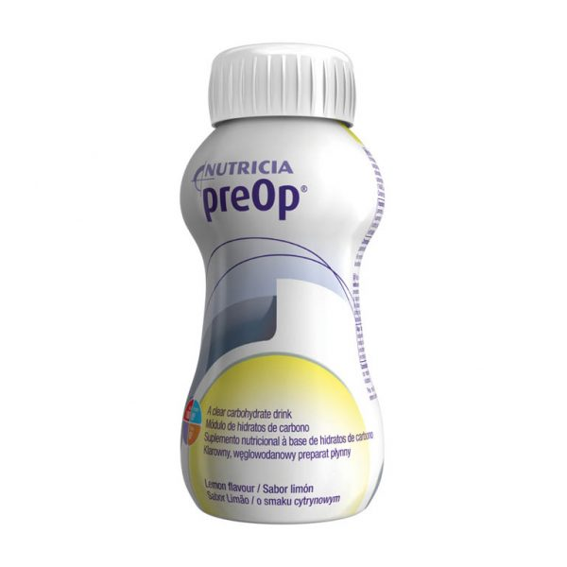
INTRODUCTION
Carbohydrate loading has been an ERAS Society recommendation that has been showing fantastic positive outcomes. Unfortunately, many are expensive, unavailable locally, or have a taste that’s not palatable to our local population.
Do we have any viable alternatives?
Notes:
Carbohydrate loading prior to elective surgery has been incorporated into the Enhanced Recovery after Surgery (ERAS) protocol. Commonly, a Maltodextrin extract is utilized for this purpose.
Here, our team explores the viability of using Honey – a naturally occurring substance known to have antibacterial, anti-inflammatory as well as wound healing properties as a carboloading solution compared to a commercially available solution, Carborie®

Slide 3
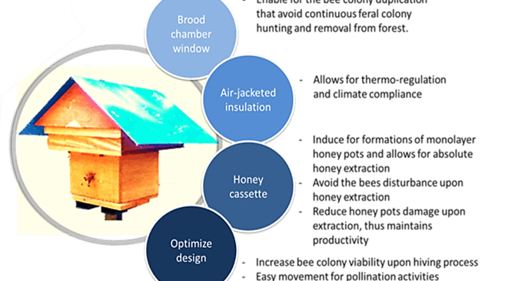
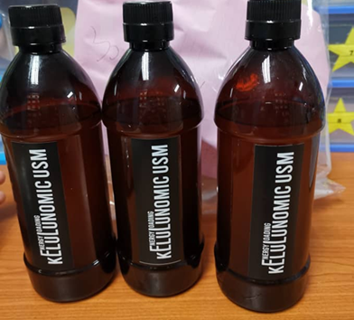
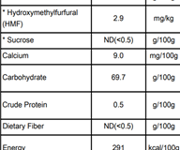
Notes:
Honey is a nectar based, carbohydrate-rich syrup produced by bees. Meliponines Sp. Or Stingless bee produce a type of honey called Kelulut honey, which contains sugar in the form of fructose and glucose.
Our team has procured medical grade honey harvested and isolated using the patented Mustafa beehive technology in order to provide, safe, clean, natural Kelulut Honey.

Slide 4
Objectives
Determine and compare the effect of Kelulut honey on Insulin Resistance and Residual Gastric Volume and compare with Carborie®
To compare post-operative outcomes (Length of stay, pain control, return to physiological function, complication severity) between patients receiving Kelulut honey and Carborie®

Slide 5
Study Design
Prospective, single centre, randomised, double blinded comparative study, conducted in Hospital Universiti Sains Malaysia
64 patients undergoing elective intra-abdominal surgery involving the digestive system above the age of 18 was recruited.
Inclusion Criteria | Exclusion Criteria
Consenting Adult (Age ≥18) | Known Diabetics
Elective Intra-abdominal surgery | Fasting Glucose Level > 7mmol/L
 | ASA >3
 | On Steroid Treatment
 | Recent Infection (3 months)
 | Preoperative unintentional weight loss (>10% of usual body weight/6 months)
 | Known allergies to Maltodextrin / Honey

Slide 6
Consort Flowchart
120 Patients assessed for eligiblity
56 patients were excluded
48 did not meet recruitment criteria
8 did not consent
32 patients assigned to group A (Carborie)
64 Patients randomly assigned to either group A or group B
32 patients assigned to group B (Honey)
1 Discontinued
could not tolerate taste
31 Included for analysis
32 Included for analysis
Notes:
A total of 120 patients were assessed for eligibility. 72 patients were found to fulfil recruitment criteria, of which 64 patients consented to participate in this study and were randomized into either Carborie® (A) or Honey (B) group. There were 32 patients per group, however one of the participants in the Carborie® group was unable to tolerate the solution and therefore was excluded from the study.
No adverse event was reported among all the study participants.

Slide 7
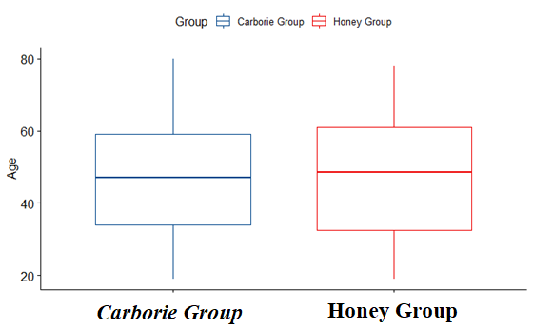
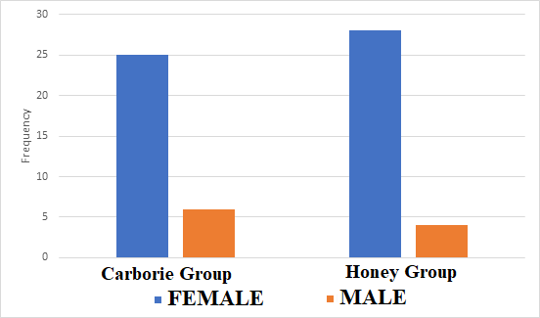
Demography
Notes:
The mean age of participants 47.3 (SD=16.6). 84% of the study participants were female with an average BMI of 27.2 (SD=6.2). More than half of the participants had at least one comorbidity.

Slide 8
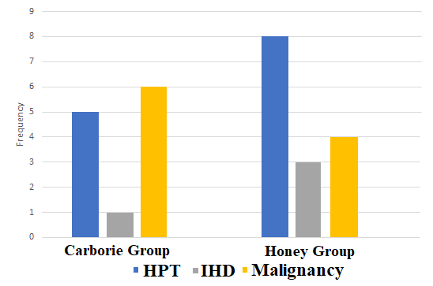
Patient Comorbidities & Surgeries
Common Comorbidities
Common Surgeries

Slide 9
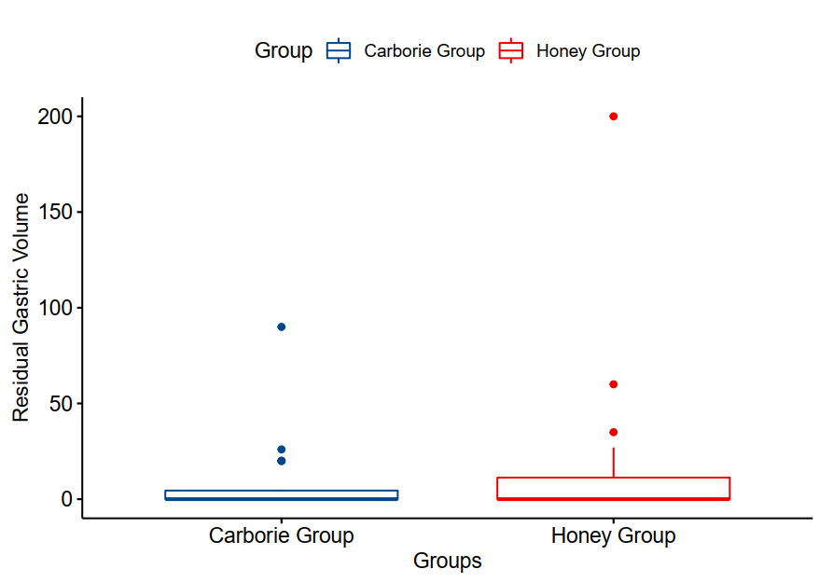
Residual Gastric Volume
Comparison of residual gastric volume between the two groups showed no significant difference.
Notes:
Once the patient has been induced under anaesthesia, a nasogastric tube will be inserted and aspirated dry. The amount aspirated will be measured as the residual gastric volume.

Slide 10
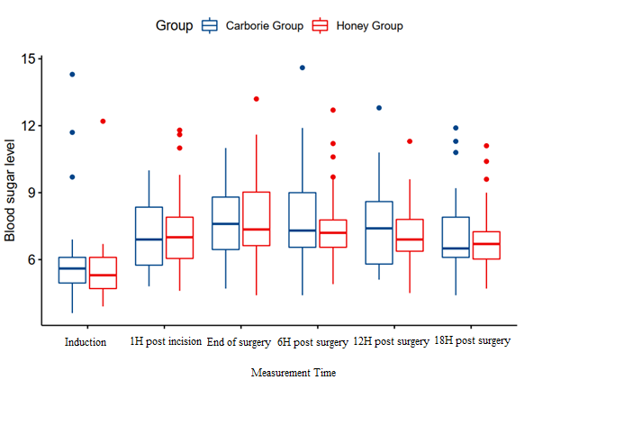
Blood Glucose Analysis
Notes:
Per protocol analysis for blood glucose levels for pre, intra, and post-operative period for 24 hours was done. Data analysis shows no significant difference throughout the measurement time between the two groups.

Slide 11
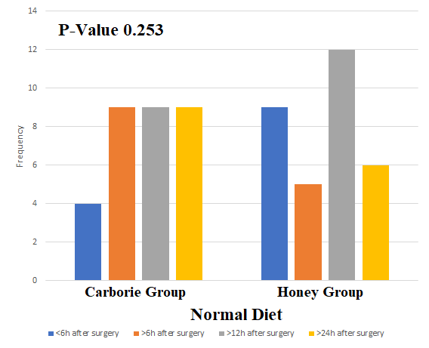
Return to Physiological Function

Slide 12
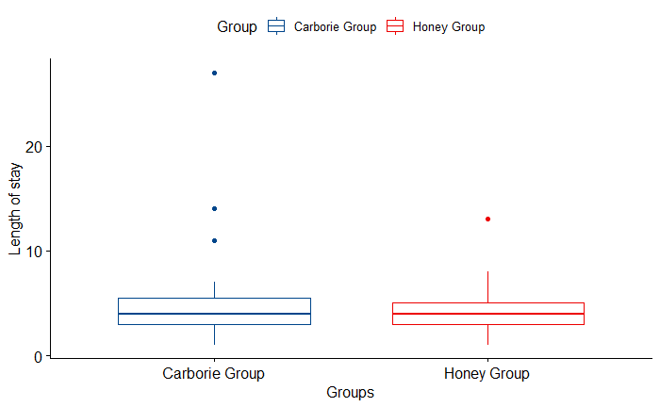
Length of Stay
P-Value 0.604

Slide 13
Discussion
The study shows there is no significant difference between the two groups to evaluate effects on insulin resistance and residual gastric volume when used as carbohydrate loading solution preoperatively.
From this, we can extradite that Kelulut Honey is safe to be used for pre-operative carbohydrate loading and it is fair to expect for the patient to receive similar benefit of carbo-loading from using the commercially available conventional carboloading product such as Carborie®.

Slide 14
Limitations
The study is confined to a single centre, and the population selection is limited to the local population from the east coast of Peninsular Malaysia.
The study involved patients undergoing elective abdominal surgery involving the digestive tract, with a high heterogenicity of the types of surgeries that were performed.
For standardization, the same batch of Kelulut Honey was used for this purpose. It is not possible to predict the outcome from honey acquired from different species of bees as these factors are not explored in the analysis.

Slide 15
Conclusion
Kelulut Honey is safe to be used as an alternative to conventional carbohydrate loading and its efficacy matches that from commercially available carbohydrate loading solutions, such as Carborie®.
If an alternate carboloading solution is able to attain similar results with the conventional product, then it can be postulated that the alternative is a viable one. Therefore we conclude, that a similar outcome can be achieved using Kelulut Honey as a carbohydrate loading solution.
Notes:
This is important because the commercial product is one that has been tested to augment the preferred outcome by following the Enhanced Recovery After Surgery Protocol.

