Slide 1
Kelulut Honey as an Alternate Source of Carbo-Loading : A Randomised Double Blind Control Study

Slide 2
The pitch?
ERAS has a well established set of protocols for almost all branches of surgery.
One of the criteria is challenging the dogma of prolonged fasting in the pre-operative patient.
Maltodextrin based carbohydrate loading has been shown to improve the outcome of the surgical patient.
Kelulut honey, a natural locally available substance, has been shown to have anti-inflammatory, antibacterial as well as wound healing properties.
As a bonus it also has a pleasant tolerable taste, unlike the tasteless Carborie or other Maltodextrin extract.

Slide 3
Why Recruit Your patients?
There are potential benefits for your patients that your patients will receive that will ultimately improve your post-operative outcome.
For starters, studies have showed, the patient without hunger pangs tends to be less anxious and is able to head to the OT with less stress.
Carbohydrate loading has shown to reduce post operative stay, faster return to normal functions and lower occurrences of surgical complications.
Furthermore it improves post-operative insulin resistance, which can boost the immune system, improve wound healing and reduce inflammatory markers.

Slide 4
If I join, does it burden and stretch out my team?
There is no significant workload increase for your team.
Preoperatively, the weekly OT list will be scanned through. There, we will filter the patients who comply to our inclusion and exclusion criteria.
The randomization, consent taking, data collection, and data review be done by the research team.
Additional workload – Insertion of a NG tube post induction by Anaest team in OT and documentation of NG Aspirate volume.
Collection of Carbo-loading substance from collection centre.
Ensuring patient care falls within the study protocol (with regards to sugar control)

Slide 5
I’m sold. Who can join?
Subject Recruitment – Amongst patients undergoing elective abdominal surgery in HUSM that fulfil inclusion and exclusion criteria.
Inclusion Criteria
Adult (Age ≥ 18)
Elective Surgery with Intraabdominal Involvement
Exclusion Criteria
Known Diabetics
Fasting Glucose Level > 7 mmol/L
ASA > 3
On Steroid Treatment
Recent Infection Past 3 Months
Preoperative Unintentional Weight Loss >10% of usual body weight within 6 months
Emergency Surgery
Minor (Age < 18)

Slide 6
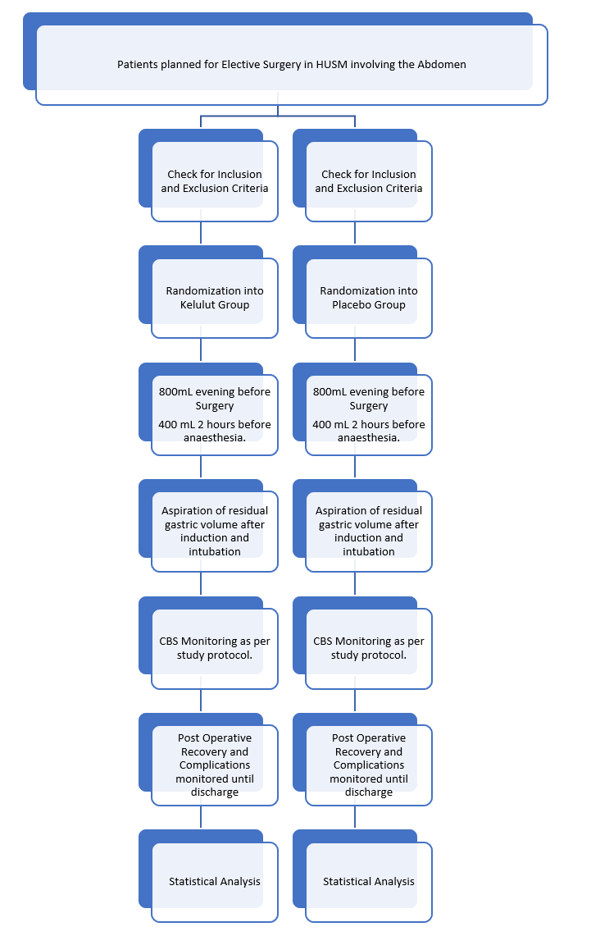
What happens once they are recruited?

