Slide 1
MDT 18/11/2018
SITI AIDA AFANDI
A022524

Slide 2
Background History
46 year old Teacher; Nulliparous. Known to have uterine fibroid, and ovarian cyst.
History of Laparatomy, Myomectomy, and evisceration of Bilateral submucosal Fibroid in 2009.
History of Laparascopic Adhesiolysis in 2012 (moderate adhesion to bowel, abdomen and peritoneal wall)

Slide 3
Presentation
Initially presented in 2015 with altered bowel habit
- Hard Stool
- Tenesmus
- Difficulty BO with straining and manual evacuation
- PR Bleed – fresh blood
- Mass protruding from the anus
Colonoscopy Done – Mass 2 cm from Anal Verge
HPE : Tubular Adenocarcinoma with High Grade Dysplasia
MRI Pelvis : Circumferential Bowel Wall Thickening arising from lower rectum causing narrowing of the bowel lumen. The thickened bowel wall measuring 2.3 cm in thickness.
MRI Local Staging T3N0Mx
CT TAP : Case of Rectal Tumour with Regional Lymphadenopathy. No Distant Metastasis (T3N2M0)

Slide 4
Management
Planned for Neoadjuvant Chemoradiotherapy – 30 cycles. Started in May 2016
Repeated MRI in September 2016 after completion. Responding to treatment.
Underwent Lap. APR IN October 2016. Intraoperatively : Liver normal, no Peritoneal seedlings, no ascites, rest of bowel are normal. Tumour Noted 2cm from anal verge. Enlarged uterus, adhered to anterior abdominal wall. Difficult to continue pelvic dissection in view of enlarged uterus.
Referred to O&G Team On-table : Uterus Globular 12/52 ~ adenomyosis. Dense adhesion onto anterior abdominal wall, bladder and rectum. Unable to identify both tubes due to adhesions.
Underwent Total Laparascopic Hysterectomy and Bilateral Salphingoopherectomy and abdomino-perineal resection with bilateral ureteric stenting.

Slide 5
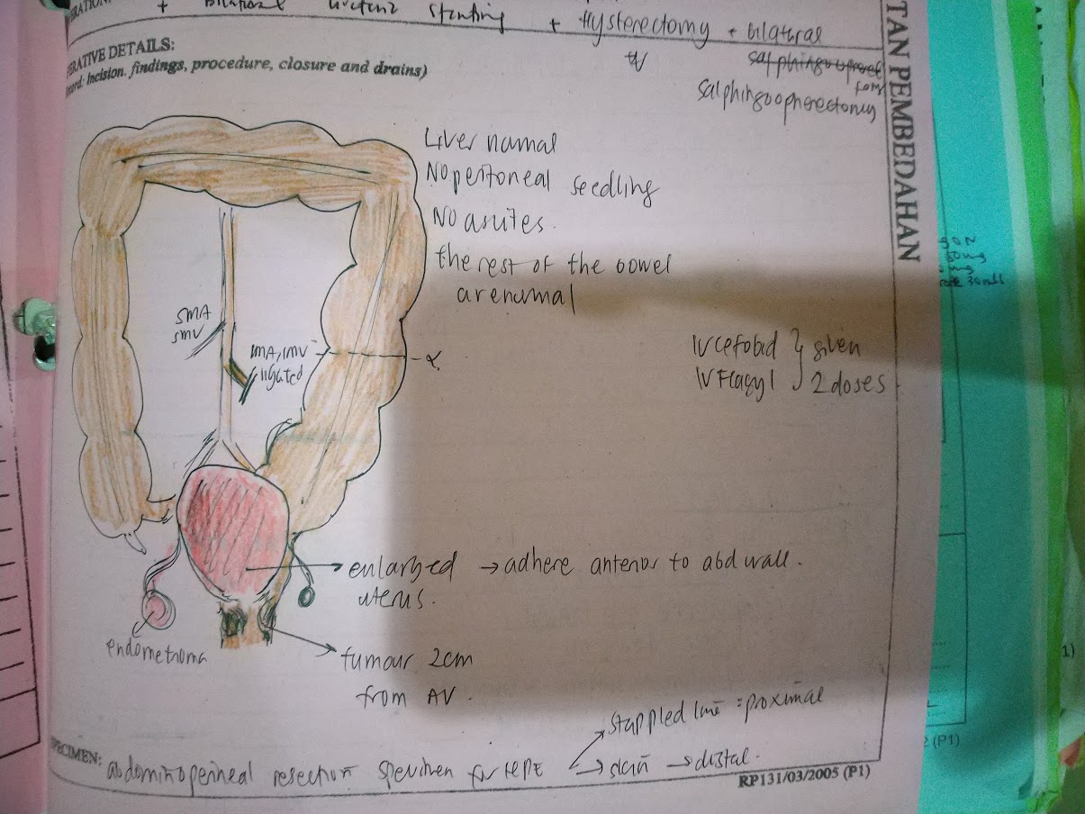
Laparascopic Abdomino-Perineal Resection

Slide 6
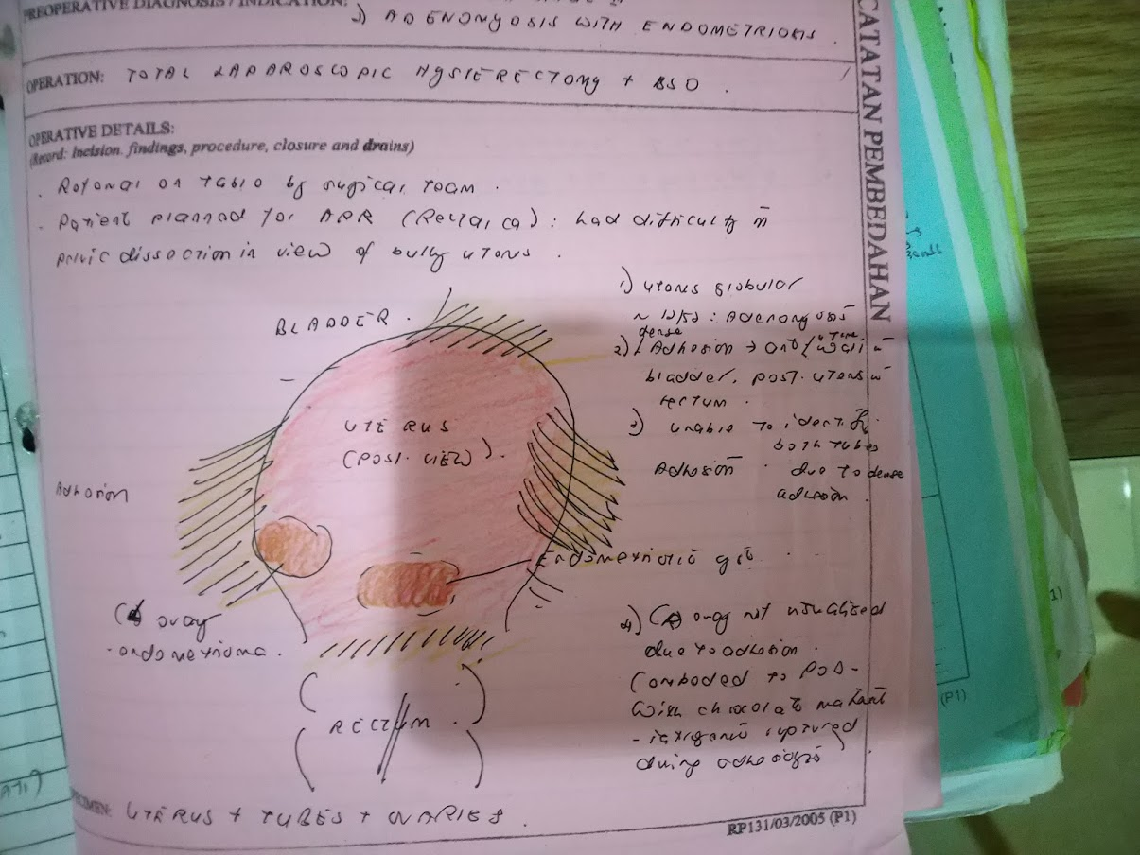
Total Laparascopic Hysterectomy + BSO

Slide 7
Progress
During Recovery period noted patient started having clear discharge PV. Uretrovaginal fistula suspected.
Usg done – Bilateral Hydronephrosis, more on the left side.
IVU done – Features suggestive of left distal ureteric injury complicated with retroperitoneal extravasation.
CE + Left RPG + URS done. EUA + pelvic drainage + partial closure of infected vaginal vault done.
Left Nephrostomy inserted.
CT Abdomen – Pelvis – Complete Abruption of Left Distal Ureter.

Slide 8
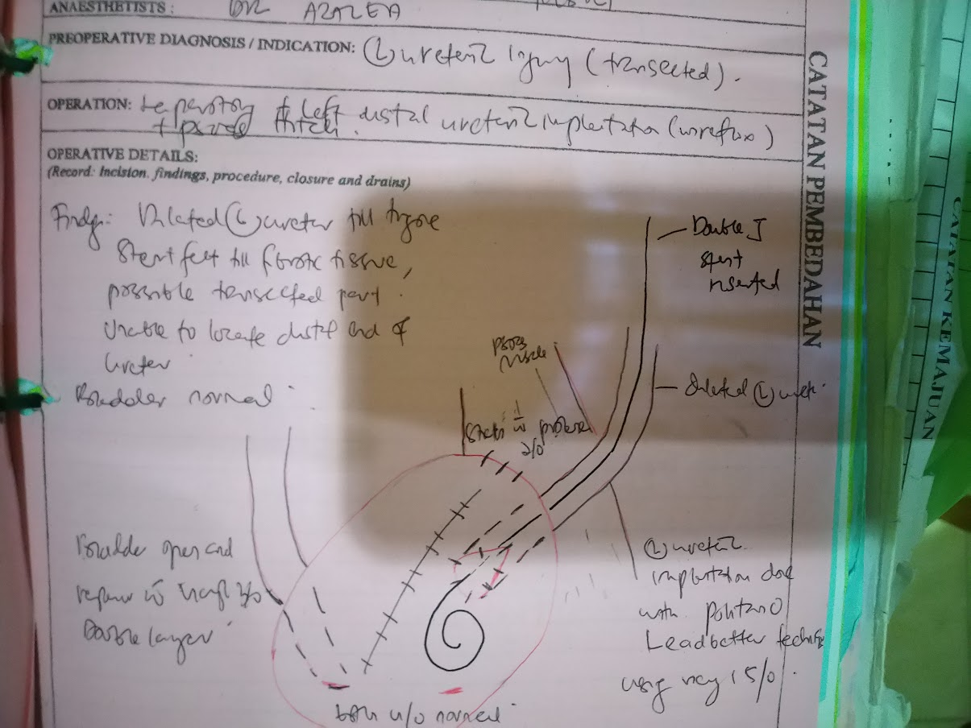
Complication Management
January 2017 – Laparatomy, Left distal ureteric implantation + Psoas Hitch.
Intraoperative : Dilated Left Ureter till Trigone. Stent felt till fibrotic tissue possible transected part. Unable to locate distal end of ureter. Bladder Normal
EUA – urethrovaginal fistula – healed. Vault area fibrosis and narrowing with fluid leakage from vault. No fistula communication within vagina and abdominal cavity – well healed.

Slide 9
Follow Up
Followed up in clical. Stent Removed in April 2017. Surveillance CT Done in February 2018
- Left Mild Hydronephrosis with Prominent Proximal Ureter
- Study suspicious of tumour Recurrence. Left thyroid nodule.
Pet Scan done at Hospital Putrajaya
Multiple Foci of FDG Hypermetabolism.
Soft tissue mass at precoccygeal region extending down to upper vagina
Enlarged left thyroid gland
FDG Avid Local Recurrence in the Pelvic, No Distant Metastasis
MRI Pelvis Done – Study shows tumour recurrence with locoregional invasion to urinary bladder, vagina, urethra and levator ani muscles.

Slide 10
MDT Goals
Possible Surgical Intervention ?Pelvic exenteration.
Possible Oncological Options

