Slide 1
VASCULAR RECAP 09/03/2020 HASHIM BIN MAN N604330

Slide 2
Patient Background
65 year old gentleman with underlying:
DM
Hypertension
CKD
Ischaemic Dilated Cardiomyopathy (EF 28%)
History of stenting x 2 in 2015 and balloon angioplasty in 2018
History of LV Thrombus; Treated with Anticoagulant
Recent Inferior STEMI in January 2020
COROS done 17/1/2020 moderate to severe eccentric stenosis in ostial LMS extending to LAD
Mild in-stent stenosis with pLAD, diffuse disease at dLAD
Total Occlusion at pLCx
Coronary Angiogram and IVUS 24/1/2020
LMS – Mild to moderate ostial LMS disease
LAD – Patent Stent
LCx – Total Occlusion

Slide 3
Presentation (14/02/2020)
ED Assessment
P/w @ 0630H
Chesty Cough x 1/52
Shortness of Breath
No fever
Bilateral Lower Limb numbness since 2 am. Unable to ambulate.
O/E Lung Auscultation Scattered Crepitations with reduced A/E bilaterally All distal pulses not palpable.

Slide 4
Investigations
Bedside USG : EF 30%.
CXR – Left lobe Pneumothorax, Cardiomegaly. B/L upper lobe diversion and perihilar consolidation. Kerley B lines
IMP : Decompensated CCF Precipitated by HAP
TRO Acute Limb Ischaemia
Patient nursed with cPAP – kiv intubation

Slide 5
Surgical Review
Hx/
c/o B/L L/L numbness and pain – sudden onset with weakness, Right > Left
Started at 2 am. No intermittent claudication. Had numbness over pelvic and perineal region initially, however improving. Eventually able to move left side, however right side remains numb and unable to mobilize.
Reduced effort tolerance, with shortness of breath of exertion.
Denies any form of Trauma
No claudication or rest pain prior to this episode.
No fever at home.

Slide 6
Examination & Investigations
P/A No mass palpable
CRT > 2 second
Left Lower Limb – Cold, able to move, sensation intact
Right Lower Limb – Cold, motor function – hip rotation. No knee flexion, no ankle dorsiflexion. Minimal movement of toes. Loss of sensation at all toes.
Distal limb – Bilaterally No pulses palpable
Doppler – Bilateral Popliteal – Monophasic, elsewhere, no signal
HB 9.3 / WC 8.4 / PLT 400
PT 12.7 / INR 0.96 / APTT 31.4
UR 10.6 / Create 215
ABG on cPAP : Ph 7.41 / pCO2 27.9 / pO2 80.3 / BE -6.3 / HCO3 19.9/ Lactate 2.7

Slide 7
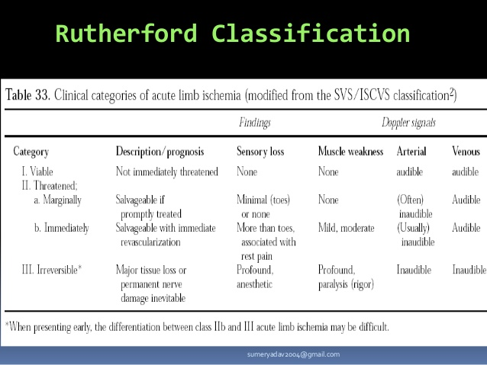
Diagnosis
Right Acute Limb Ischaemia (Rutherford 2A) 2* Showering Emboli
Left Acute Limb Ischaemia (Rutherford 1)
Decompensated CCF with Type 1 Respiratory Failure

Slide 8
Management
Principal of Life over Limb.
Save Life, Save Limb, Relief Pain, Improve Quality of Life, Prolong Life
Patient must always be resuscitated and stabilized prior to engaging invasive intervention
In this case, one might be tempted to go for embolectomy, however the outcome may not be favourable.
Instead IVI Heparin was started, 5000 unit stat and 1000 unit hourly with 6 hourly review of coagulation profile
Nurse and stabilize patient in ICU

Slide 9
Imaging Options
Goal based approach (Diagnostic / Diagnostic + Therapeutic)
Identify the cause of ALI – Embolic / Thrombotic / External Causes
ECHO / Doppler / CTA / DSA
ECHO : EF 40%. RA Clot present over RAA 1.2 x 0.8
No LA clot / No Vegetation
Mild pericardial effusion
MR : Mild to moderate
AR : Trivial

Slide 10
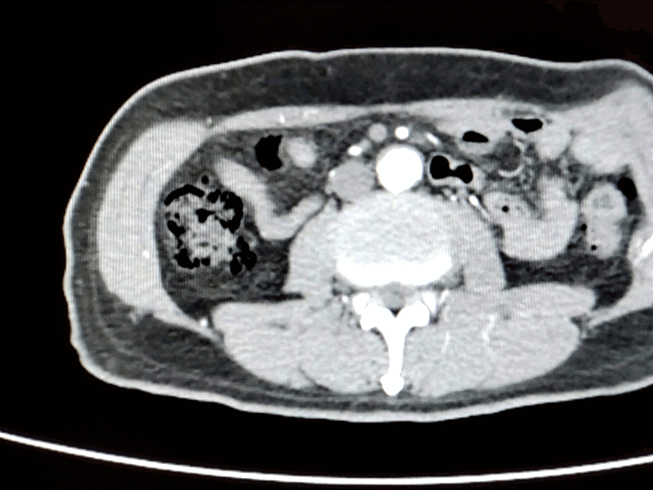
CTA
CTA (18/2/20)
Presence of focal filling defect in keeping with thrombus at the distal aorta extending into the bifurcation of common iliac and proximal region of bilateral external and internal iliac arteries arteries (right worse than left) with resultant occlusion of right common iliac artery and narrowing of the other previously mentioned artery. The thrombus measures about 2.7 x 1.7 cm
Normal opacification of coeliac, superior mesenteric, renal and inferior mesenteric arteries.
No arteriovenous malformation noted
Distal vessels are well opacified

Slide 11
Management Options
Trombolysis
IVI Heparin
Catheter directed thrombolysis (Streptokinase, Urokinase, TPA)
CI : CVA 2/12, Recent / Active GI Bleed 10/7, ICB/Neuro Surg 3/12 Relative CI : CPR 10/7, Major Surgery / Trauma 10/7, BP
Operative
Operative Revascularisation (Embolectomy / Bypass / Stenting)
Amputation

Slide 12
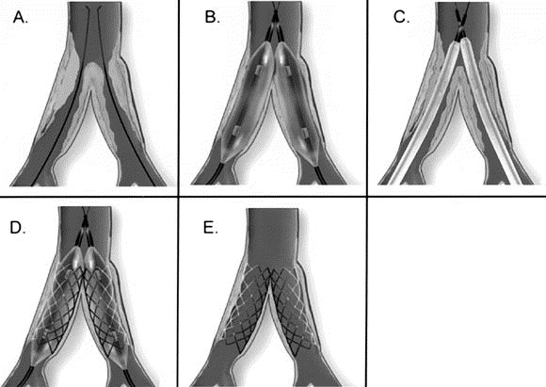
Kissing Stent

