Slide 1
Synthetic Graft Complications
Karthik Krishnan

Slide 2
Case Background
55/M
Treated in Hospital Temerloh for Meliodosis
C/O left lower back pain radiating to left thigh
Worsening over the past 10 days. A/W Fever
Went to Hospital Tung Shin – MRI Done
Suggestive of vascular lesion in close proximity to the left CIA
Proceeded with CTA – isolated leaking (old) left CIA.
Referred to PPUKM for Left CIA mycotic Aneurysm

Slide 3
Examination
Lower Limb Pulse Examination
Bilateral Femoral 2+ / Popliteal 2+ / DPA 2+ / PTA 2+
Bedside USG by Vascular Team
Left common iliac artery aneurysm. Saccular in shape, measuring 3.5 x 3.5cm. No extravasation. Surrounding haematoma 2.5cm
Posted for emergency excision of aneurysm and ligation of iliac artery, kiv bypass.

Slide 4
Intraoperative
Recent contained ruptured left CIA
Mycotic aneurysm at left retroperitoneal region with haematoma tracking along the left psoas muscle
Thickened inflammatory tissue surrounding the aneurysm and distal aorta.
Left external iliac artery healthy
Reasonable flow from internal iliac artery into CFA
Right common iliac artery healthy

Slide 5
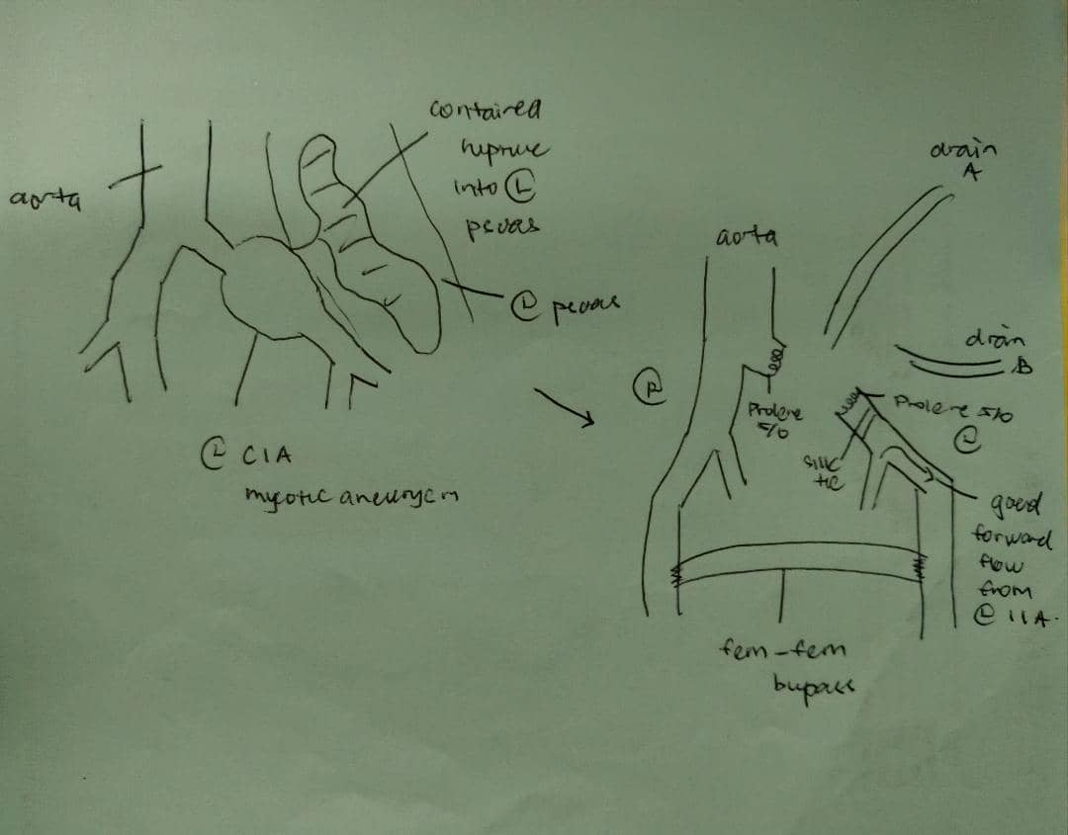
Intraoperative
Prophylactic Stenting of Left Ureter done
Left CIA divided at both proximal and distal end of aneurysm
Aneurysm sac opened up and debrided until clean.
Distal left CIA ligated with Silk 1 and underrun with Prolene 5/0
Proximal left CIA underrun with Prolene 5/0
Aortic Clamp time 68 minutes.
Laparatomy closed and bilateral vertical incision made at femoral region.
CFA identified and skeletonized – proximal and distal control acquired
Straight Intergard Silver Knitted Ringed Graft 8mm tunneled through the mons pubis.

Slide 6
Post operatively had good pulses and doppler signal.
Femoral, Popliteal, DPA / PTA 2+ Biphasic
No pseudoaneurysm, with retrograde flow into left internal iliac artery.
Eventually discharged and on outpatient follow-up
Follow up in first two years uneventful.
In third year, noted that popliteal, dpa/pta bilaterally no longer palpable, however patient is not a claudicant and still able to attain doppler signal biphasic over popliteal, DPA and PTA bilaterally.

Slide 7
Synthetic Graft Failures
Prosthetic conduits can be classified as
Early
Midterm
Late
Early failure – within first month
Midterm – 6-24 months
Late – after several years

Slide 8
Early Failure
Occur in the first month
Commonly due to technical problems during surgery
Presence of Underlying Thrombophilia.
Technical problem – procedural or suturing issues
Poor / Limited choice of inflow or outflow targets.
Operational related difficulties.

Slide 9
Mid-Term Failure
Midterm 6-24 months.
Usually due to myointimal hyperplasia at anastomosis.
Intimal hyperplasia is the universal response of vessels and grafts to injury.
Narrowly defined as abnormal migration and proliferation of vascular smooth muscle cells with the associated deposition of extracellular connective tissue matrix, followed by remodelling of this new tissue.
Otherwise, when blood encounters artificial surface, adsorption of protein activate complement and coagulation cascade. Contribute to surface-induced thrombosis through platelet activation with monocyte and neutrophil infiltration – implicated in myointimal hyperplasia.

Slide 10
Late Failure
Several Years
Late graft thrombosis is frequently secondary to the progression of proximal or distal atherosclerotic disease.

Slide 11
Graft Complications
Graft Thrombosis
Graft Infection
Anastamotic Aneurysm

Slide 12
Graft Thrombosis
Significant clinical challenge
Early or delayed – significant morbidity, limb loss, and mortality.
Implanted prosthetic graft can develop myointimal hyperplasia and eventually thrombose -> graft occlusion.
When myointimal hyperplasia results in haemodynamically significant stenosis prior to thrombosis – failing graft.
Less than 2 weeks – thrombolysis shown to be superior to thrombectomy – STILE / TOPAS trial (provided no evidence of critical limb ischaemia)
More than 2 weeks - Operative intervention and placement of new bypass graft if feasible.

Slide 13
Graft Infection
Occurs in 1%-6% undergoing lower-extremity bypass.
Associated with considerable morbidity – amputation rates 10-70%. Mortality up to 20%.
Causative Agent : Staphylococcus Auereus / Epidermidis.
Origin : microbe seeded at the time of operation, or postoperatively through wound complications, adjacent infections or bloodstream infection from a distant source.
Treatment strategy driven by patient clinical status and type of infective organism.
Graft preservation sometimes possible – no signs of sepsis or extensive graft involvement with sparing anastomosis.

Slide 14
Anastamotic Aneurysm
Complicate around 1%-4% of arterial anastomosis. Anastamotic aneurysms occur almost exclusively between prosthetic grafts and native arteries, and rarely in completely autogenous anastomoses.
When suture line between vascular structure is disrupted – anastamotic aneurysm. The egress of blood from defect forms pulsatile haematoma, becomes lined peripherally with laminated thrombus and encapsulated by surrounding host tissue.
As the structure is subjected to systemic arterial pressure – may gradually enlarge, embolize or rupture.
Notes:
Local causes – Arterial wall degeneration, suture line disruption, prosthetic graft failure, infection / inflammation / technical errors / mechanical stress
Systemic – Smoking, Hyperlipidemia, Hypertension, Anticoagulation, Systemic vasculitides, generalized arterial weakness.

