Slide 1
Shari Othman
RN : N556563
DOA : 31/1/2020
DOD : 06/02/2020
COD : Sepsis with Multiorgan Failure Post Axillo-Bifemoral Popliteal Bypass

Slide 2
Background
66/M
U/L HPT, IHD
IHD – SVD Angioplasty done in 2004
Hx of Aorto Bifemoral Bypass with Allograft 2014
2017 – Left Aortofemoral graft Thrombosis – Left Thrombectomy Done
Feb 2019 – Right Aortofemoral Bypass Thrombosis – Right Thrombectomy Done – cx with Haematoma Formation – Subsequently evacuation Done.
Dec 2019 – Right Aortofemoral Bypass Thrombosis (Initially given 72 hours of IVI Heparin, planned for left axiollo-femoral, femoral-femoral, and right femoral-popliteal bypass– however patient opted for best medical therapy instead.

Slide 3
Presentation
Came to ED on 30/01/2020
P/W Increase in Right Lower Limb Pain x 3/52
  Right Big Toe Gangrene x 5/7
  Upon standing, felt pain over right foot 3/52 – worsening and ascending up to the knee
  Reduced sensation and numbness over lower limb
  Otherwise no fever

Slide 4
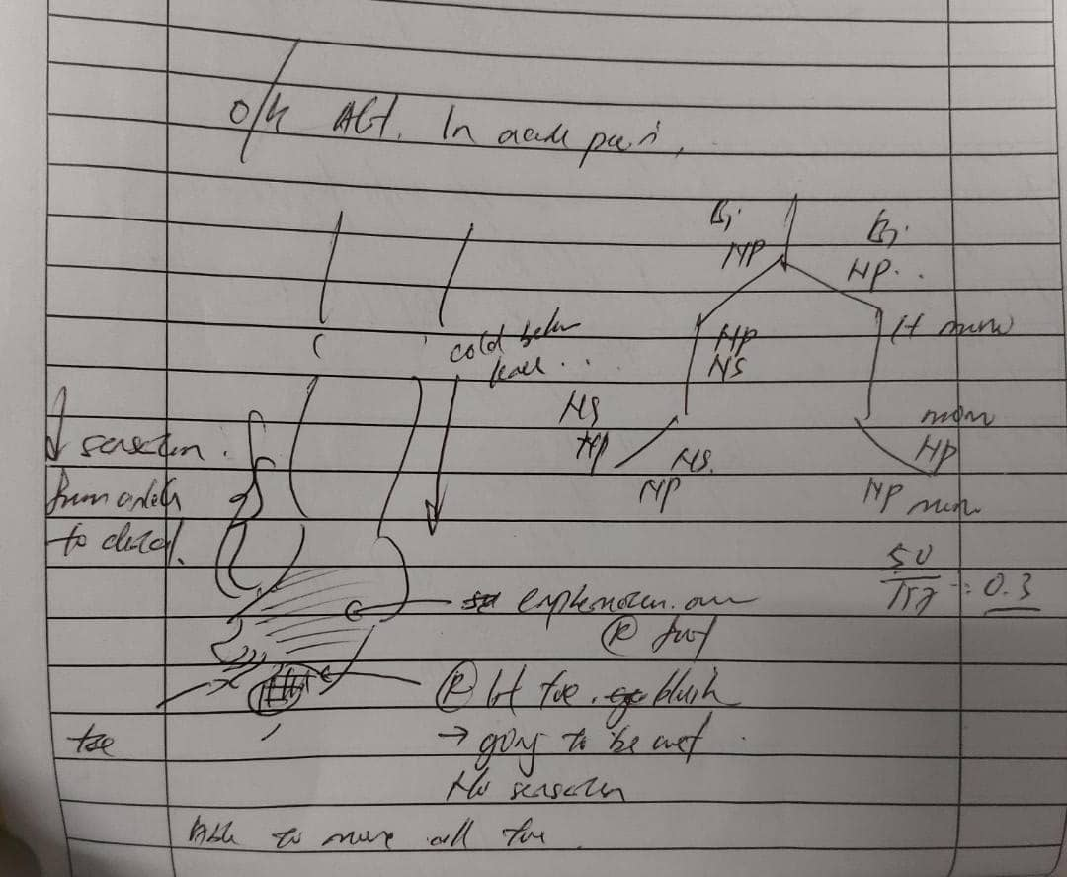
O/E
BP 157/100
PR 99
T 36.6 *C
PA : Soft

Slide 5
IX
HB | WC | PLT
12.8 | 13.7 | 467
Ur | Creat | Na | K+
2.3 | 54.8 | 131 | 4.5
CRP
12.40
PT | APTT | INR
11.8 | 55.4 | 0.88
Alb | Ca | Mg | Po4 | CK
36 | 2.41 | 0.80 | 1.17 | 647

Slide 6
Imp : Right leg critically threatened limb ischaemia ? Blocked graft
Admitted to Surgical ward
Started on Augmentin
Analgesia

Slide 7
Admitted in Ward and Reviewed Previous CTA done on 22/12/2019
Long Segment Total occlusion of the infrarenal abdominal aorta and bilateral iliac limb of aorto-bifemoral bypass graft.
Reconstitution of flow in the left common femoral artery from left lumbar and native left external iliac arteries.
The native right common iliac artery and external iliac artery are completely thrombosed and not opacified. Right Common Iliac artery not opacified.

Slide 8
Referred to Anaest for preoperative assessment and plan to post case on 4/2/2020 as Semi-E.
Cardiac Assessment from December :
Echo (20/12/2019) EF 50%. Akinetic Apex. Normal chamber, size and valves.
Planned for Left Axillo-femoral, femoral-femoral, right femoral-popliteal bypass and right Big Toe Ray’s Amputation

Slide 9
Surgery
Time Start : 1310H
Time Finish : 1840H
Duration : 5H30M
Procedure : Left Axillofemoral Bypass + Femoral – Femoral Bypass + Right Femoral-Popliteal Bypass + Left CFA to SFA Jump Graft
Approach : Longitudinal incision over B/L Upper Thigh
Left infraclavicular incision
Right Distal Thigh (Medial Aspect)
Intraoperative Finding – Thrombus at left common femoral artery and previous graft. Iatrogenic arterial wall tear at left CFA at bifurcation during dissection – Decided for Jump Graft (CFA to SFA)

Slide 10
Surgery
Anaesthetic Operative Findings
EBL 1L
Intraop Fluids : Crystalloid 3L, PC 2 pints, Platelet 3 units.
Multiple episodes of hypotension requiring multiple boluses of Phenyephrine. Started on IVI Norad 4mg 8ml/hr
BP Range 80-130/60-90 / HR 80-110

Slide 11
Post Op IX
HB | WC | PLT
9.3 | 21.4 | 474
Urea | Creatinine | K+ | Na
3.8 | 68 | 6.1 | 133
PT | APTT | INR
21 | >180 | 1.83
Alb | ALP | ALT | Bil
19 | 65 | 25 | 37.6

Slide 12
Post-op
Post Operatively Nursed in ICU
Intubated and Sedated. BP Supported on Inotrope Norad 0.6 mcg/kg/min. BP 117/82 PR 115. Afebrile
Vascular Assessment Post Operatively
Left Ulnar / Radial pulse palpable. CRT < 2s, Doppler – Triphasic
Right Lower Limb pulses noted to be feeble
Right PTA – Biphasic / Left PTA – Biphasic
Right Popliteal – Triphasic / Left Popliteal – Triphasic
Started on Tazosin

Slide 13
Issues in ICU
Renal Shutdown – low urine output to nil by 10 hours post op.
Persistent Metabolic Acidosis
2 AM ABG (8H Post Op)
pH 7.067 / pCO2 18.2 / pO2 182/HCO3 7.5 / BE -22 / LAC 14.8
4AM ABG (10H Post Op)
pH 7.274 / Pco2 18 / Po2 166 / HCO3 11.2 / BE -17.7 / LAC 14.6
Started on CVVH
Liver Transaminatis

Slide 14
Review again by Vascular Team @ 10 Hour Post Op
Now on double inotropic support
BP 96/68 / PR 135
Right Femoral Drain 150cc – bloody
Left Femoral Drain – Nil
Left Infraclavicular Drain – 150cc haemoserous
Vascular Assessment – Left Radial and Ulnar – Triphasic
Right Popliteal – Monophasic, Left PTA – Monophasic
Left Popliteal, Right DPA, Right PTA – Triphasic
Impression : Reperfusion Injury
Plan to cont CVVH
Repeat FBC and Coag profile

Slide 15
Post Op Review with Vascular Surgeon @ 13H post Op
Bp now supported on triple inotrope
Bp 109/66 , PR 142
Vascular Assessment – Right Popliteal / PTA – Monophasic
Left Popliteal – Triphasic. DPA /PTA – Biphasic
HB 9.3 (TX 2 PINTS) – 9.5 -> 8.4
PT 27.1 / APTT 98.6 / INR 2.4
Ur 5.5 / Create 117 / K+ 4.0 / Na 142
Urine Output Minimal
Drain – Left Infraclavicular 365cc / Left Femoral Nil / Right Femoral 150cc
Imp – Reperfusion Injury
For Urgent Dialysis. Remove Adrenaline as inotrope. Transfuse 2 pints PC

Slide 16
Post Op D1
Able to Wean Down inotrope to double inotrope
BP 106/76 / PR 127
Ongoing CVVH
HB 10.5 / WC 22.7 / PLT 112
pH 7.26 / pCO2 23.8 / pO2 185 / HCO3 12.9 / BE -15.4 /
Lac 8.6
Left Infraclavicular Drain 20cc/Right Femoral 50cc/Left Femoral 5cc

Slide 17
Review on POD1 with Surgeon
Persistent Metabolic acodisis
Renal and Liver Failure – Oliguria and Coagulopathy
Inotropic Support
Examination of lower limb – compartment bilaterally soft
Gangrene of right big toe – dry , no pus, no erythema
Bedside scan – SMA and Celiac Vessel flow present
AA Signal +ve
Renal Artery Patent
Imp ?Undervolume
Plan – To cont ICU care and suggest for more boluses intermittently.

Slide 18
IX
Hb | WC | Plt
10.5 | 22.7 | 112
Urea | Creat | Na | K+
6.4 | 117.2 | 142 | 4.0
Alb | ALP | ALT | Bil
11 | 42 | 1697 | 58
PT | APTT | INR
48.6 | 141.9 | 5.35

Slide 19
POD2
Distal pulses bilaterally no signal
Right popliteal – monophasic
Left Popliteal – biphasic
Issues
Abg persistent acidosis despite given blood, fluid bolus, albumin infusion, HCO3 infusion. Haemodynamically remain unstable and volatile. DIL reissued.

Slide 20
Progressive hypotension despite triple inotrope. BP 60/47, HR 140
Asystole at 1355H
Cpr commenced – 15 minutes – Adrenaline x 2, Subsequently ROSC. Pupils fixed and dilated. BP 80/60 , PR 80
Discussion again with family – not for further CPR.
Asystole again at 1440H. Pronounced dead.
COD : Sepsis with Multiorgan Failure Post Axillo-Bifemoral Popliteal Bypass

