Slide 1
Patency of Lower Limb Graft
Karthik Krishnan

Slide 2
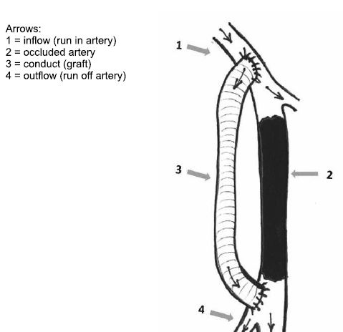
Background
Patients with severely diseased arteries in one or both legs can experience intermittent claudication, rest pain or death of tissue.
When there is an occlusion of the artery, an option would be to create a bypass to restore blood flow beyond the occlusion.
This can be achieved via open or endoscopic techniques using synthetic and autologous grafts.
Autologous grafts have shown to give the best outcome however many not be feasible to be used in all cases.

Slide 3
Graft Patency
Efficacy of prosthetic grafts to the above knee popliteal artery is approximately equivalent to autogenous vein for the first two years. Thereafter, patency curve diverge with lower patency for prosthetic grafts.
Patency Rates :
Saphenous Vein Graft Rates (1,5,10 years) : -86%, 72% and 51%.
Secondary Patency Rate (1,5,10 years) :- 92% , 83%, and 63%
ePTFE Primary Rates :- 77%, 51% and 32%.
ePTFE Secondary Rates : 79%, 62% and 24%
Dalman RL, Taylor LM Jr.. Infrainguinal revascularization procedures. In: Basic Data Underlying Clinical Decision Making in Vascular Surgery, Porter JM, Taylor LM Jr (Eds), Quality Medical Publishing, St. Louis 1994. p.141.

Slide 4
Above Knee Popliteal Position
Type of Graft | 1 Year | 5 year | 10+
SVG – Primary Patency | 86% | 75% | 44%
SVG – Secondary Patency | 89% | 80% | 46%
ePTFE – Primary Patency | 80% | 53% | 32%
ePTFE – Secondary Patency | 87% | 70% | 24%
Below Knee Popliteal Position
Type of Graft | 1 Year | 5 year | 10+
SVG – Primary Patency | 86% | 71% | 53%
SVG – Secondary Patency | 92% | 83% | 71%
ePTFE – Primary Patency | 74% | 44% | 29%
ePTFE – Secondary Patency | 49% | 46% | No Data
Ziegler KR, Muto A, Eghbalieh SD, Dardik A. Basic data related to surgical infrainguinal revascularization procedures: a twenty year update. Ann Vasc Surg. 2011;25(3):413‐422. doi:10.1016/j.avsg.2010.10.010

Slide 5
Graft Patency
Infrapopliteal bypass (tibial or popliteal artery)
Type of Graft | 1 Year | 5 year | 10+
SVG – Primary Patency | 82% | 69% | 48%
SVG – Secondary Patency | 88% | 79% | 60%
ePTFE – Primary Patency | 60% | 24% | No Data
ePTFE – Secondary Patency | 65% | 28% | No Data

Slide 6
Adjunctive Techniques
Adjunctive Techniques can be applied to improve synthetic graft patency
1) Antithrombotic Therapy
2) External Support of PTFE
3) Heparin Bonded PTFE
4) Composite Graft / Vein Cuff
5) Dacron Graft over PTFE
6) Distal Arteriovenous fistula

Slide 7
Antithrombotic Therapy
The Antiplatelet Trialists Collaboration showed that single antiplatelet therapy (acetylsalicylic acid) was associated with a 43% relative risk reduction of graft occlusion.
For prosthetic grafts that cross the knee joint, addition of copidogrel to aspirin contributed an additional 37% relative risk reduction of graft occlusion.
Similarly, therapeutic anticoagulation with warfarin may provide protective effect for prosthetic infrainguinal bypass graft, especially to infrageniculate targets.
Suckow BD, Kraiss LW, Stone DH, et al. Comparison of graft patency, limb salvage, and antithrombotic therapy between prosthetic and autogenous below-knee bypass for critical limb ischemia. Ann Vasc Surg. 2013;27(8):1134‐1145. doi:10.1016/j.avsg.2013.01.019

Slide 8
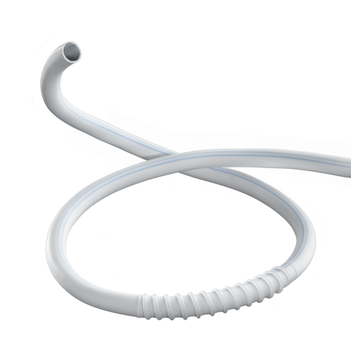
External Support of PTFE
Repeated flexion of knee with every step, or close proximity of graft to tendon at knee joint may cause compression or kinking. Application of an external support for graft avoid compression or kinking. PTFE tubes have been externally supported with plastic rings or spirals.
Randomized trial by SWEXSUS has external support to a PTFE graft used for bypass to below-knee arteries improves primary and secondary patency but not limb salvage.
Lundgren, F. (2013). External Support of a Polytetrafluoroethylene Graft Improves Patency for Bypass to Below-Knee Arteries. Annals of Vascular Surgery, 27(8), 1124–1133. doi:10.1016/j.avsg.2013.02.009

Slide 9
Heparin Bonded PTFE
Heparin Bonded ePTFE prostheses have been reported to yield better outcomes compared to conventional PTFE.
A study on long-term outcomes showed the patency rates as such;
The study concluded that below knee femoro-popliteal bypass in CLI provide excellent long-term limb salvage, especially in cases where endovascular therapy was not possible. However in the long term, autologous vein should be the preferred graft material.
Type of Graft | 1 Year | 3 years | 5 years
Overall Primary Patency | 74.5% | 65.7% | 51.7%
Primary Patency – Vein | 75.3% | 62.2% | 55.5%
HePTFE | 73.6% | 51.7% | 51.7%
Uhl, C., Grosch, C., Hock, C., Töpel, I., & Steinbauer, M. (2017). Comparison of Long-term Outcomes of Heparin Bonded Polytetrafluoroethylene and Autologous Vein Below Knee Femoropopliteal Bypasses in Patients with Critical Limb Ischaemia. European Journal of Vascular and Endovascular Surgery, 54(2), 203–211. doi:10.1016/j.ejvs.2017.05.001

Slide 10
Composite Graft / Vein Cuff
Composite graft is defined as a graft composed of both a PTFE and a segment of autogenous vein.
The main motivation to use composite grafts is that the vein part of the graft, rather than the prosthesis, traverses the knee joint. This would decrease the tendency to kinking and thereby the risk of developing thrombotic occlusion.
However, especially in the below knee region, a good run off is essential for good outcomes, as they demonstrated significantly better patency rates. (55% vs 17% - 12 months), (35% vs 11% - 36 months)
Eur J Vase Endovasc Surg 12, 337-341 (1996) Composite Polytetrafluroethylene/Vein Bypass Grafts: Conventional Distal Vein Segment or Vein Cuff?

Slide 11
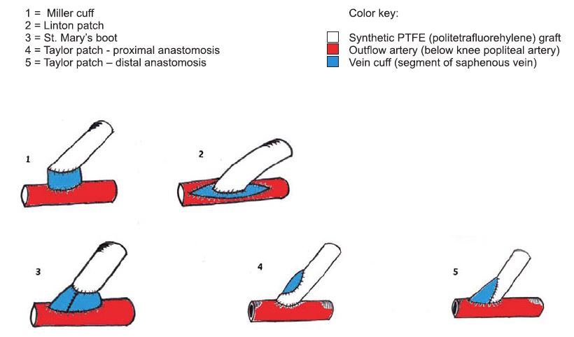
Vein Cuff
A Cochrane review showed some evidence that a vein cuff at distal anastomosis site improved patency rates for below knee PTFE, but does not reduce risk of limb loss.
Evidence for beneficial effect of vein cuffed PTFE is weak and based on underpowered trial. Pre-cuffed PTFE have comparable patency and limb salvage rates to vein cuff PTFE.
Spliced veins improve secondary patency but did not translate into improving limb salvage.
Khalil, A. A., Boyd, A., & Griffiths, G. (2012). Interposition vein cuff for infragenicular prosthetic bypass graft. Cochrane Database of Systematic Reviews. doi:10.1002/14651858.cd007921.pub2

Slide 12
Dacron Graft
Dacron graft, a polyester graft available in woven or knitted form. Knitted form has high porosity and good stability.
In a meta-analysis comparing Dacron vs PTFE, despite inherent limitations, the meta-analysis strongly supports use of Dacron grafts over PTFE, particularly for above-knee femoropopliteal arterial bypasses.
Primary Patency Rates | 12 Months | 24 moths | 36 months | 5 Years | 10 Years
Dacron | No Significant Difference | No Significant Difference | 61% | 52% | 50%
PTFE | No Significant Difference | No Significant Difference | 46% | 36% | 41%
Rychlik IJ, Davey P, Murphy J, O'Donnell ME. A meta-analysis to compare Dacron versus polytetrafluroethylene grafts for above-knee femoropopliteal artery bypass. J Vasc Surg. 2014;60(2):506‐515. doi:10.1016/j.jvs.2014.05.049

Slide 13
Distal AVF
After the PTFE conduit is tunneled between the two exposures and distal artery anastomosis is done, a 5mm side to side arteriovenous fistula is fashioned between the outflow artery and it’s paired vein, 5 to 10cm distal to the PTFE anastomosis.
It is postulated that placing a fistula at this point increases the flow in the intervening segment and improve collateral flow in the leg. The fistula will reduce the resistance to flow and thereby increase the flow through the prosthetic graft. The increase in graft flow volume and velocity may overcome the thrombotic threshold velocity of the prosthetic material, thereby increasing the patency.
The study concluded that DAVF is technically more difficult that a vein cuff, and is less advantageous if the graft occlude and attempts are made at graft salvage.
Adjunctive techniques to improve patency of distal prosthetic bypass grafts: Polytetrafluoroethylene with remote arteriovenous fistulae versus vein cuffs Paul B. Kreienberg, MD, R. Clement Darling III, MD, Benjamin B. Chang, MD, Philip S. K. Paty, MD, William E. Lloyd, MD, and Dhiraj M. Shah, MD, Albany, NY

