Slide 1
Case Discussion
Chronic Limb Threatening Ischaemia
20/04/2020

Slide 2
Patient History
63/M
DM / HPT
IHD (Nov 2019 – NSTEMI – 3VD – COROS 5/11/19, ECHO : EF 30%, Global Hypokinesia
ESRF (HD Via Perm Cath, 1,3,5)
Initially presented in early march for left 4th toe gangrene.

Slide 3
Initial Presentation
Initially presented with blackish discolouration of 1st, 3rd and 4th toe of left leg for about a weeks duration a/w foul smell. No pus discharge.
Having rest pain, pain score 5/10
No history of fever or claudication

Slide 4
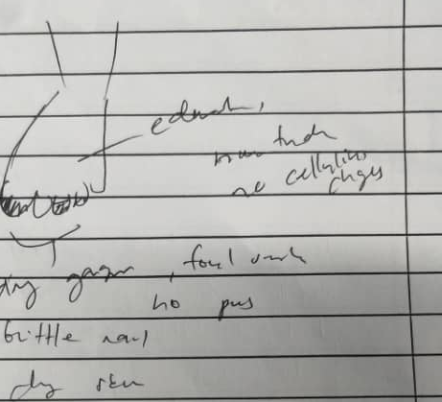
Examination
Bilateral Femoral and Popliteal Artery 2+
Bilateral DPA / PTA not palpable.
ABSI left 0.96
ABSI right 0.91

Slide 5
Plan
Wound Debridement and Ray’s Amputation of 4th toe done.
Planned for DSA kiv Plasty

Slide 6
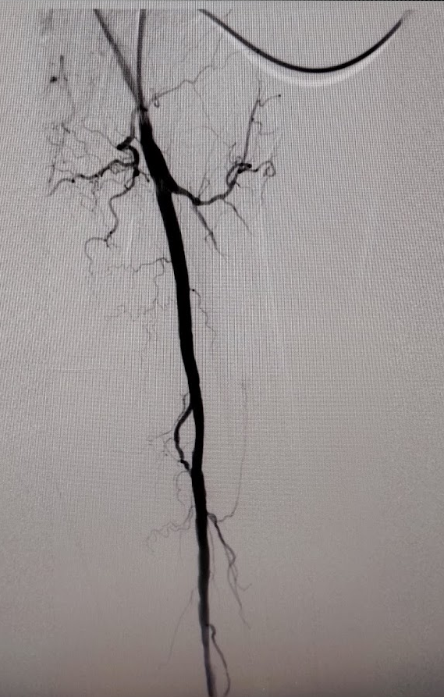
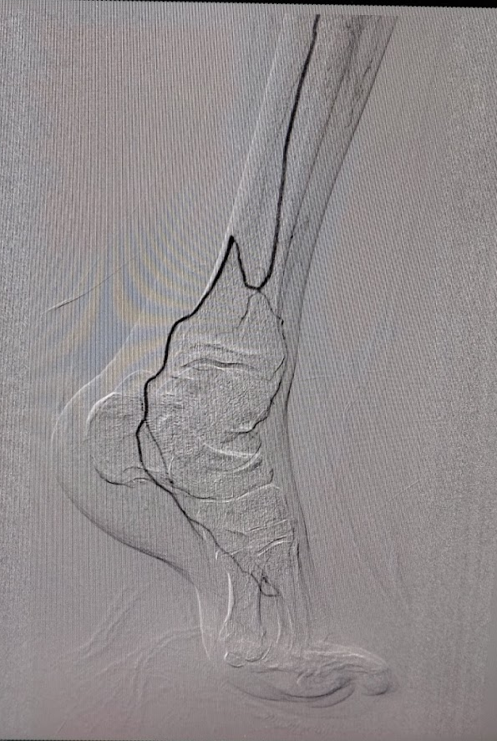
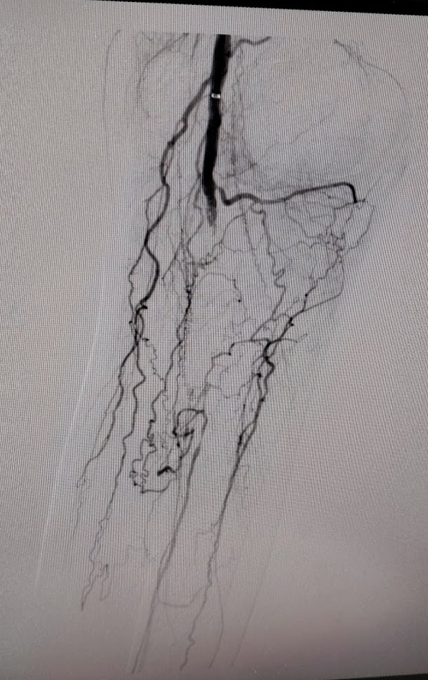
Multiple Short Segment Stenosis <50% CFA and SFA
CTO Popliteal Artery, ATA, PTA, Proximal left Peroneal Artery
Mid and Distal Peroneal artery supplied by collaterals
Distal PTA supplied by Malleolar branch of Peroneal Artery

Slide 7
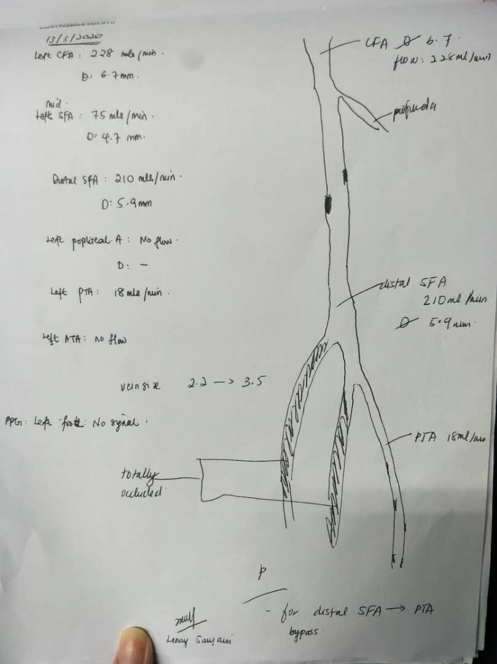
Vascular Mapping
Total occlusion of Popliteal artery, PTA and ATA
Planned for Distal SFA to PTA bypass.

Slide 8
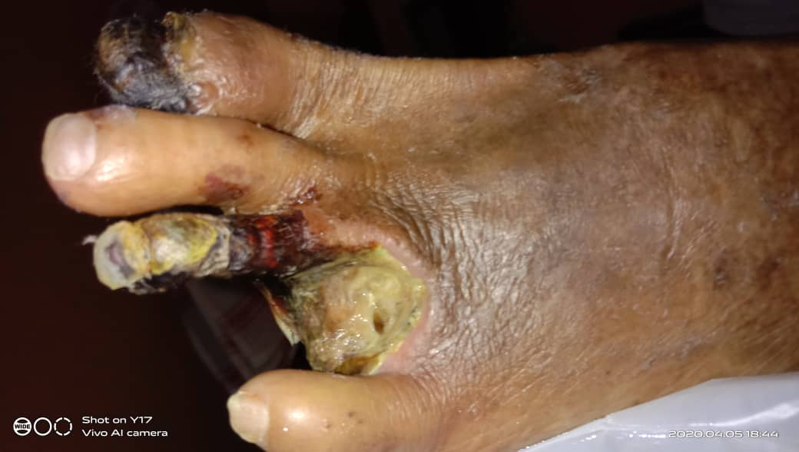
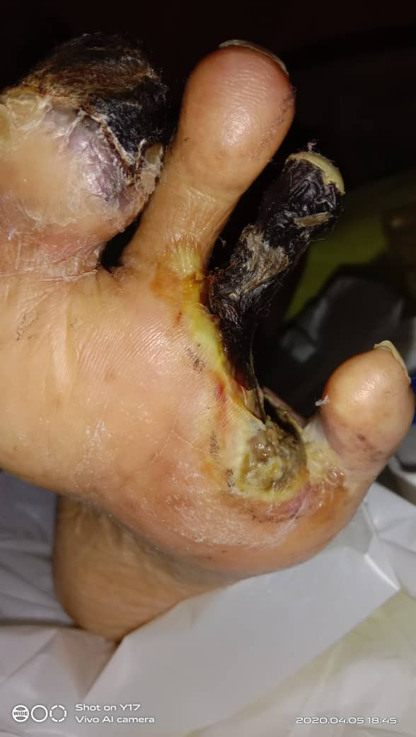
Latest Presentation
Was on EOD dressing at home. Came back to the hospital in view of having pus discharge and foul smelling wound.

Slide 9
Slough and Pus discharge from wound
Third Toe gangrene with pus discharge
Dry gangrene of great toe and 5th toe.
Bilateral Femoral Artery 2+
Bilateral PTA 1+, biphasic
Right PTA / DPA 1+ Monophasic.
Left PTA / DPA – No signal
ABSI Right 0.94
ABSI Left -

Slide 10
Plan

Slide 11
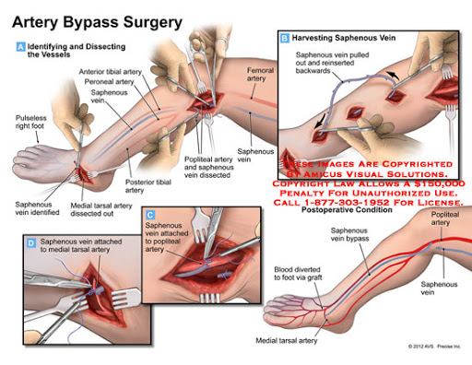
Plan
Ray’s Amputation and Wound Debridement of Infected Toe
Definitive – SFA to PTA bypass
Establish pulsative flow to distal PTA

Slide 12
Backup Plan
1) If no vein usable
2) If no landing zone due to calcification

