Slide 1
Calcium metabolism & homeostasis
by Dr Ram Naidu

Slide 2
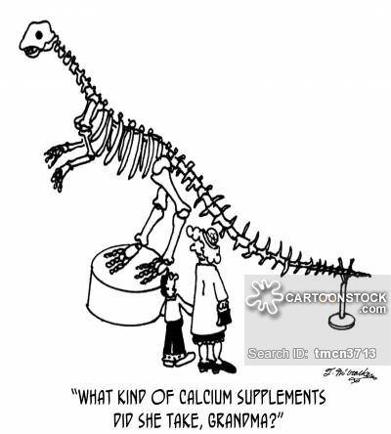
What is calcium and why is it important?
Most abundant cation, extracellular > intracellular (x10000)
Many crucial functions (eg. muscle contraction, coagulation, synaptic transmission, secretion of other hormones, increase bone density)
99% calcium contained within bones
Of remainder 1%: 50% -> ionized form, 40% -> protein bound (albumin, globulin), 10% bound to phosphate & citrate
Normal range 2.2 – 2.6 mmol/L, but should always consider relationship with plasma protein level (ie. albumin)

Slide 3
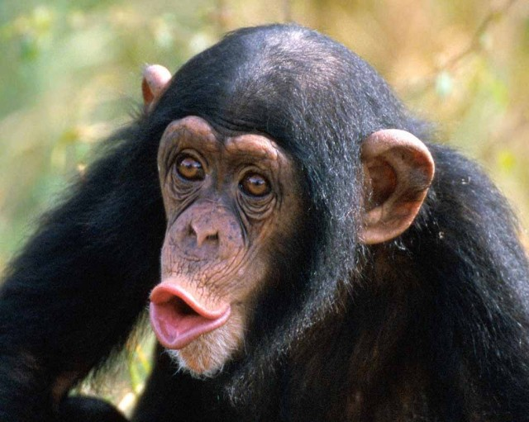
Causes
Hypercalcemia:
C – calcium supplements
H – hyperparathyroidism
I – iatrogenic, immobilization
M – multiple myeloma, milk-alkali syndrome
P – parathyroid adenoma or hyperplasia
A – alcohol
N – neoplasm (malignant)
Z – Zollinger-Ellison syndrome
E – excess Vitamin D
E – excess Vitamin A
S – Sarcoidosis

Slide 4
Causes
Hypocalcemia:
- hypoparathyroidism
- Vitamin D insufficiency
- chronic kidney disease
- iatrogenic (post total thyroidectomy / parathyroidectomy)
- familial hypocalcemia
- acute pancreatitis
- hypomagnesemia
- massive blood transfusion
- rapid correction of severe acidosis by dialysis
- severe sepsis
- liver cirrhosis

Slide 5
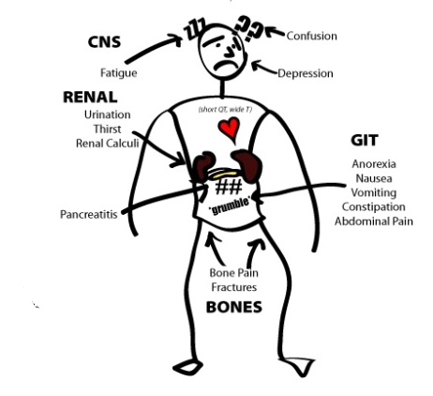
Symptoms
Hypocalcemia: Neurological (tingling, tetany – laryngeal spasm), muscle cramps, cardiac signs, seizures
Hypercalcemia: painful bones, renal stones, abdominal groans, psychic moans, neuropsychiatric overtones

Slide 6
Calcium homeostasis: Key Players
Parathyroid hormone (PTH)
Vitamin D
Calcitonin

Slide 7
Parathyroid hormone (Parathormone)
Produced by parathyroid glands (4 in number, but position & number may vary)
Consists of epithelial cells (chief & oxyphil cells)
PTH production: stimulated by -> low calcium; inhibited by -> high calcium (negative feedback), Vitamin D

Slide 8
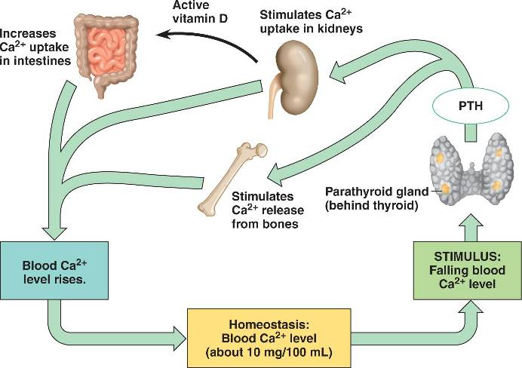
Action:
1) Bone: increases osteoclastic activity, thereby increasing resorption
2) Kidney: distal tubule, promotes Calcium reabsorption
3) Gut: increases absorption of calcium (indirect via Vit D)
Biochemical changes:
-hypercalcemia
-hypophosphatemia
-hyperchloremia
-hypercalciuria

Slide 9
Vitamin D (Cholecalciferol)
Synthesized from precursor 7-dehydrocholesterol by sunlight, then in liver undergoes 1st hydroxylation, then 2nd hydroxylation in kidney to form 1, 25-dyhydroxycholecalciferolv (most active metabolite)
Actions:
1) Gut: increases calcium & phosphate absorption
2) Bone: increases bone resorption
3) Kidney: increases Calcium & phosphate absorption from proximal tubules

Slide 10
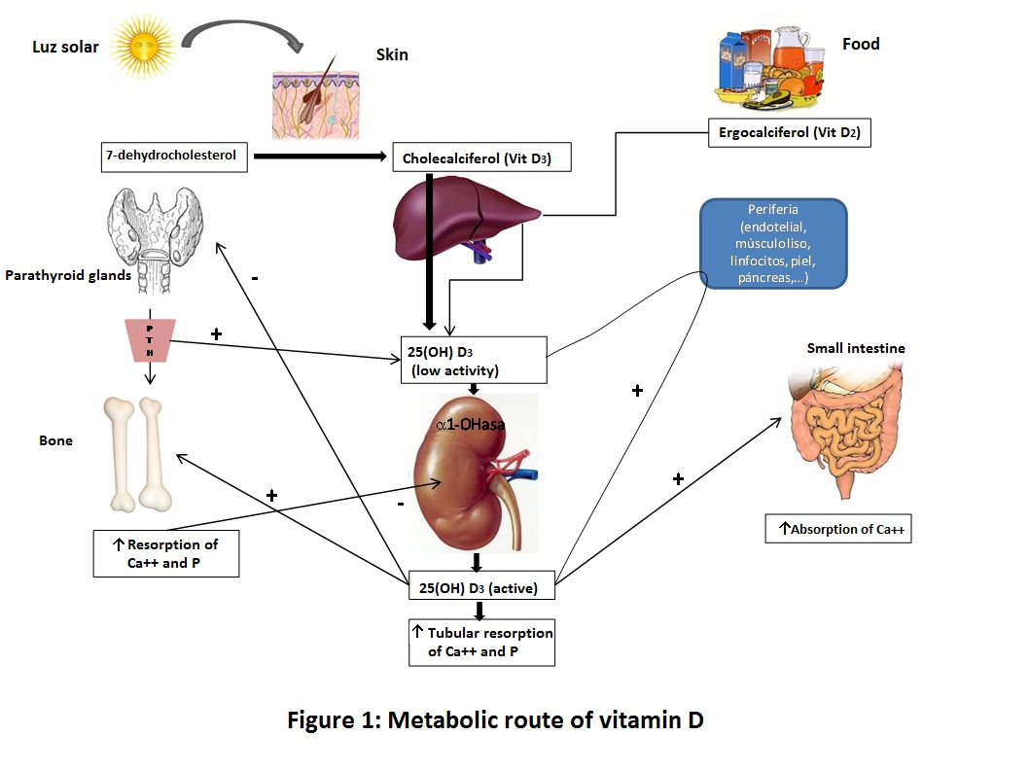

Slide 11
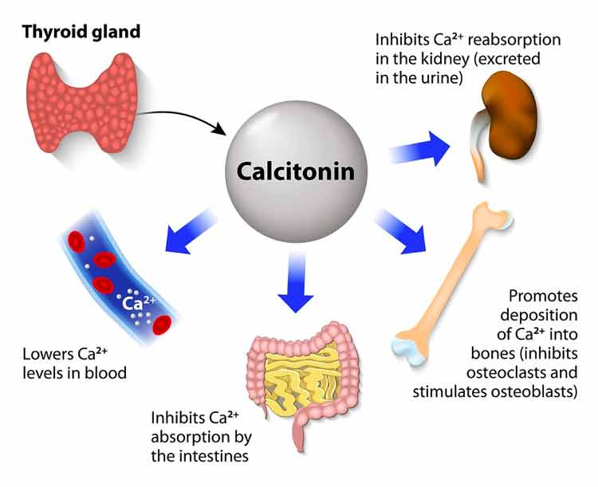
Calcitonin
Secreted by parafollicular C-cells of thyroid gland
High levels may be seen in hypercalcemia and medullary thyroid cancer (MTC)
Actions:
1) inhibits bone resorption by inhibiting osteoclastic activity
2) increased renal tubular excretion of calcium, conserves Mg²⁺

Slide 12
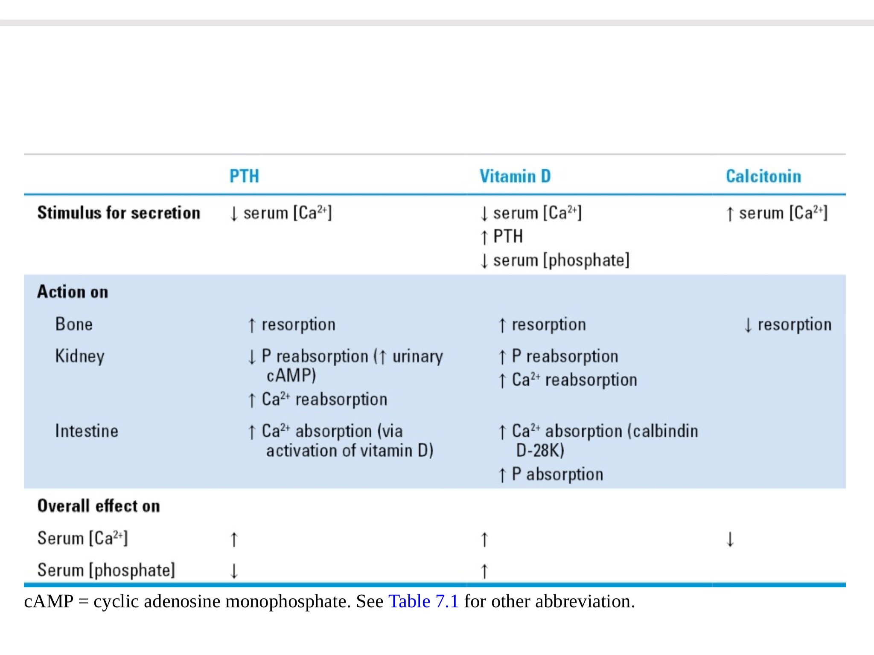
Summary of hormone actions

Slide 13
Common disorders of calcium homeostasis
Primary hyperparathyroidism
-80% cases caused by parathyroid adenoma
-hypercalcemia, hypophastemia, hyperchloremia, raised ALP
Secondary hyperparathyroidism
-chronic renal failure patients
-reduced Vitamin D, causing hypocalcemia, chronic stimulation of PT glands
-normal calcium, very high levels of PTH, high phosphate and ALP

Slide 14
Tertiary hyperparathyroidism
-parathyroid function becomes autonomous after renal transplant
-hypercalcemia
Familial syndromes (MEN 1, MEN 2A)
MEN 1 -> parathyroid adenoma
MEN 2A -> parathyroid hyperplasia
Familial benign hypocalciuric hypercalcemia
-autosomal dominant inherited disorder
-inactivating mutation of Ca sensing receptor gene
-mild hypercalcemia with elevated PTH & hypocalciuria
-usually completely asymptomatic

Slide 15
Humoral hypercalcemia of malignancy
- PTH-related peptide (PTH-rp) secreted by some malignant tumors (eg. Breast, lung)
- has all physiologic effects of PTH

Slide 16
 | PRIMARY HYPERPARATHYROIDISM | SECONDARY HYPERPARATHYROIDISM | TERTIARY HYPERPARATHYROIDISM
PTH | High | High | Very high
Calcium | High | Low | High
Phosphate | Low | High | High

Slide 17
Management of hypercalcemia
ABC
Hydration
Forced diuresis
IV bisphosphonates (zoledronic acid, pamidronate) & calcitonin

Slide 18
Management of hypocalcemia
ABC
IV calcium gluconate and/or oral calcium (carbonate & lactate)
Oral Vitamin D (rocalcitriol)

Slide 19
THANK YOU

