Slide 1
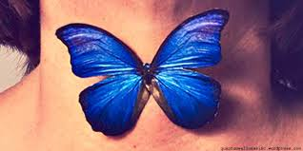
Thyroid Gland Anatomy
KARTHIK Krishnan

Slide 2
Outline
Introduction
Embryology
Anatomy
Relations
Arterial + Nervous Supply
Venous Drainage
Lymphatic Drainage
Clinical Relevance
Reference

Slide 3

Introduction
Endocrine gland situated in the lower part of the anterior neck.
Regulates BMR, Stimulates Somatic and Psychic Growth
Plays Important Role in Calcium Metabolism
Notes:
Neuropsychological

Slide 4
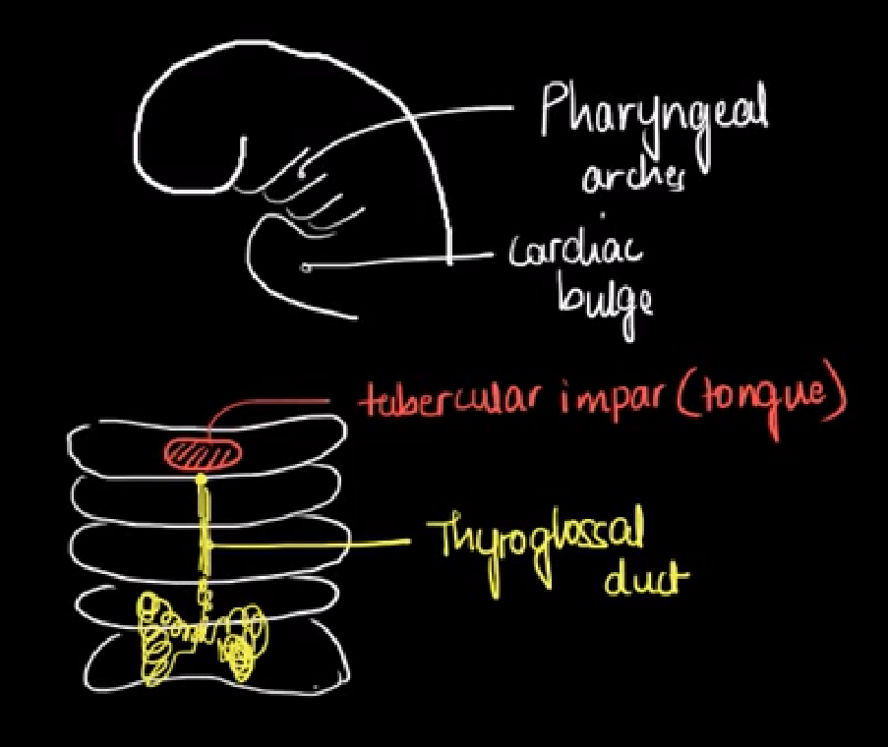
Embryology
First endocrine gland to develop; approximately 24th day of gestation
Arises from 2 main structures – Primitive Pharynx and Neural Crest
Rudimentary Lateral Thyroid develops from Neural Crest cells
Medial Thyroid which forms the bulk of the gland, arise from primitive pharynx

Slide 5
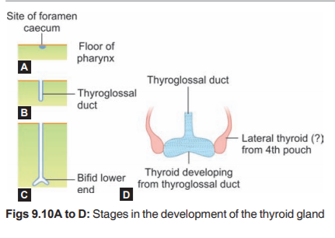
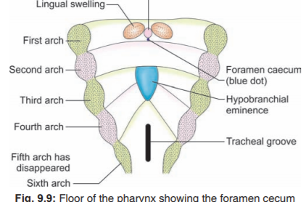
Embryology
Medial ends of two mandibular arches are separated by midline swelling called tuberculum impar.
Behind the tuberculum, the epithelium of the floor thickens and forms a diverticulum called thyroglossal duct.
Origin of the diverticulum now seen as a depression called Foramen Cecum. Diverticulum proliferates down the midline and bifurcates at the tip.

Slide 6
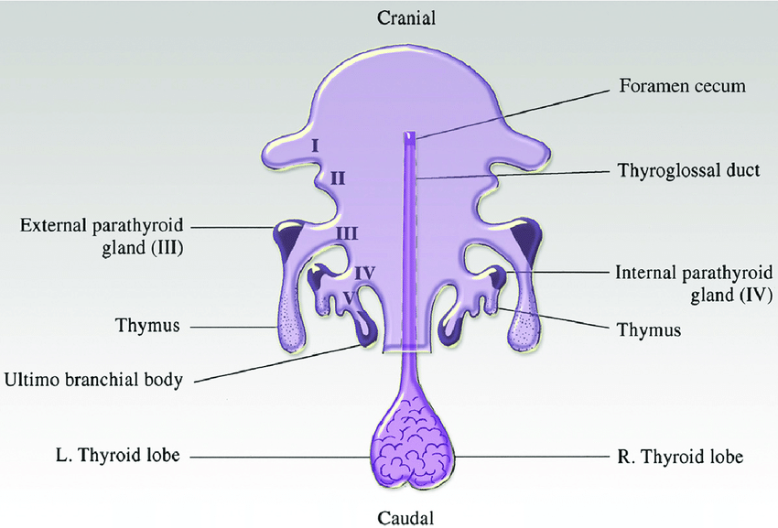
Embryology
Parathyroid gland are 2 pairs of small endocrine gland (superior and inferior) that usually lies on the posterior border of the thyroid gland.
Superior Parathyroid arise from the endoderm of the 4th Pharyngeal Pouch.
Inferior Parathyroid arise from the 3rd Pharyngeal Pouch

Slide 7
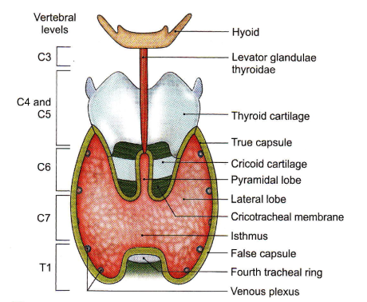
Gross Anatomy
Lies Against Vertebrae C5-T1, embracing upper part of trachea.
Consist of Right and left lobe joined by the isthmus.
A pyramidal lobe may sometimes be present.
Each Lobe extends from middle of thyroid cartilage to the fouth or fifth tracheal ring. Isthmus extends from the second to the fourth tracheal ring

Slide 8
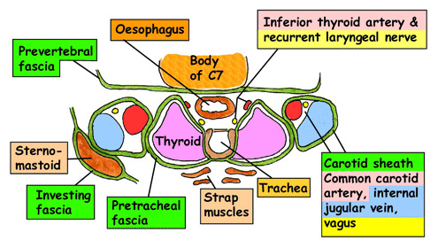
Relations
Anteriorly - Strap Muscles - Sternocleidomastoid - Enclosed in Pretracheal fascia
Posteriorly - Larynx - Trachea - Pharynx - Oesophagus
Laterally - Carotid Sheath
RLN – Thyro-oesophageal Grove Ext. Branch SLN – deep to upper pole
Notes:
Strap Muscles – Sternohyoid, Sternothyroid, Thyrohoid, Omohyoid

Slide 9
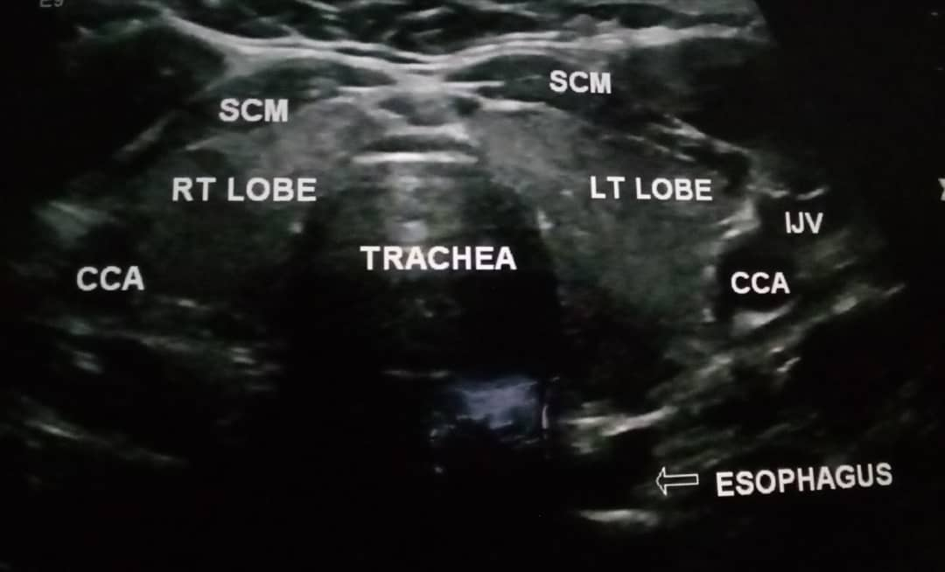

Slide 10
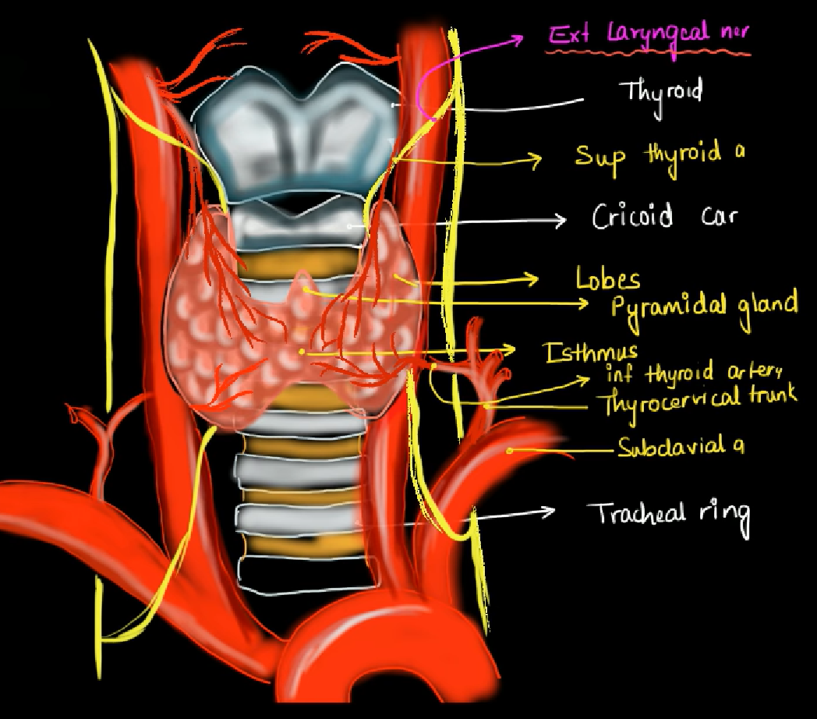
Blood & Nervous Supply
Superior Thyroid Artery from External Carotid at upper pole, closely related to external branch of SLN
Inferior Thyroid Artery from Thyrocervical trunk of first part of subclavian, closely related to RLN close to gland
Thyroidea Ima, from Aortic Arch; Inconstant
Notes:
STA – Anterior and Posterior Branch. Anterior descent on anterior border along upper border of isthmus to anastamose with other side.
Posterior branch descends on the posterior border to anastamose with the ascending branch of inferior thyroid artery
ITA – divide 4-5 glandular branches which pierce fascia separately to reach lower part of gland. One ascending branch anastamose with posterior branch of STA and supply Parathyroid Glands

Slide 11
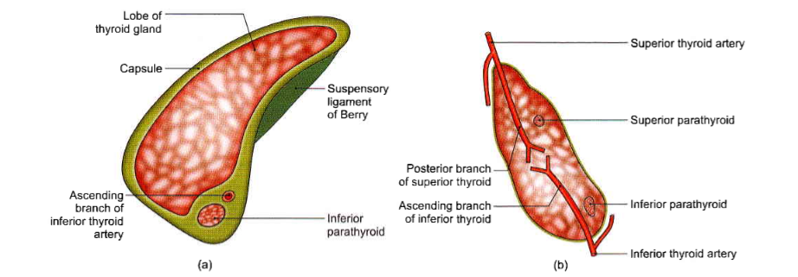

Slide 12
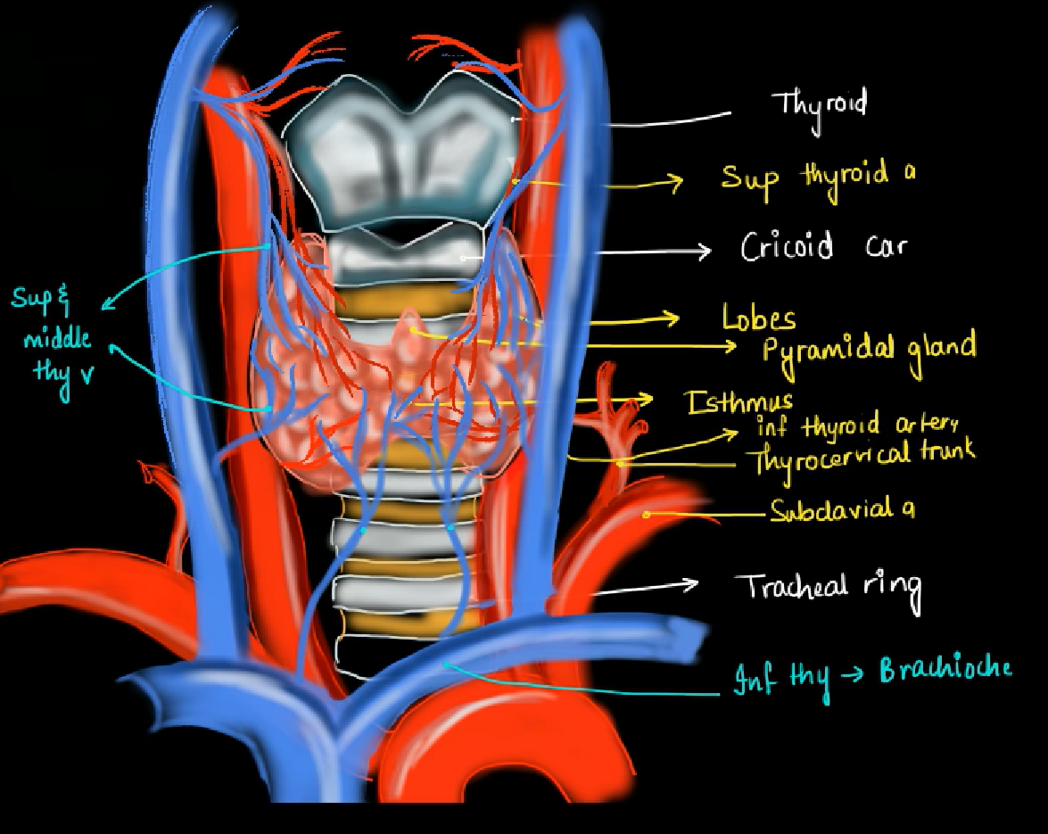
Venous Drainage
Superior Thyroid Vein Drains Upper Pole to Internal Jugular Vein
Midlde Thyroid Vein drains to Internal Jugular Vein
Inferior Thyroid vein drains lower pole to brachiocephalic veins

Slide 13
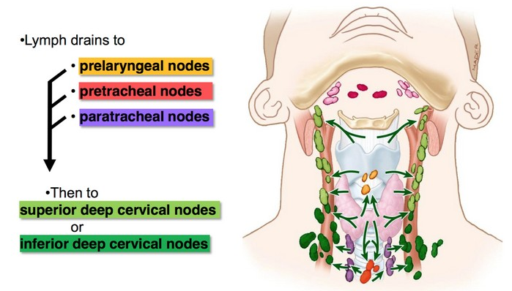
Lymphatic Drainage
Lymph from Upper part -> Upper deep cervical LN directly or via prelaryngeal nodes.
Lymph from Lower Part -> Lower deep cervical LN directly and via pretracheal and paratracheal nodes.

Slide 14
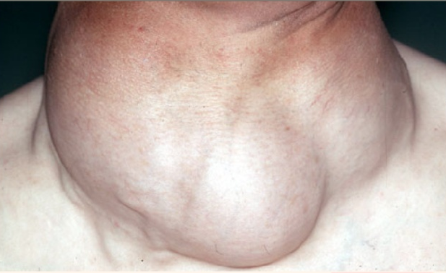
Clinical Relevance
Enlargement of Thyroid Gland may compress or displace it’s close relations. In the case of trachea, may result in breathing difficulty, or difficult intubation, or dysphagia if the oesophagus is compressed.

Slide 15
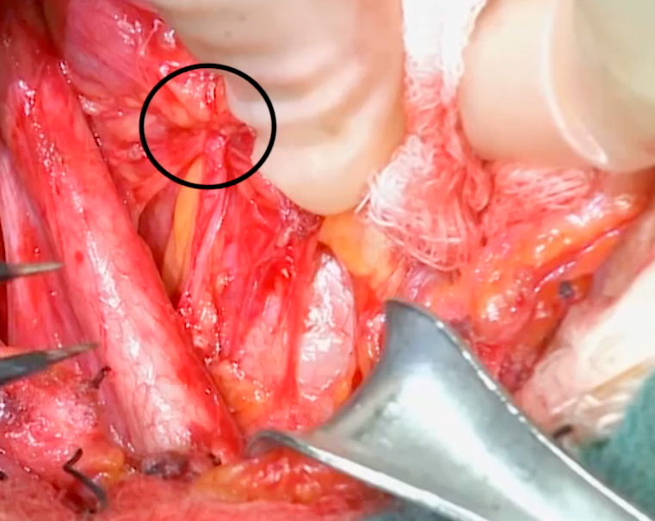
Clinical Relevance
Carcinoma of the Thyroid May Invade the Recurrent Laryngeal Nerve – Hoarseness of Voice

Slide 16
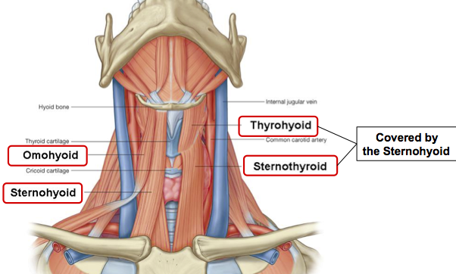
Thyroidectomy
Performed via transverse incision two finger breadths above the suprasternal notch following skin crease.
Structures Encountered – Plastysma -> Investing Fascia (Open Longitudinally between Strap Muscles and Ant. Jugular Veins) -> Strap muscles (which may be divided in their upper half to preserve their nerve supply from Ansa Cervicalis)
Thereafter, pretracheal fascia is divided, to expose the thyroid gland.
STA must be ligated close to gland to avoid external branch of SLN injury
ITA must be ligated away from the gland, to avoid RLN injury

Slide 17
Reference
Inderbir Singh’s Human Embryology – 11th Ed
BD Chaurasia’s Human Anatomy Volume 3 Head-Neck Brain 6th Ed
Andrew T. Raftery – Basic Science for the MRCS – 2nd Ed

