Slide 1
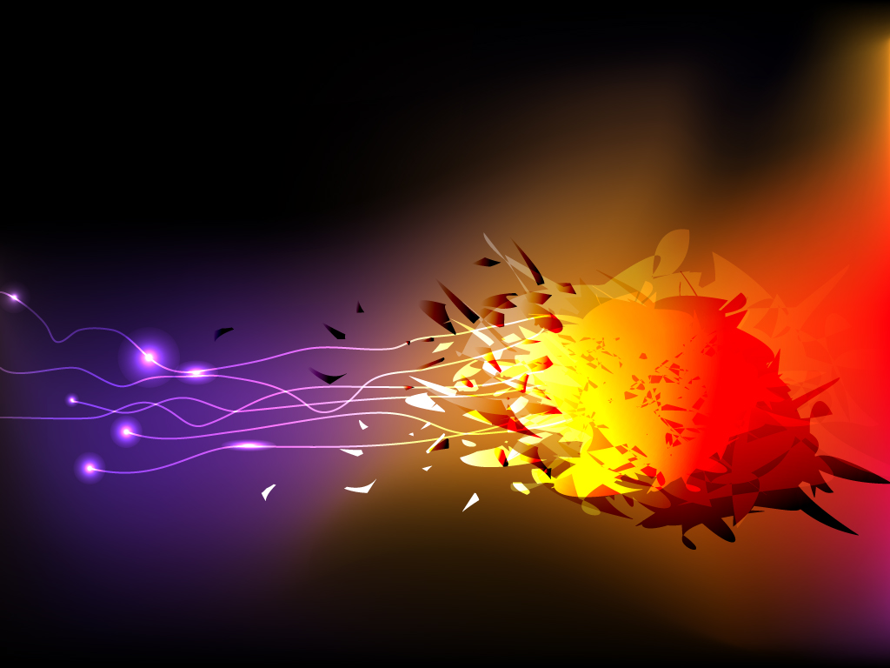
Therapeutic Uses Of Radioisotopes And Radiation Therapy In Surgery
Karthik Krishnan
Supervisor : Dr. Wan Fatihah Binti Wan Sohaimi
Department of Nuclear Medicine
Radiotherapy and Oncology

Slide 2
Presentation Outline
Introduction
Nuclear Medicine Services
Components of Nuclear Medicine
Diagnostic Uses
Therapeutic Uses
Sterilization Uses
Take Home Messages

Slide 3
Introduction
Nuclear Medicine – The Use of Radiation to provide diagnostic information about the function of a specific organ, and even to treat particular conditions.
Radiotherapy – Treat some medical conditions, particularly cancer, using radiation to weaken or destroy targeted cells.
They also play a role in sterilization of certain medical equipment.
The demand for Nuclear Medicine Procedures are increasing annually, whereby over 40 Million procedures are done yearly.

Slide 4
Nuclear Medicine Services
Diagnostic | Therapeutic
Bone Scan (Tc99m MDP/HDP) Thyroid Scan, Thyroid Uptake Study (Tc99m-Pertechnetate) Meckel’s Scan, RBC Tag Parathyroid Scan (Tc99m sestamibi) Remnant Differentiated Thyroid Cancer (I-131 Whole Body Scan) HBS (HIDA Scan) Sentinel Node Scintigraphy Renal Dynamic Study Renal Cortical Imaging | I-131 : Differentiated Thyroid Carcinoma & Hyperthyroidism in Benign Thyroid Disease Transarterial Radioembolisation (TARE) in primary and Secondary Liver Cancer Prostate Carcinoma (Yttrium-90 & Lutetium-177) Bone Palliation For Bone Metastasis
1. Miscellaneous Use: I-131 MIBG 2. Myoview / Cardiac Scan 3. Lung Perfusion / Ventilation Study 4. Infection / Inflammation : Scintimun 5. Neurology : Epilepsy / Dementia / Brain Death 6. F18 FDG PET/CT – Malignancy | Miscellaneous Use : Radiosynoviorthesis (Radiation Synovectomy) NET (Neuroblastoma, Paraganglioma)

Slide 5
Radioisotopes
Isotopes - A particular Chemical Element which differ in Neutron Number
All Isotopes of an Element have same number of Protons in each atom.
Some Isotopes are radioactive, ergo radioisotopes, others are stable isotopes.

Slide 6
Radioisotope – An Atom with Excess Nuclear Energy; Unstable
Excess Energy can be used in 3 ways
  Emitted from Nucleus as Gamma Radiation
  Transferred to one of its electrons to release as a conversion electron
  Used to create and emit a new particle (alpha or beta particle) from the nucleus
  This is called Radioactive Decay

Slide 7
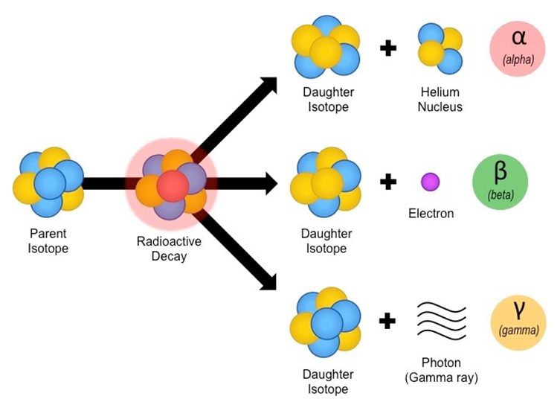

Slide 8
Diagnostic Techniques – Radiactive Tracers which emit Gamma Rays are Used.
Short-Lived Isotopes – linked to chemical compound, permit specific physiological processes to be scrutinized.
Prescribed – Injection, Inhalation, Oral
Single Photon Emission Computerised Tomography (SPECT) – scanning technology to diagnose and monitor.

Slide 9
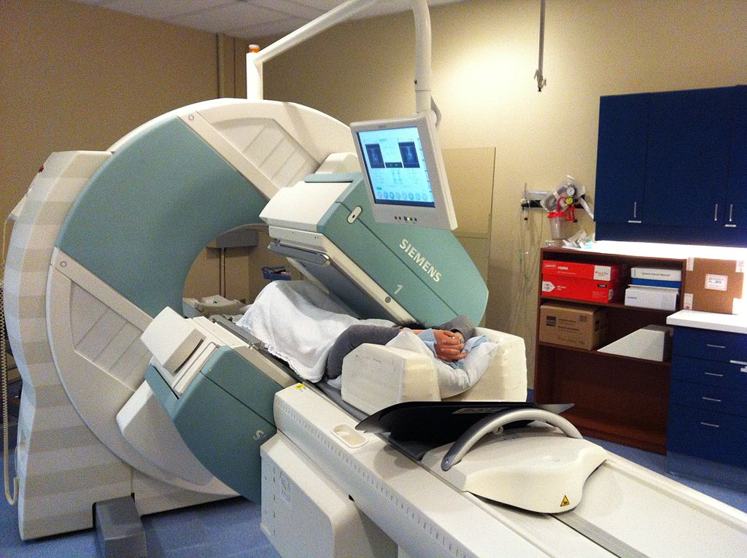

Slide 10
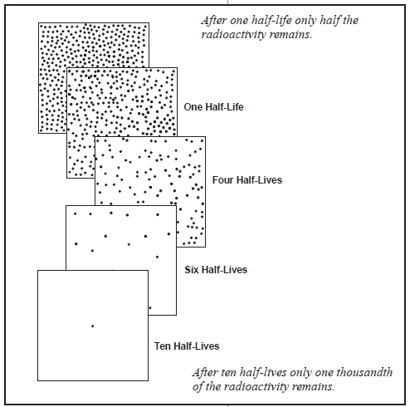
Radionuclide / Radioisotope
Tc99m | I-131
Widely Used 6 hours Half-Life Low-Energy Gamma Ray (156 kev) Easily Available Easily tagged with Pharmaceuticals Versatile, can form tracers, incorporate into a range of biologically-active substance. | Half Life 8 days Produce Gamma (364 Kev) and Beta (606 Kev) rays High-Energy Radiation

Slide 11
Radiopharmaceutical
Radioisotopes | Pharmaceutical | Type of scan
Tc99m(Tc99m pertehnetate) | - | Thyroid scan & thyroid uptake study (solitary nodule, ectopic, assessment of function) Meckel’s diverticulum
Tc99m | MDP HDP | Bone scan for sclerotic bone metastases primary bone malignancy fracture , avascular necrosis Metabolic bone disease etc
Tc99m | 1. DTPA , MAG3 2. DMSA | Renal dynamic study : function of kidney, obstruction Cortical imaging : scarring, congenital anomalies, ectopic, function of kidney
Tc99m | HIDA | HBS (biliary atresia, cholecystitis)
Tc99m | RBC tag | GI bleed
Tc99m | Sestamibi | Myoview/cardiac scan

Slide 12
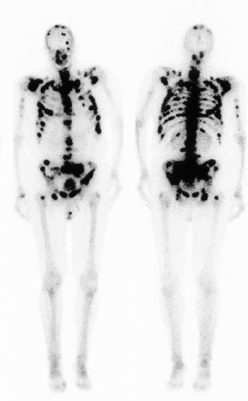
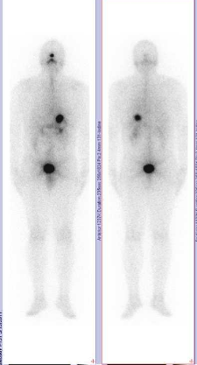
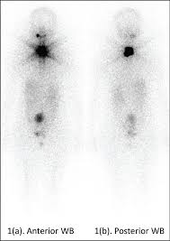
Tc99m-MDP | I -131
Provides Position and Concentration of the Radioisotope within the body.
If Isotope is partially taken up (cold spot) or taken up in excess (hot spot) – Organ Malfunction

Slide 13
Radionuclide (PET / CT)
Positron Emission Tomography (PET) – precise and sophisticated using isotopes produced in a cyclotron.
Positron-Emitting Radionuclide introduced (usually via injection) and accumulates in target tissue.
Positron emitted on decay, which combines with electrons nearby – emission of 2 identifiable gamma rays in opposite direction. Captured by PET Camera.
PET scan most important role in oncology, with Fluorine-18 as tracer. Most accurate, non-invasive method of detection and evaluation.

Slide 14
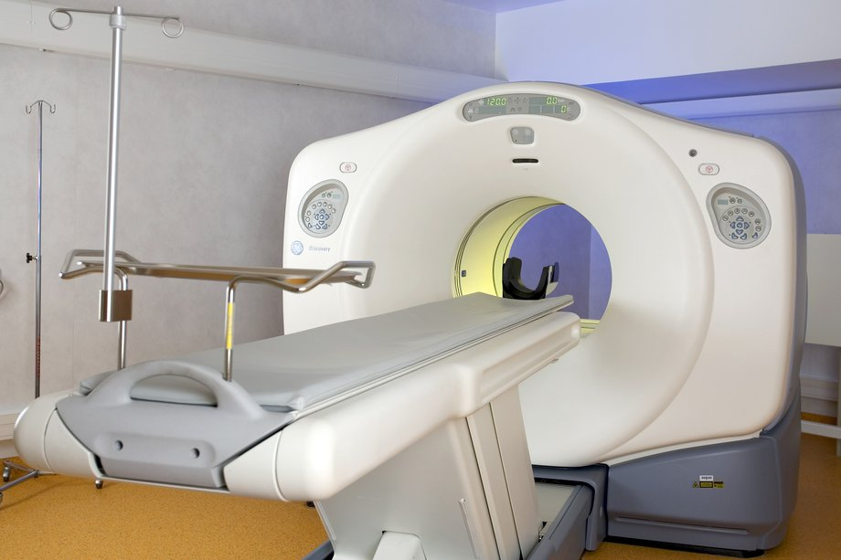

Slide 15
F-18 FDG | F-18 PSMA | Ga-68 Dotatate
most important clinical role is in oncology | for prostate cancer | For neuroendocrine tumour (NET)
Features of F-18 : Produce by cyclotron Short T ½ of 110 min Costly Disadvantage : - false negative in : low grade tumour, small lesion (<7mm), - false positive in high activity area (eg brain, kidney, pancreas, intestine) | Features of F-18 : Produce by cyclotron Short T ½ of 110 min Costly | Features of Ga-68 : Produce by generator by parent Ge68 with T ½ of 271 days Short T ½ of 68 min
Indication: Detection (cancer of unknown origin) Localization Staging Follow-up Monitor response tor treatment | Indication : Localization of tumour tissue in recurrent prostate ca Staging | Indication : 1. Localization of somatostatin receptor-positive NET

Slide 16
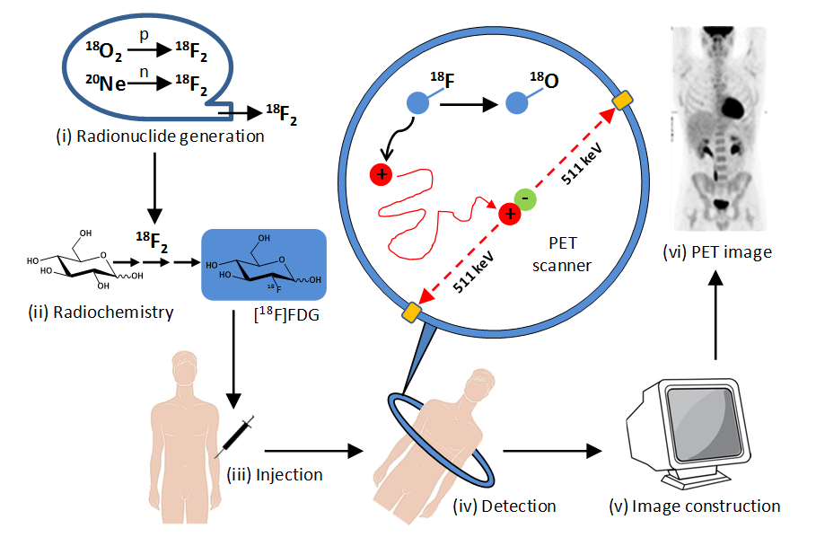

Slide 17
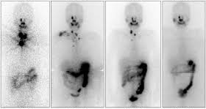
Diagnostic Uses
Endocrine Uses
  I-131 Whole Body Scan
    Detection of LN Metastasis
    Follow Up Post-Therapy
    Residual Thyroid Tissue
  Thyroid Scan / Thyroid Uptake
    Evaluation of Thyroid Function
    Evaluate Nodules (Hot / Cold )
    Ectopic Thyroid

Slide 18
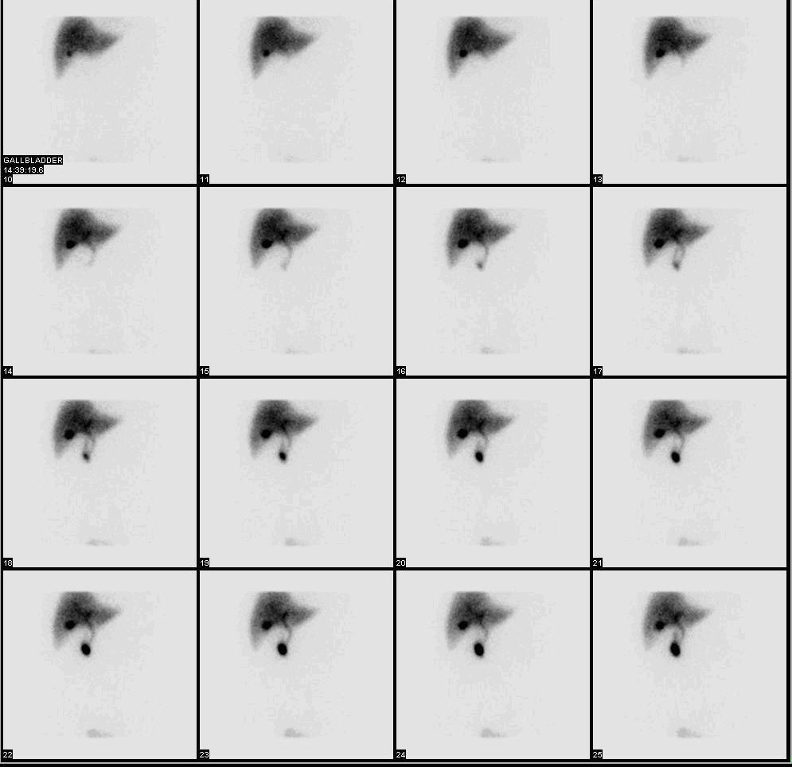
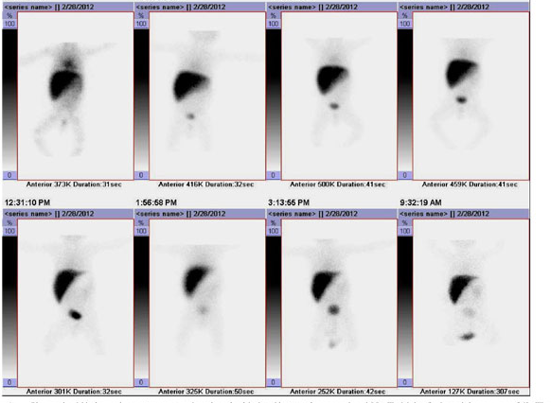
Diagnostic - Hepatobiliary
Cholescintigraphy
HIDA Scan. Technetium Tc99m lidofenin
Uses
  Acute Cholecystitis
  Chronic Cholecystitis
  Abnormal Biliary Leakage
  Biliary Atresia
Notes:
hepatobiliary iminodiacetic acid

Slide 19
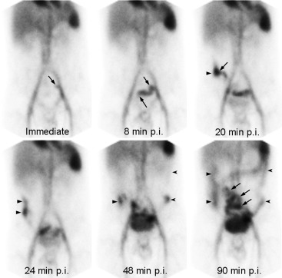
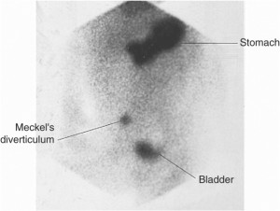
Diagnostic - Gastrointestinal
GI Bleed RBC Scan Meckel Scan

Slide 20
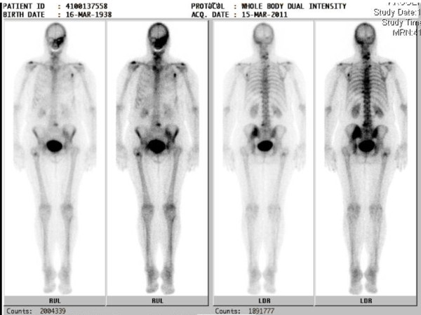
Diagnostic – Bone Scan

Slide 21
Nuclear Medicine Therapeutic Uses
Cancerous Growths are Sensitive to Damage By Radiation
Some Growths Can be Controlled or Eliminated by Irradiating The Area of Growth
High Energy Particle or wave (X-Ray, Gamma Ray, Electron Beam, Proton) destroy or damage cancer cells.
Radiation works by causes damage to the DNA inside cells – stops growth or division.

Slide 22
Indication | Radioisotopes
Differentiated thyroid cancer Benign thyroid disease | I-131
Prostate cancer | Lutetium 177 (Lu) PSMA
Primary or secondary liver tumour | I-131 Lipidiol Yttrium90 –labelled microsphere
Peptide Receptor Radionuclide Therapy (PPRT) - gastroenteropancreatic - Neuroendocrine tumour (NET) | Lutetium-177 Dotatate Yttrium-90 Dotatate
Peptide Receptor Radionuclide Therapy (PPRT) - Neuroendocrine tumour (NET) | I-131 MIBG
Radiosynovectomy | Yttrium-90 , Rhenium-186/188
Bone palliation | Strontium-89 , Samarium-153, Rhenium-186/188, Yttrium-90

Slide 23
Radioactive I-131
Radioactive Iodine – used in PTC & FTC
Iodide is taken up by Thyroid cells. Radioactive Iodine becomes toxic to cells that accumulate iodine. Thereafter it kills these cells.
Most common use – in cases where there are small amounts of remnant thyroid tissue – ablation can be done.
Some thyroid cancer cells are iodine-avid. If there is recurrence of cancer then RAI can target and kill these cells

Slide 24
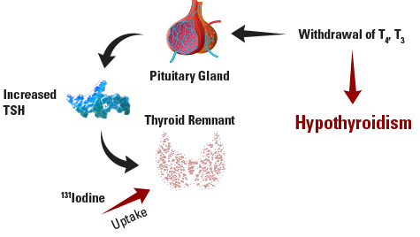
i

Slide 25
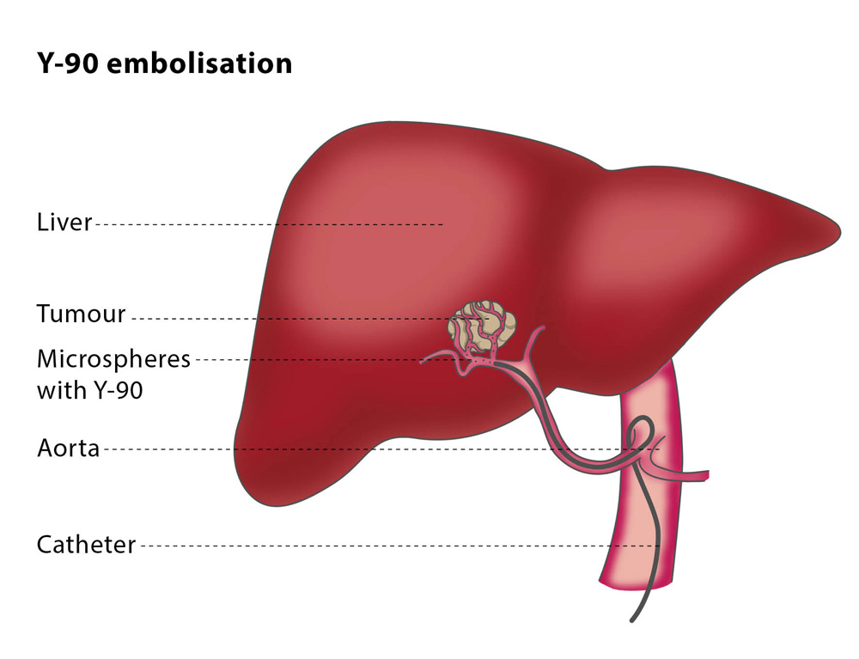
TARE Transarterial Radioembolization
Selective Internal Radiotherapy (SIRT) with Yttrium-90 microspheres
Used in HCC and Non-Resectable Liver Metastasis
Alternative to TACE

Slide 26
TARE
3 Types of microspheres for Selective Internal Radiation Therapy
SIR-Sphere
  Resin based microspheres impregnanted with Yttrium-90
TheraSphere
  Millions of microscopic radioactive glass microspheres infused into arteries to feed live tumours. These microspheres embolize and lodge themselves in the liver capillaries and bathing the malignancy with high levels of Yttrium-90 radiation.
QuiremSpheres
  Radionuclide holmium-166 and made of poly(l-lactic acid)

Slide 27
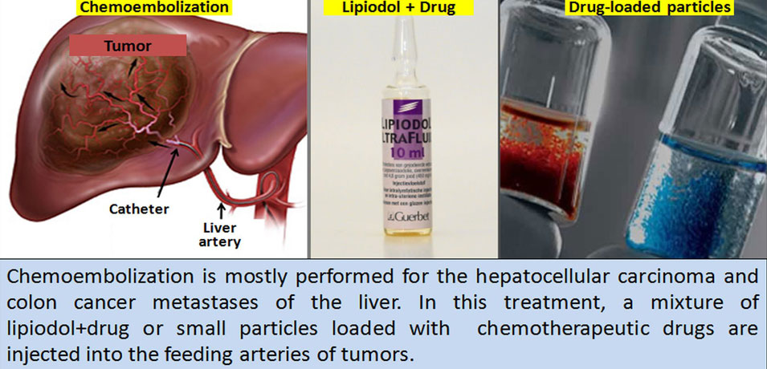
TACE vs TARE

Slide 28
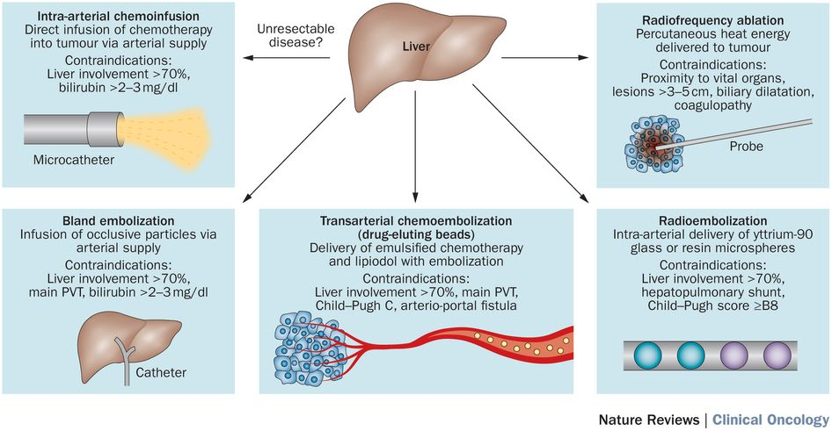
TACE VS TARE

Slide 29
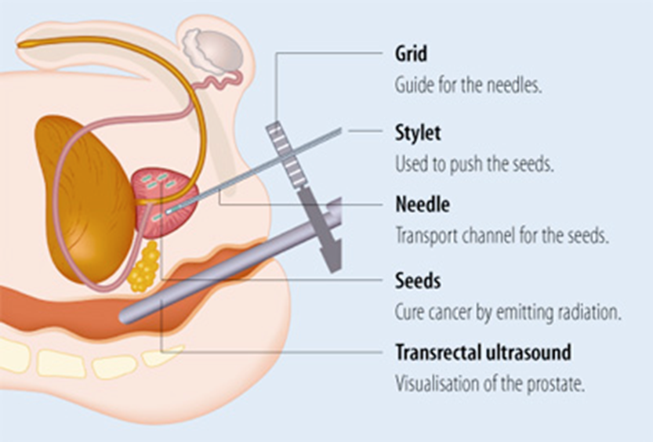
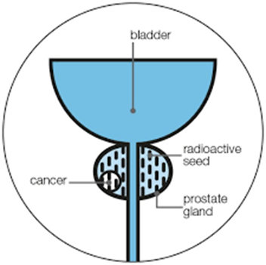
Prostate Cancer
Lutetium 177 (Lu) labelled PSMA Peptides (IV)
Prostate-Specific Membrane Antigen – receptor on surface of Prostate Cancer Cells
Permanent Implant seeds (40 to 100) of Iodine-125 or Palladium-103 used in brachytherapy for early stage prostate cancer.

Slide 30
Bone Palliation Radionuclide Therapy
Strontium-89 and Samarium-153 via Injection
Used to Treat Secondary Bone Cancer or Metastasis
Help to reduce Bone Pain / Improve Quality of Life

Slide 31
Radiotherapy
External Irradiation – Carried out using a gamma beam from radioactive cobalt-60 source
External Radiation – Gamma Knife
Radiosurgery – focus gamma radiation to precise area (i.e. Brain with Cancerous Tumour)
Teletherapy is effective in the ablation of tumours instead of their removal

Slide 32
Roles of Radiotherapy
Primary Treatment
Adjuvant Radiotherapy (Pre and Post Op)
Intraoperative Radiotherapy
Chemoradiotherapy
Palliative
Treatment of Systemic Diseases

Slide 33
Primary Treatment
Curative in Nature
Alternate Modality to Surgery
Effective at controlling small, well localized and defined tumours.
For many types of cancer, it is as effective as Surgical Resection.
Usage depends on a myriad of factors, site, stage, histological variant, patient age and ECOG status.

Slide 34
Adjuvant Radiotherapy
Utilized for improving outcome of another modality i.e Surgery
Many cases offers improvement of local control, thereby improving quality of life.
Controls microscopic spread, beyond resection margins, tumour spillage or lymph node metastasis.
May be given at the site of primary disease to reduce local recurrence or sites of potential metastatic spread.

Slide 35
Adjuvant Radiotherapy
Can be delivered as
  Preoperative Radiotherapy
  Intraoperative Radiotherapy
  Post Operative Radiotherapy
  Combined as Pre and Post Operative

Slide 36
Pre-operative
Downstage Tumour
Convert technically inoperable tumours into an operable state
Destroy unrecognized peripheral projections of tumour
Control subclinical disease in the primary site or Lymph Nodes

Slide 37
Postoperative Radiotherapy
Eradicate residual disease remaining at resected peripheral margins.
Reduce rates of local recurrence
Advantage of Radiotherapist having details of surgical and pathological findings with operative notes and surgical clipping to aid delivery

Slide 38
Intraoperative Radiotherapy
Delivered during surgery resulting in sterilization of malignant cells on the tumour bed.
Electron Beam Irradiation and interstitial brachytherapy can improve local control.
Used in soft tissue sarcoma, pancreatic cancers, stomach cancers, retroperitoneal sarcomas, or breast cancers.

Slide 39
Chemoradiotherapy
Chemotherapy given concurrently with radiotherapy
Antineoplastic drugs like Cisplatin, 5FU, Hydroxyurea, Gemcitabine given in conjunction with the radiotherapy.
Enhances the efficacy of Radiation
Commonly used in Anal Canal, Bladder, Oesophageal and Cervical Cancers

Slide 40
Bone Metastasis
Symptomatic Bone Metastasis affect around 20% of patients at some stage during illness.
Radiotherapy is highly effective in local pain control.
Single 8Gy fraction of RT will relieve pain partially or completely in 80% of patients after 4 weeks of treatment
Patients with extensive bone metastasis such as prostate cancer / breast cancer obtain good palliation from wide-field hemibody single irradiation followed by other half in 4-6 weeks later
2/3rd of patients claim good pain relief.

Slide 41
Spinal cord compression
Emergency – leads to motor, sensory and sphincter disturbances (cauda equina syndrome)
Caused by direct extension of tumour, epidural deposits or rarely intermedullary disease
Effective as long as tumour is not radioresistant.
70% will achieve good pain relief if treated before major neurological deficit

Slide 42
SVCO
Tumours in the head and neck area can compress against superior vena cava and cause obstruction.
May cause breathlessness, with facial and neck swelling.
In the urgent setting, radiotherapy can often work well by shrinking the tumour and decompress the involved vein.
Whilst not curative, can offer symptomatic relief.

Slide 43
Brain Metastasis
Common sight in many cancers such as lung and breast.
Usually multiple with poor prognosis.
Irradiation prior to surgical resection gives better results.
WBRT is possible palliative Option
Sterotactic Radiosurgery using the Gamma Knife concept, whereby arcing radiation beams precisely hit the site of interest.

Slide 44
Sterilization
Sterilized with Gamma Rays from a Co-60 source.
Cold Process Radiation – Sterilise a range of heat-sensitive items.
Smaller Gamma Irradiators, utilising Cs-137 – treating blood for transfusion
Sterilisation is safe and cheap and can be done after packaging
Sterile Shelf-Life is practically indefinite if seal is not broken

Slide 45

Take Home Message
Nuclear Medicine is extremely useful with diagnosing and treating a myriad of illnesses on top of sterilising medical equipment and blood products.
Millions of Nuclear Medicine Procedures are performed worldwide, and the demand for them are increasing consistently.
Tailoring management of a patient using nuclear medicine improves outcome, and allows for holistic care.
With the advent of technology, the costs can be further brought down and the availability more apparent so more patients can benefit from them.

