Slide 1
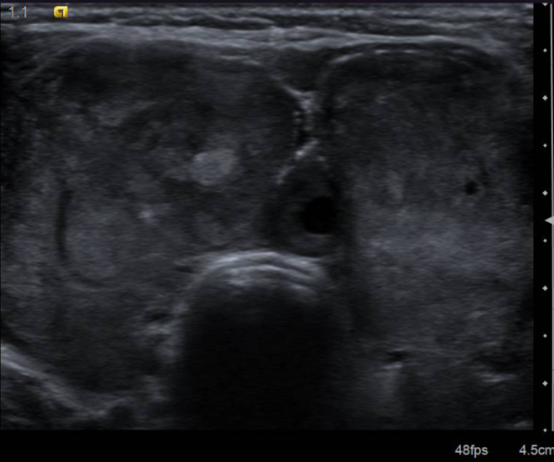

The Enigma of The Ectopic Thyroid
Department of general surgery
Hospital universiti sains Malaysia
6th Malaysian Breast & Endocrine Surgery Course 2018

Slide 2
Introduction
Ectopic Thyroid refers to the Presence of Thyroid Tissue in Locations other than the normal anterior neck region between the second and fourth tracheal cartilage. It is the most frequent form of thyroid dysgenesis, whereby it represents 48-61% of cases.¹
The abnormality involves an aberrant embryogenesis of the thyroid gland during its passage from the floor of the primitive foregut to its final pre-tracheal position.²
Prevalence of this condition is between 1 per 100,000-300,000 persons and occur 1 in 4,000-8,000 patients with thyroid disease. ³
90% of all ectopic thyroid tissues are found along the path of descent, whereas about 10% are found in other anatomical locations including the mediastinum and heart. Mediastinal ectopic thyroids alone are exceedingly rare and account for less than 1% of all cases.⁴
We present our patient whom we initially treated as a common toxic nodular goitre, underwent a total thyroidectomy, but was incidentally noted to have a mediastinal mass. The thyroid specimen was reported as multifocal Papillary Thyroid Carcinoma, and the mediastinal mass came back as Ectopic Thyroid Tissue.

Slide 3
History; Madam R.
48 year old lady with underlying hypertension, presented with neck swelling for over a year duration.
She had started developing hyperthyroidism symptoms (hand tremors, palpitations, irritability, heat intolerance), and went to a Klinik Kesihatan. Initial investigation noted a goitre, with hyperthyroidism (T4 60.87, TSH <0.005). She was started on Carbimazole 30mg OD and subsequently referred to us.

Slide 4
SOPD Visit
She first visited us at our SOPD in February 2017. On our examination, she was noted to have a multinodular mass over the anterior neck. It was about 15cm x 15 cm. Firm, Non Tender and Fixed. No Lymph Nodes were palpable. The lower border of the thyroid is felt.
She was subjected to an Ultrasound, with findings as follows;
Enlarged Thyroid gland. Heterogenous in echogenicity with multiple nodular lesions, varying in sizes. Largest nodule is a mixed nodule predominantly solid seen at the left thyroid lobe, measuring 3.9cm x 1.9cm x 5.0cm. Most of the nodules are hyperechoic with no internal vascularity.
Diffuse Enlarged Thyroid Gland with Multinodular Nodules.

Slide 5
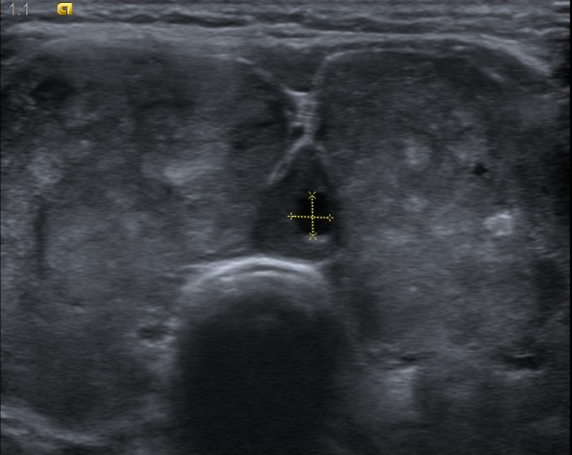
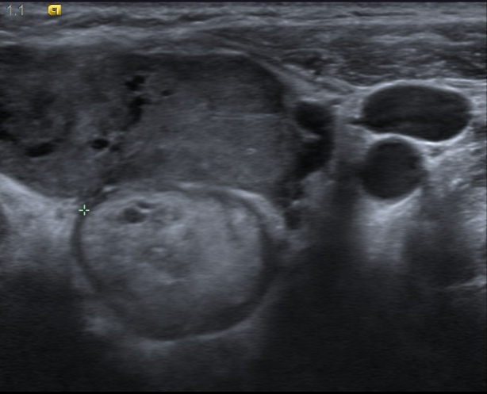
Ultrasound Neck

Slide 6
SOPD Visit
After having reviewed the Ultrasound Findings, the patient was counselled for a Total Thyroidectomy when she is euthyroid.
She was subjected to a routine IDL, which was found to be Normal.
As part of her preoperative assessment, she was subjected to a Chest X-ray.

Slide 7
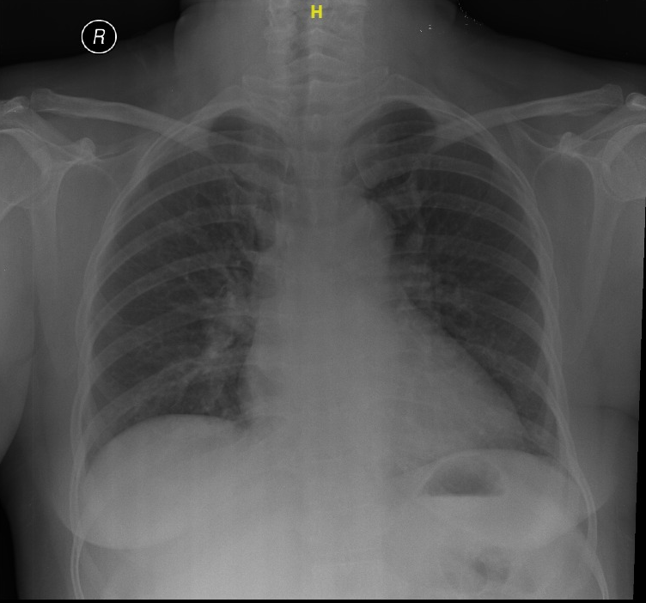
The CXR showed no obvious opacity retrosternally, and as we could get to the lower border of the thyroid, we did not proceed for any further imaging and missed to image the retrosternal component.
After the Surgery, we had requested the radiologist to report the film in view of intraoperative findings.

Slide 8
Surgery
Intraoperatively, she was noted to have an enlarged thyroid, with multinodular goitre 6cm x 4cm with a 1cm x 1 cm x 1 cm mass anteriorly and also at the inferior margin in the left lower lobe of the thyroid gland.
Noted a single superior mediastinal mass, about 5cm x 4 cm x 3 cm, non nodular, with a smooth surface, located posterior and inferior to the thyroid. The mass is suprasternal in it’s entirety and was able to be removed from the neck with Cardiothoracic Surgery Backup.
1 Enlarged ?lymph node posterior to the single mass at the level of T2 excised.
Both recurrent laryngeal nerves identified and confirmed with nerve monitoring.

Slide 9
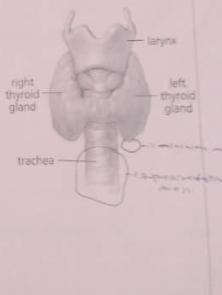
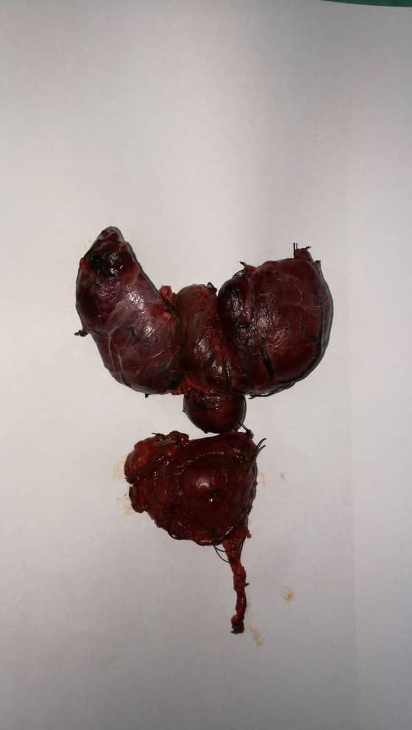

Slide 10
Histopathological Examination
Total Thyroidectomy Specimen
Sections from the right lobe and isthmus shows multifocal (4 foci) of papillary thyroid carcinoma, with the largest tumour diameter of 7mm. Malignant cells are arranged in papillary configuration with some are in compact microfollicles.
Multifocal Papillary Thyroid Carcinoma pT1a pNX (TNM 8TH Edition, 2016)
Mediastinal Mass and Nodule are composed of Thyroid Tissue with features of Nodular Hyperplasia and Degenerative Changes. No features of Malignancy.
Toxic / Hyperfunctioning Nodular Hyperplasia
The ?lymph node excised turned out to be composed of thyroid tissue as well.

Slide 11
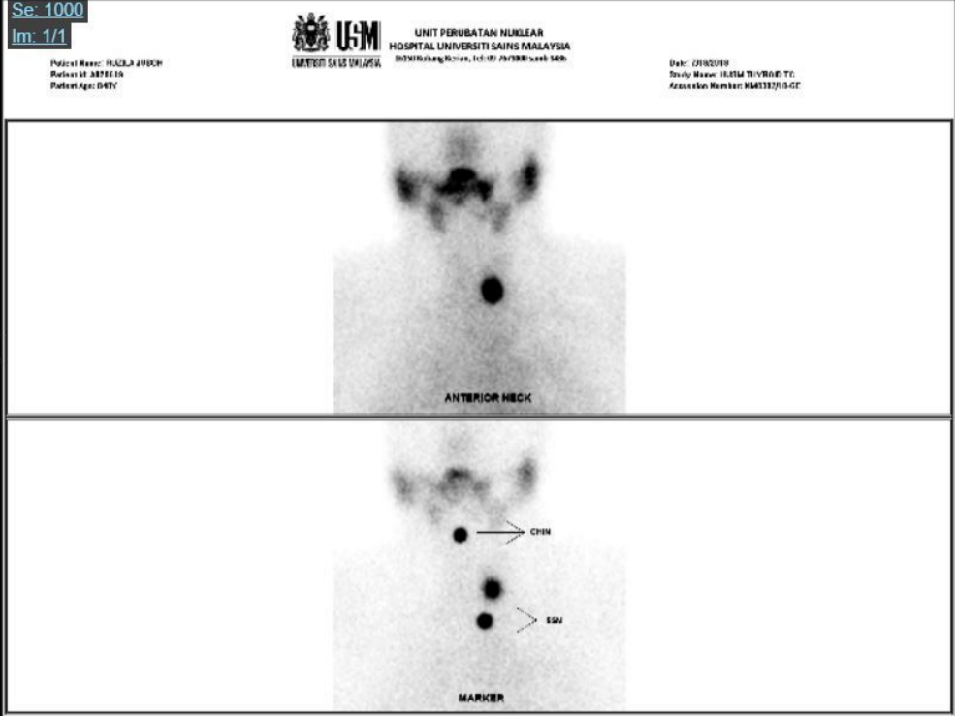
Thyroid Scan
Having reviewed the Histopathological Report, and given the Mediastinal Ectopic Thyroid Mass, it was imperative to identify if there were thyroid tissue elsewhere.
We had subjected her to a TC-99M Pertechnetate Scan
Focal Increased Tracer Uptake is seen in the left lower neck, adjacent to the trachea at C7 Vertebra level with corresponding soft tissue lesion measuring 1.4 cm x 1.2 cm x 1.4 cm.
Scan evidence of remnant of thyroid tissue at left lower neck.

Slide 12
Discussion
What is the patients prognosis?
What are her risk stratification?
Is there a role for Postoperative RAI Remnant Ablation given her previous toxic status?
Redo Surgery to remove the remnant?

Slide 13
RISK STRATIFICATION
The Malaysian Consensus Guidelines described three groups of risk stratification; 1) Low-Risk 2) Intermediate-Risk 3) High-Risk₅
Based on this stratification, our patient is deemed to be in the low-risk group.
Should we plan for Radioactive Remnant ablation, whereby it is administered for the destruction of residual tissue as the patient has had prior toxic status.
The Malaysian Consensus describes three levels of indication for post-operative RAI 1) No Indication (Low Risk Patients) 2) Definite Indication (High-Risk Patients) 3) Uncertain Indications (Intermediate-Risk Patients)
Our patient falls under the uncertain indication subgroup, due to the extrathyroidal extension, which dictates Selective Use of Radioactive Remnant Ablation
MACIS Score 6.05 with 20-Year Survival Rate of 89%.

Slide 14
Reference
1. Felice MD, Lauro RD, 2004 Thyroid Development and its disorders: Genetic and molecular mechanisms. Endocrine Reviews 25: 722-7460.
2. J. Rosai, L. V. Ackerman, and J. Rosai, Rosai and Ackerman’s SurgicalPathology,Mosby,Edinburgh,Scotland,2011.
3. Yoon JS, Won KC, Cho IH, Lee JT, Lee HW, 2007 Clinical characteristics of ectopic thyroid in Korea. Thyroid 17: 1117-1121.
4. Sakorafas GH, Vlachos A, Tolumis G, Kassaras GA, Anagnostopoulos GK, Gorgogiannis D. Ectopic intrathoracic thyroid: case report. Mt Sinai J Med. 2004;71(2):131–3
5. Malaysian Consensus Guidelines on Screening, Diagnosis, Treatment, and Follow-up of Well-Differentiated Thyroid Cancers - Malaysian Endocrine & Metabolic Society
6. Nori L. Bradley, Sam M. Wiseman. BMC Cancer. Papillary Thyroid Microcarcinoma: The significance of high risk features

