Slide 1
Case Discussion
Karthik Krishnan

Slide 2
Patient Information
Name: S. Naidu
Age : 60
Hx of Left Superficial Parotidectomy for Left Parotid Pleomorphic Adenoma a year ago
HPE: Pleomorphic Adenoma with Squamous and cartilaginous metaplasia
Moderate Build, 70kgs

Slide 3
HOPI
Noted to have an anterior neck swelling since childhood
However not increasing in size
Otherwise non-tender
Asymptomatic

Slide 4
Further History
Housewife
No family history of malignancy
No constitutional symptoms
No dysphagia
No tremors
No palpitations

Slide 5
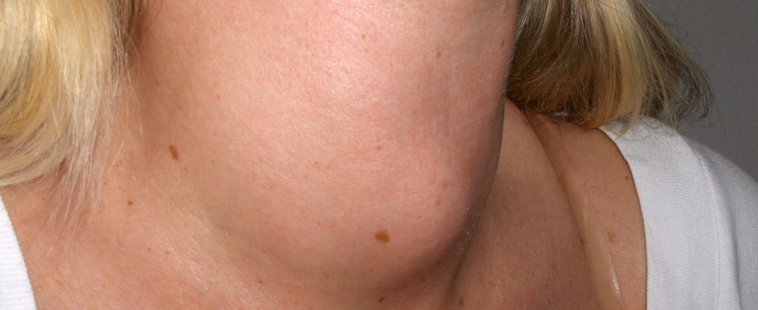
Clinical Examination
Central Neck Swelling
2x2cm
No skin changes
Non-tender
Moves with tongue protrusion
Does not move with deglutition
No lymph nodes palpable
No dilated vein/skin changes

Slide 6
Blood Ix
Unremarkable blood panel
TSH 3.87 / T4 12.59
Proceed for Imaging

Slide 7
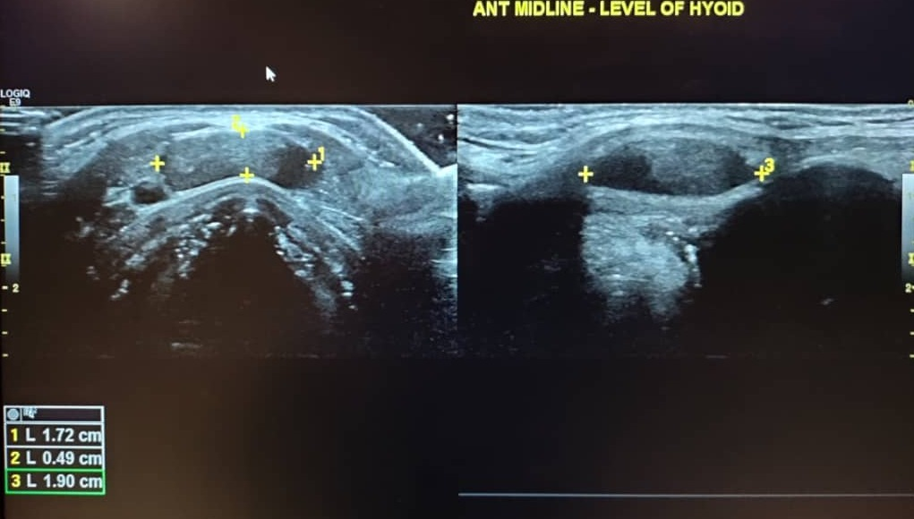
USG Findings
Well-defined cystic lesion seen at the midline of anterior neck at level of hyoid bone
At inferior aspect of lesion, there is hypoechoic content seen.
No intralesional vascularity or calcification seen

Slide 8
Impression
Thyroglossal Cyst
For Sistrunk Procedure

