Slide 1
Journal Presentation
Karthik Krishnan
Critical Appraisal : Dr. Ramanuja Naidu

Slide 2
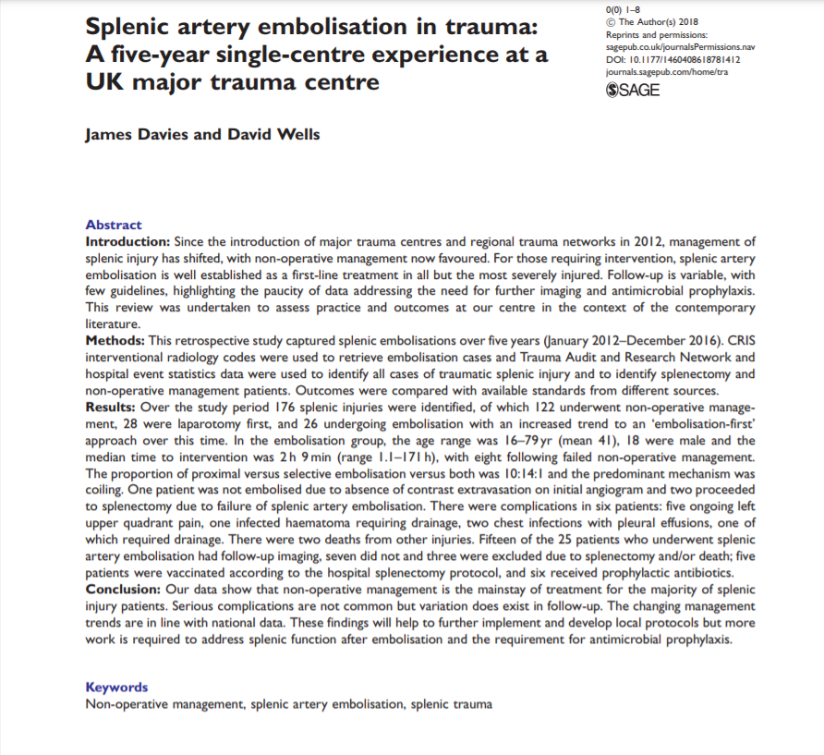

Slide 3
Splenic artery embolization in trauma: A five-year single-centre experience at a UK major trauma centre
TITLE
The title is clear & straight to the point. It depicts the experience from a major trauma centre for 5 years.
Perhaps some details such as retrospective data-analysis, or observational study could be mentioned in the title.

Slide 4
Credibility of Journal & Timing of Publication
The paper is published in Sage publishing.
Sage Publishing began publishing in 1965.
Q1 Journal for Medicine
SJR 2020 Impact Factor 3.02
The paper was published in 2018
Study period was between January 2012-December 2016
The author is an Interventional Radiologist from the Royal Stoke University Hospital, UK

Slide 5
Does the paper address a clinically relevant issue?
Motor vehicle accidents are a frequent occurrence in Malaysia, where in 2020 alone there were 418,240 accidents. Of this 4,634 involved fatalities. The MOH published the registry finding of the first year performance of Trauma Surgery service in HSAJB from May 2011 – April 2012.
In that 1 year, they documented 57 cases of spleen injury, with 25 (40.98%) of cases that were treated non-operatively.
Since a sizeable amount of patients were treated non-operatively, this paper addresses a clinically relevant issue.

Slide 6
Does the abstract give sufficient background to support this, and is a clear measurable objective stated?
The abstract contents are clear.
The structure is appropriate:-
The background describes the relevance of the study. In their centre, embolization is established as first-line treatment in most cases.
The Methods explains the retrospective nature of study between a 5 year time span with radiological codes used to retrieve and capture embolization cases.
The findings of the study is well elaborated.
The conclusion of the study is summarised and backed with national data. A fair recommendation is also suggested.

Slide 7
Primary & Secondary Outcomes
Primary Objective: To assess splenic artery embolization (SAE) in their centre over the last 5 years since designated as a level 1 major trauma centre.
Secondary Objective: Recognition of the trend in non-operative management of the haemodynamically stable patient, with Splenic artery embolization used to treat haemorrhage endovasculary.

Slide 8
Is the methodology appropriate? Comment on study population, study design, statistical analysis
The study is a retrospective review of all splenic injury patients admitted for a 5 year period from 1 January 2012 to 31 December 2016. Data was captured from multiple sources to ensure full data capture. (Trauma Audit Database, Healthcare Software solution, Radiology Information System)
Patients undergoing SAE for reasons other than trauma were excluded. Electronic hospital records were reviewed to include details from clinical follow up.
Information was collated and analysed using Microsoft Excel. Data was compared with Society of Interventional Radiology 2010 standards and Eastern Association for the Surgery of Trauma 2012 guidelines.

Slide 9
Results
Total of 176 splenic injuries, 28 (15.9%) proceeded directly to laparotomy. 15 underwent splenectomy, 2 significantly injured spleens were salvaged, and 11 other cases with low grade splenic injuries were retained.
A total of 130 (73.9%) were managed non-operatively. 122 (93.8%) of those were successful. 8 proceeded to SAE after failure of non-operative management. 18 patients went direct to embolization, so a total of 26 (14.7%) underwent SAE.
25/26 patients were embolised, one, not embolised as no active contrast extravasation.

Slide 10
Results
5 patients proceeded to laparotomy following SAE. 2 required splenectomy. 1 was 18 hour post surgery for recurrent bleeding and the other immediately after due to hemodynamical instability.
In the other 3 cases, laparotomy was done for other concurrent injury (bowel, biliary and mesenteric injury)
In 2012, all patients who required intervention went for laparotomy, in 2016, only 1 patient went directly to surgery and 9 had an embolization-first approach

Slide 11
Complications
22 patients were analysed for complications (2 deaths from TBI, 1 after spelenectomy with multiple co-existing injuries excluded)
One needed drainage for infected splenic collection
One needed pleural drain for effusion
5 had ongoing left upper quadrant pain
2 patients had pneumonia with pleural effusion.

Slide 12
Antibiotics / Vaccinations
Majority were not vaccinated or given antibiotics as no hospital guideline for embolised patients.
6 patients received long-term antibiotics according to their post-splenectomy protocol.
5 SAE patients received protocol vaccinations.

Slide 13
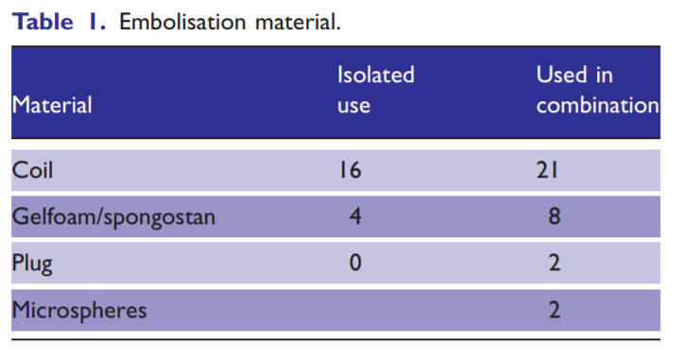
Embolization Material

Slide 14
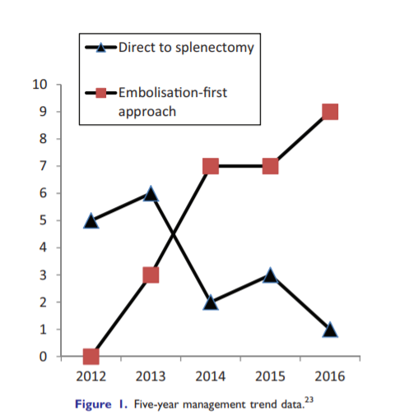
Management Trend

Slide 15
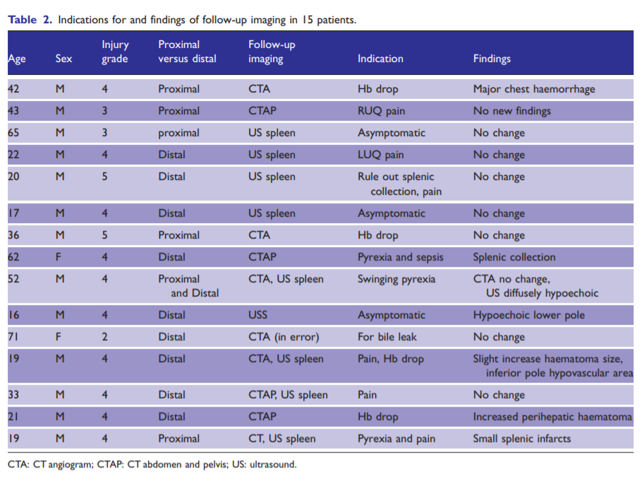
Re-imaging

Slide 16
Conclusion
SAE is a viable primary treatment modality for an injured spleen with acceptable complication rates.
Appropriate use of antimicrobial prophylaxis and whether proximal or distal embolization is superior requires more data to conclusively determine.
Important for trauma providers to recognise the role of IR in own institution in order to provide timely care for the critically injured patient.

Slide 17
Is the conclusion in keeping with the results?
Yes the conclusion corresponds with the stated results.

Slide 18
Further information to obtain?
Level of experience of the IR personnel performing the SAE.
Objective parameters that were used to decide If a patient should be NOM or SAE.
Since haemodynamic instability is the indication for SAE, as well as Laparatomy, how is the distinction made?

Slide 19
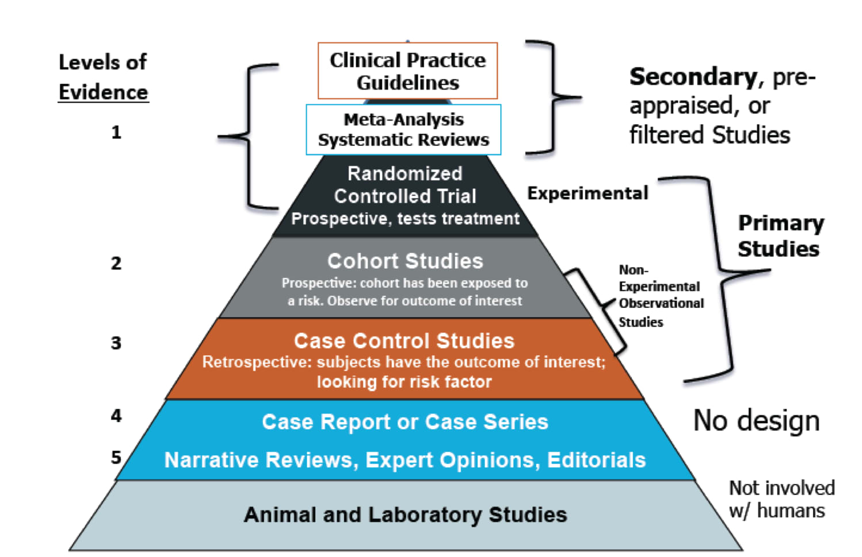

Slide 20
Would this paper change your practice?
Not at this time.
IR services are not available around the clock and trauma presentations are unpredictable in nature.
Whilst in the ideal situation the SAE can be done and a major undertaking such as laparotomy can be avoided, unfortunately in our local setting this may not be possible.
Furthermore, the SAE itself requires expensive reagents as well as a well trained skilful IR Personnel who is experienced in trauma work.

Slide 21
How would you design a better study, if money & resources were no object?
If I was to design this study, I would do a Multi-centre Prospective randomized trial.
Patient failing NOM will be randomized into SAE and Laparatomy group. Naturally those who need immediate surgical intervention will be excluded from the study.
I will standardize the embolization reagent as well as site of embolization to prevent data outliers.
I would also standardize the antibiotics and or vaccination based on available local guidelines.

Slide 22
Thank you

