Slide 1
Screening and Surveillance of Colorectal Cancer
Clinical Practice Guidelines
Academy of Medicine Malaysia
2017
Notes:
Second most common Cancer in Malaysia (13.2% - MNatCancerRegistry 2007-2011. Higher among male than female 1.33x Incidence highest in Chinese, followed by Malay and Indian. Overall mortality is 9.8 cases per 100,000 population 1.42x higher in male than female.
Most common presentation is altered bowel habit 41.7%, blood in stool 35.5%, abdominal pain 31.5%, weight loss 31%, anaemia 9.8% and I/O 9.3%
Left sided most common 81.8%. Majority Stage III and IV 54.36%, and only 8.4% stage I (TNM)

Slide 2
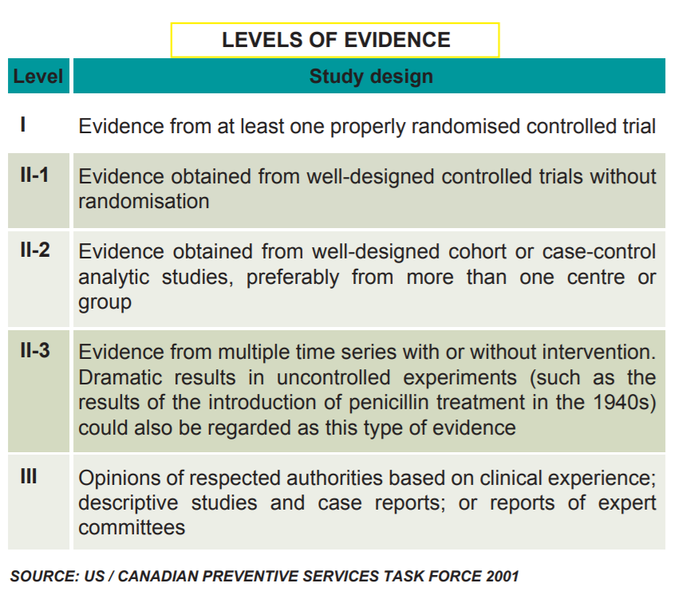
Level of Evidence

Slide 3
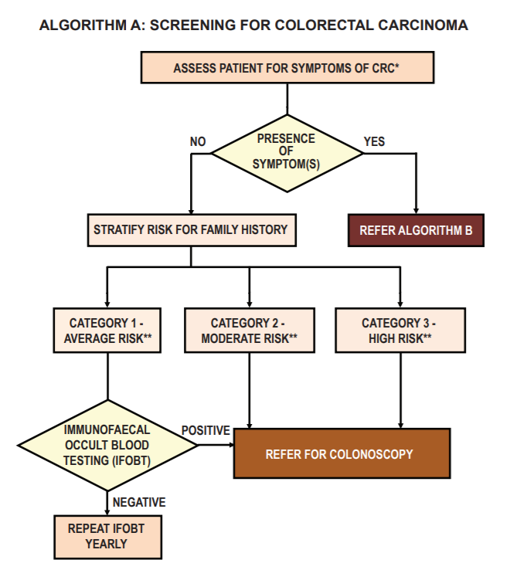

Slide 4
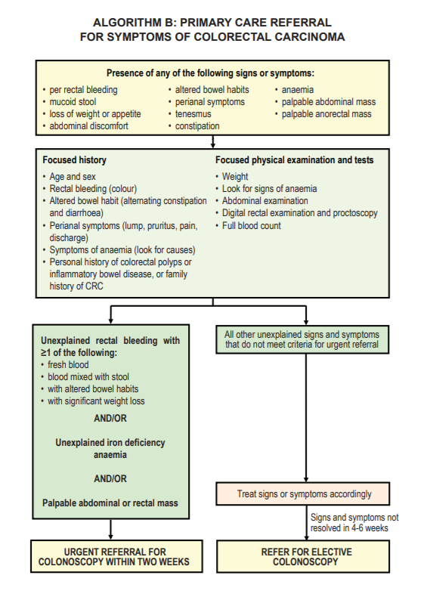

Slide 5
Screening Modalities
Faecal Tests
- FOBT – Sensitivity to detect CRC 74% for quantitative test methods and 79% for qualitative test methods. _{(Level} _{III)}
- IFOBT/gFOBT – Sensitivity 0.67 & 0.54_{(Level I)}
– Specificity 0.85 & 0.80 _{(Level I)}
- Faecal M2-PK – Sensitivity 79% _{(Level I)}
– Specificity 80% _{(Level I)}
- Faecal DNA Test – Sensitivity 92% _{(Level III)}
IFOBT can detect pre-cancerous lesions and CRC in early stages, thus reduce mortality by 23-60% _{(LevelII-2)}
Notes:
Most CRC arise from Adenomatous Polyps that progress from small to large polyps and later to cancer.
Slow transition permits window of opportunity for screening and early detection.
Faecal Test – Non-Invasive Tool
Detect Blood, Proteins (e.g Enzyme M2-PK and DNA) Immunochemica FOBT / Guaiac-based FOBT
DNA and M2-PK rarely done in view of high cost incurred.
Chemical testing: For chemical testing, a solution containing the chemical guaiac and an oxidizing chemical is used. If blood is present in the sample of stool, the mixing of the solution with blood causes the guaiac to turn visibly blue. The blue color is caused by the interaction (promoted by the oxidizing agent) of the heme portion of the hemoglobin molecule, the oxygen carrying molecule in red blood cells, and the guaiac.
Immunologic testing: For immunologic testing, a sample of stool is mixed with a solution that contains an antibody to globin, the protein part of the hemoglobin molecule. The antibody is combined with a small amount of gold. When the antibody/gold complex binds to the globin in stool, the antibody/gold/globin complex settles out of the solution as a visible line on the test strip.

Slide 6
Screening Modalities
Sigmoidoscopy
Flexible Sigmoidoscopy reduces the CRC incidence by 18-32% and mortality by 26-38% in general population with low incidence of bowel perforations associated with it. _{(Level} _{I)}
Can be performed with less rigorous bowel preperation and as clinic-based procedure without sedation. Small polyps biopsies are possible but excision of larger lesions requires subsequent colonoscopy
Notes:
Flexible Sigmoidoscopy can be done as clinic procedure without sedation and less rigorous bowel preperation. Small polyps can be biopsied however lesions >1cm will require excision during subsequent colonoscopy

Slide 7
Screening Modality
Colonoscopy
Ability to Visualise the colonic mucosa directly, perform Biopsy and excise Polyps. Can detect proximal lesions missed by sigmoidoscopy and reduces risk of right colon cancer. _{(Level} _{II-2)}
Screening Colonoscopy reduces CRC incidence by 56% and Death by 68% _{(Level} _{II-2)}. Those screened have CRC risk reduced by 91% up to 10 years. _{(Level II-2)}
Safe modality, low incidence of bleeding and perforation._{(Level II-2)}
Notes:
GI Bleed (0.29 to 1.59 per 1000 scopes)
GI Perforation (0.19 to 0.89 per 1000 scopes)

Slide 8
Screening Modality
Colon Capsule Endoscopy (CCE)
Ingest a Camera Embedded Capsule. Less invasive, however unable to perform biopsy or polyp removal.
Sensitivity of 71% and specificity of 75% for polyps of any size. Safe modality with low rate (4.1%) of mild to moderate side effect. _{(Level} _{II-2)}
Notes:
CCE- Obtain images of the colon by using video cameras embedded in ingested capsule. Less invasive however does not allow biopsy or polyp removal.
Side effects – Nausea and Abdominal pain.

Slide 9
Screening Modality
Computed Tomographic Colongraphy / Virtual Colonoscopy
Detection of Adenomas ≥6mm
* Sensitivity 82.9% Specificity 91.4%
Detection of Adenomas ≥10mm
* Sensitivity 87.9% Specificity 97.6% _{(Level II-2)}
Flat adenomas are more likely to be missed by CTC _{(Level} _{II-2)}
Notes:
Multiple Thin Slice computed tomographic data to construct images of the bowel mucosa in 2-3 dimensions in detecting polyps.
Requires bowel preperation similar to colonoscope.
Air or CO2 introduced into rectum via catheter. No sedation required. Patient is able to return to work post procedure.
Drawback include Radiation exposure and need for colonoscopy after identification of polyps for excision and tissue diagnosis whilst smaller lesions will require follow up suerveillance CTC

Slide 10
Screening Modality
Carcinoembryonic Antigen (CEA)
Glycoprotein present in normal mucosal cells and elevated amount associated with adenocarcinoma.
No recommendation by US Preventive Services Task Force, Nice Guidelines and SIGN Guidelines on use of Serum CEA test for CRC Screening _{(Level} _{III)}
Should not be relied as a screening tool as normal level of CEA does not indicate absence of CRC, however has a role as tumour marker.

Slide 11
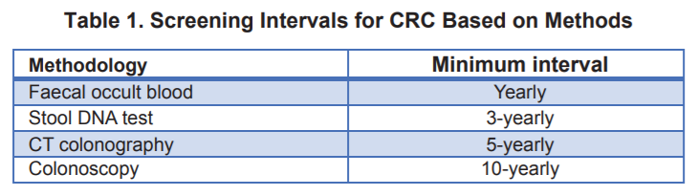
Average Risk Population
Screening of CRC To Start at Age 50 up to age 75. Beyond that, screening should be individualised taking into account patient’s overall health and prior screening history. _{(Level III)}
Level II-2;III
Notes:
Average Risk Population – No known risk for CRC. No retrievable evidence on the age to start CRC Screening for ARP.
Screening Interval : Level III - > European Colorectal Cancer Screening Guidelines Working Group
II-2 -> U.S. Preventive Services Task Force

Slide 12
Moderate / High Risk Group
1. Family History
Affected by first, second or third degree relatives and might include positive family history from both parents.
2. Post Adenomatous Polypectomy
For patients who underwent screening and had an excision of adenoma

Slide 13
Moderate / High Risk Group
3. Hereditary Colorectal Cancer Syndrome
- Genetic Susceptibility Syndromes HNPCC, FAP, MAP, Juvenile Polyposis and Peutz- Jegher Syndrome
4. Inflammatory Bowel Disease - Ulcerative Colitis and Crohn’s Disease.
5. Other Risk Factors
- Smoking, DM, Obesity, Alcohol Consumption, Red Meat Consumption.
Notes:
Hereditary Nonpolyposis Colorectal Cancer ( Lynch)
Familial Adenomatous Polyposis
MYH Associated Polyposis
PJS – Autosomal Dominant Inherited Disorder Characterized by Intestinal Hamartomatous Polyps in Association with a distinct pattern of skin and mucosal macular melanin deposition.

Slide 14
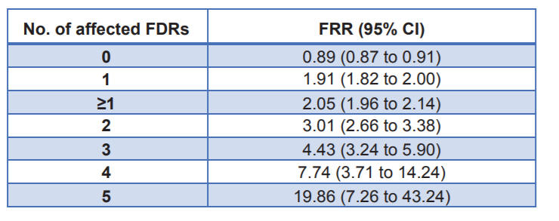
Family History
Familial Relative Risk (FRR) of developing CRC Increases with greater number of First-Degree Relatives (FDR) irrespective of second-degree and third degree relatives. _{(Level} _{III)}

Slide 15
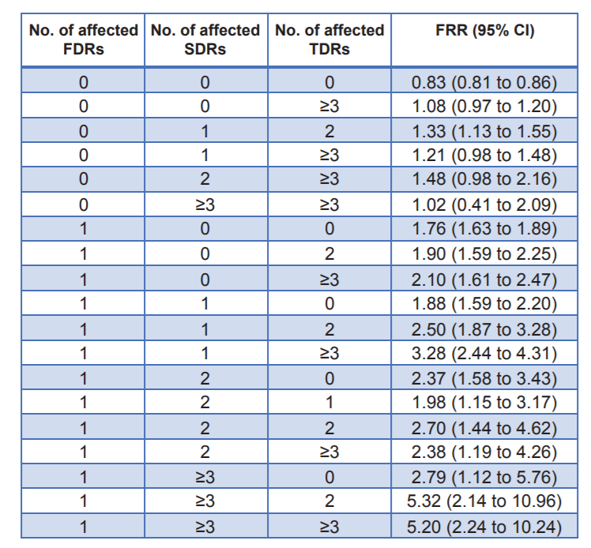
_{Level} _{III}
Notes:
This table shows that the Familial Relative Risk is higher when only a single first degree relative has CRC regardless of the number of Second Degree and Third Degree Relatives. However, with a FDR involved, the risk increases when SDR and TDR are also involved.

Slide 16
Adenomatous Polyps
Removal of Adenomas is an effective tool in reducing CRC incidence and mortality _{(Level} _{III)}
Advanced adenomas are defined as >10mm, villous components (villous/tubulo-villous) or with high-grade/severe dysplasia
Surveillance colonoscopy can be scheduled every 10 years for low risk and 3 years for high risk after initial clearing as 10% of low risk patient develop advanced metachronous adenomas after 10 years and 10% of high risk patients develop it after 3 years _{(Level} _{II-2)}
Notes:
Risk of recurrent advanced adenoma during surveillance colonoscopy following polypectomy is 2-3 times significantly higher among those with advanced adenoma compared with low risk group (Level I)

Slide 17
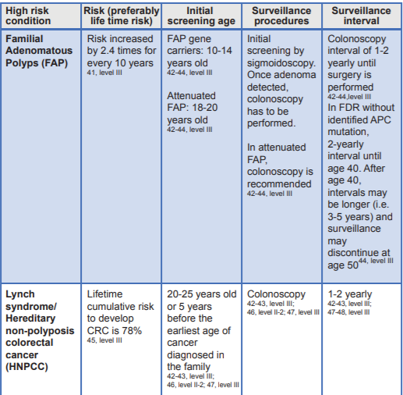
Hereditary Colorectal Cancer Syndromes

Slide 18
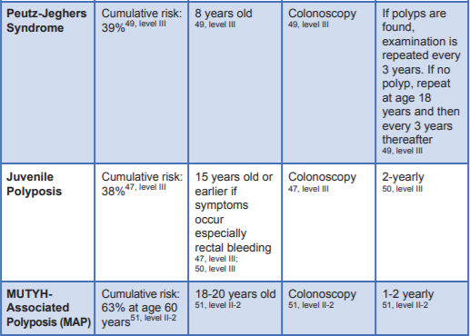

Slide 19
Inflammatory Bowel Disease
Risk of CRC IN UC was found to be 2% at 10 years, 8% at 20 years, and 18% at 30 years, irrespective of disease extent _{(Level} _{II-2).} Surveillance scope is performed annually in UC patients seven to eight years after onset _{(Level} _{II-2)}
Risk of CRC in Crohn’s disease is similar to UC. Therefore the surveillance programme is similar to those with UC _{(Level} _{II-2)}

Slide 20
Miscellaneous Risk Factors
Smoking – 16% greater risk compared to those who had never smoked. Even higher if duration of smoking > 25 years _{(Level} _{II-2)}
DM – Increased Risk of CRC _{(Level} _{II-2)}
BMI – Significant positive association between overweight or obese and CRC among males _{(Level} _{II-2)}
Alcohol Consumption >30g/day positively associated with risk for CRC _{(Level} _{II-2)}
Meat Consumption – Increased intake of 100g/day red meat and 25 g/day of processed meat were risk factors of CRC _{(Level II-2)} Further evidence needed to establish advice on safe meat consumption per week.

Slide 21
Genetic Counselling and Testing
All individuals whose family history is suggestive of hereditary CRC syndrome should be referred to a clinical genetics service for counselling, risk assessment and consideration of genetic testing.
Targeting genetic services for patients with a strong family history of cancer rather than screening the entire population is cost-effective.

Slide 22
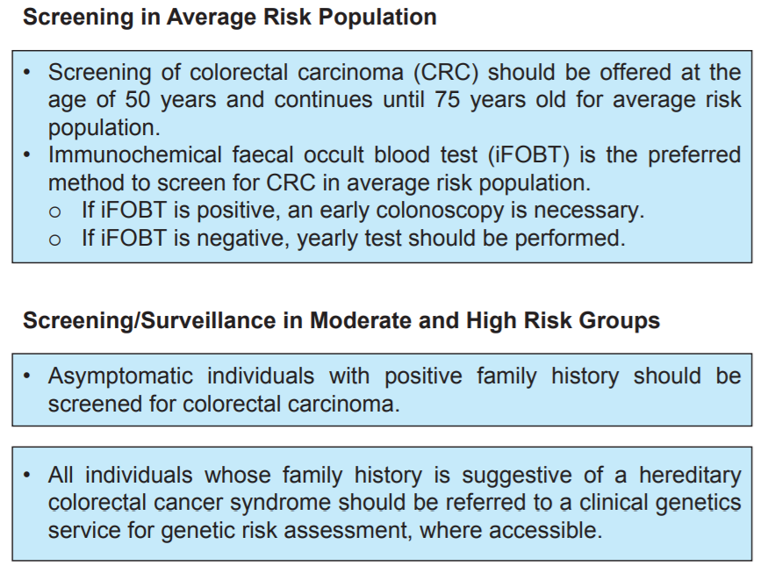
Take Home Message

Slide 23
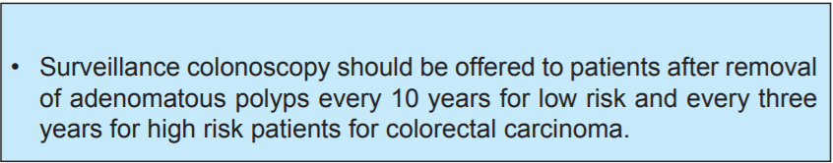
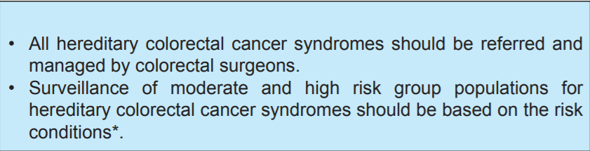
Take Home Message

