Slide 1
Journal Presentation
Karthik Krishnan
Critical Appraisal : Dr. Viknesh

Slide 2
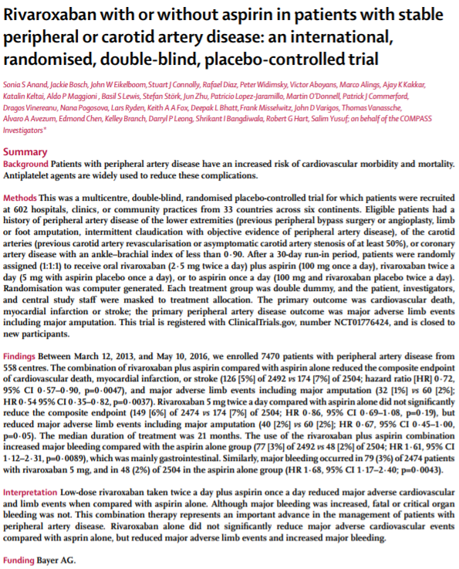

Slide 3
Rivaroxaban with or without aspirin in patients with stable peripheral or carotid artery disease: an international, randomised, double-blind, placebo-controlled trial
TITLE
The title is clear and catchy, however it isn’t concise. It ostensibly is a international multicentre prospective, double blind RCT.
Perhaps the duration the study was conducted could be added to the title.

Slide 4
Credibility of Journal & Timing of Publication
The paper is published in the Lancet.
The Lancet began publishing in 1823.
Q1 Journal for Medicine.
SJR Impact Factor 13 (2020)
The paper was published on November 10, 2017
Study Period between March 12, 2013 to May 10, 2016
The study involves investigators from the COMPASS Trial (Cardiovascular Outcomes for People Using Anticoagulation Strategies)

Slide 5
Does the paper address a clinically relevant issue?
The paper addresses a clinically relevant issue.
Patients with carotid artery disease or PAD of lower extremities are at high risk for major ACE.
Patients with PAD of lower extremities are also at high risk for major adverse limb events such as Severe Limb Ischaemia and Amputation.
As anticoagulant therapies have not been shown to be superior to antiplatelet theraphy, they also have an unacceptably high rate of major bleeding.

Slide 6
Does the abstract give sufficient background to support this, and is a clear measurable objective stated?
The abstract contents are clear.
The structure is appropriate:-
The background describes the relevance of the study.
The Methods explains the study deisgn, the eligibility of recruits, the randomization details, as well as outcomes.
The findings of the study is well elaborated.
The conclusion of the study is summarise
The funding provided is declared.

Slide 7
Primary & Secondary Outcomes
Primary Outcome – Cardiovascular Death, myocardial infarction, Stroke
Primary PAD outcome – Major adverse limb events including major amputations.
Secondary Outcome
  Coronary heart disease death
  Chronic Limb Ischaemia

Slide 8
Is the methodology appropriate? Comment on study population, study design, statistical analysis
The study design has used the previously published COMPASS study design, multicentre, double-blind, randomised, placebo-controlled trial.
The study compared low-dose rivaroxaban with aspirin or rivaroxaban alone (with aspirin placebo) vs aspirin alone (with rivaroxaban placebo) for prevention of CV death, MI, and stroke in patients with CAD or PAD.
Clear inclusion and exclusion criterion are elucidated. The protocol was approved by health authorities and institutional review boards of all participating countries (33 countries, 602 places of practice)
Randomization 1:1:1 ratio performed using computer-generated randomization. Each treatment group was double dummy.

Slide 9
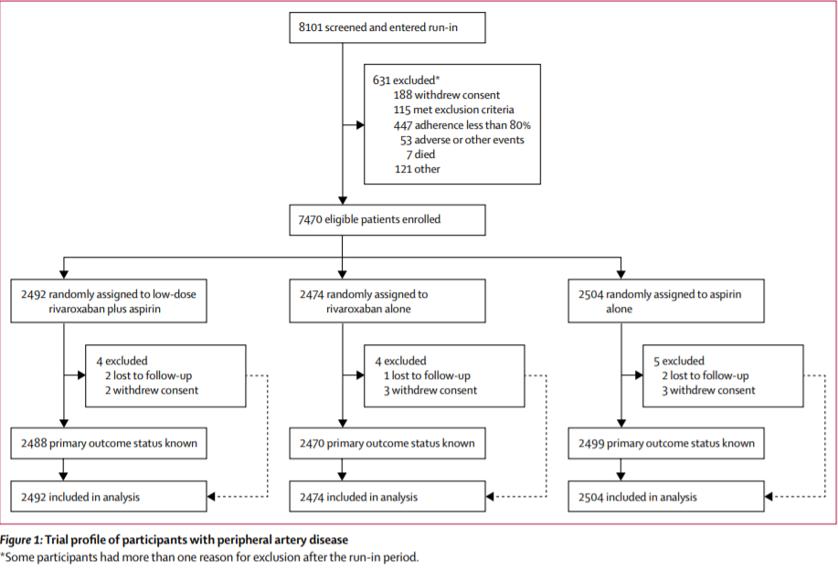

Slide 10
Eligibility of Patients
Inclusion -> Peripheral artery disease with
  Aorto-femoral bypass, limb bypass, percutaneous transluminal angioplasty revascularisation of the iliac or infrainguinal arteries
  Limb or foot amputation for Arterial vascular disease
  Intermittent claudication and ABSI <0.9, or periphery artery stenosis >50%
  Carotid disease
  CAROTID REVASCULARISATION
  ASYMPTOMATIC CAROTID ARTERY STENOSIS OF AT LEAST 50%

Slide 11
Eligibility of patients
Exclusion -> Patients with a need for dual antiplatelet therapy, other non-aspirin antiplatelet therapy, oral anticoagulant therapy, strong inhibitors of CYP 3A4, or on medication with known interactions with rivaroxaban.
Patients with high risk of bleeding, stroke within 1/12, history of haemorrhagic or lacunar stroke, severe heart failure with EF <30% OR eGFR <15 ml/min.

Slide 12
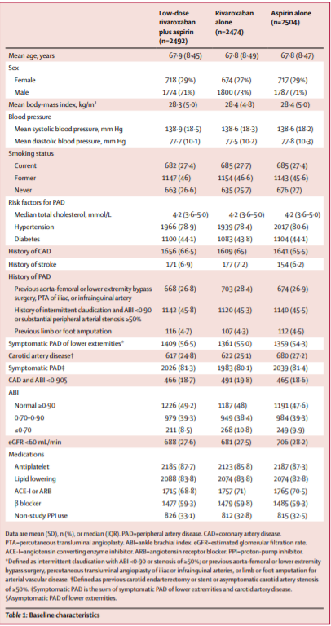

Slide 13
Results
A total of 7,470 patients with peripheral artery disease from 558 centres were enrolled.
2492 randomly assigned to low-dose rivaroxaban plus aspirin.
2474 randomly assigned to rivaroxaban alone.
2504 randomly assigned to aspirin alone.
Whilst each group had 4-5 patients who were excluded due to lost to follow up and withdrawal of consent, they were included in statistical analysis

Slide 14
Outcomes
The primary outcome of cardiovascular death, myocardial infarction or stroke occurred in :
126 (55) of 2492 patients who received Rivaroxaban and aspirin
174 (7%) of 2504 patients who received aspirin alone
149 (6%) of 2474 patients who received Rivaroxaban alone
Low dose rivaroxaban plus aspirin was superior to aspirin alone (hazard ratio [HR] 0.72, 95% CI 0.57-0.90, p=0.0047)
Rivaroxaban alone agroup not significantly superior to aspirin alone group (HR 0.86, 95% ci 0.69-1.08, p=0.19)

Slide 15
Outcomes
Major adverse limb events:
30(1%) of 2492 patients – Rivaroxaban + Aspirin
56(2%) of 2504 patients – Aspirin Alone
35(1%) of 2474 patients – Rivaroxaban Alone
There were significantly lower ALE in the low-dose rivaroxaban plus aspirin group compared with the aspirin alone group (HR 0.54,95% CI 0.35-0.84, p=0.0054)
Similarly major ALE was significantly lower in the rivaroxaban group vs the aspirin group (HR 0.63, 95% CI 0.41-0.96, p=0.032)

Slide 16
Outcomes
Major bleeding occurrence
77(3%) of 2492 - Rivaroxaban + Aspirin
79(3%) of 2474 - Rivaroxaban
48(2%) of 2504 – Aspirin
There was a relative increase in major bleeding in the low-dose rivaroxaban plus aspirin group compared with the aspirin alone group
(HR 1.61, 95%, CI 1.12-2.31, p=0.0089)
There is a relative increase in major bleeding in the rivaroxaban alone group vs aspirin alone (HR 1.68, 95% CI 1.17-2.40 p=0.0043)

Slide 17
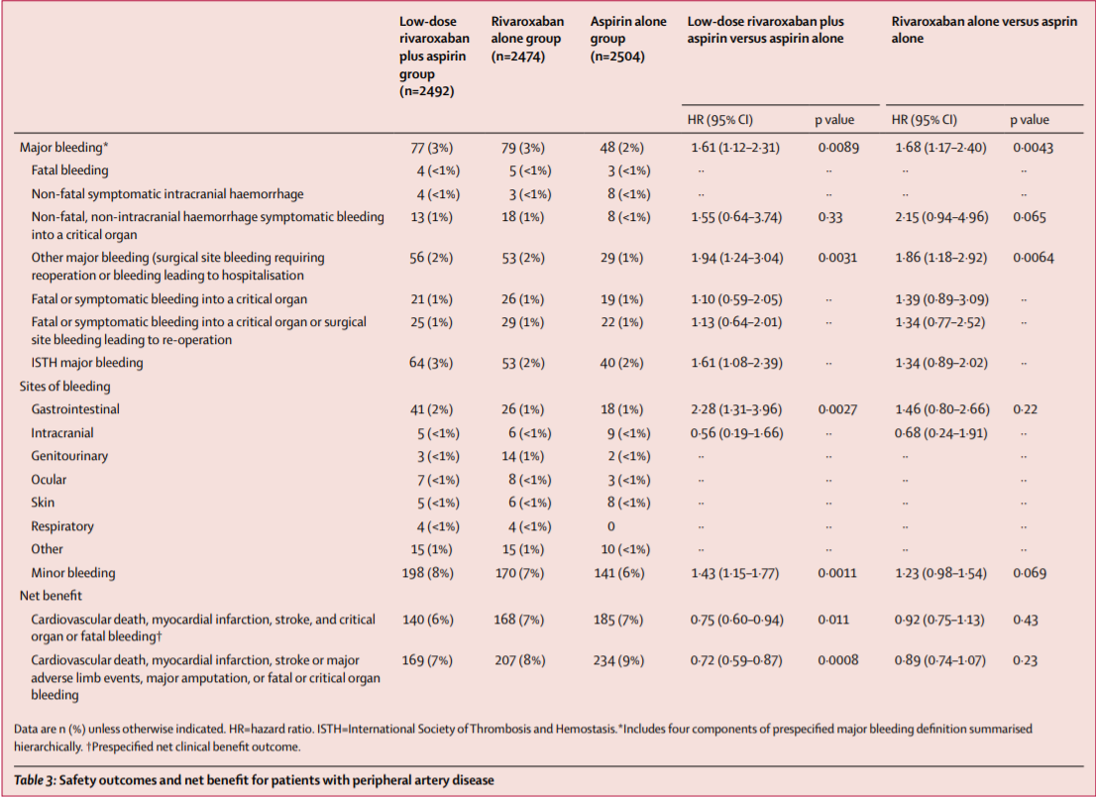

Slide 18
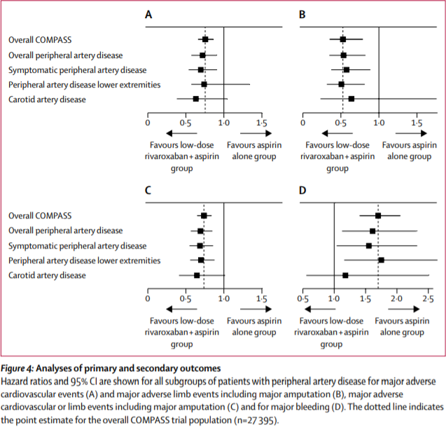

Slide 19
Conclusion
Utilizing rivaroxaban in addition to aspirin had fewer major cardiovascular events by 28% and major adverse limb events by 46%. Although this combination was associated with an increase in risk of major bleeding, there were no excess in fatal or critical organ bleeds and the benefit risk analysis indicates a net benefit.
Rivaroxaban 5mg bd when compared with aspirin alone did not significantly decrease major adverse cardiovascular events but decreased limb events and increased major bleeding.

Slide 20
Is the conclusion in keeping with the results?
Yes, conclusion corresponds with the stated results.

Slide 21
Further information to obtain?
Why the use of PPI was not standardized in all cases? (Only patients who were already on PPI’s were continued on this treatment) As the main source of major bleeding was noted to be gastrointestinal.
Would the results have been skewed if PPI’s were across the board? Did patients with PPI have a significant difference in the rate of gastrointestinal bleeding?
Why were patients that received dual antiplatelet excluded from this study, instead of just placing them in a 4th arm?

Slide 22
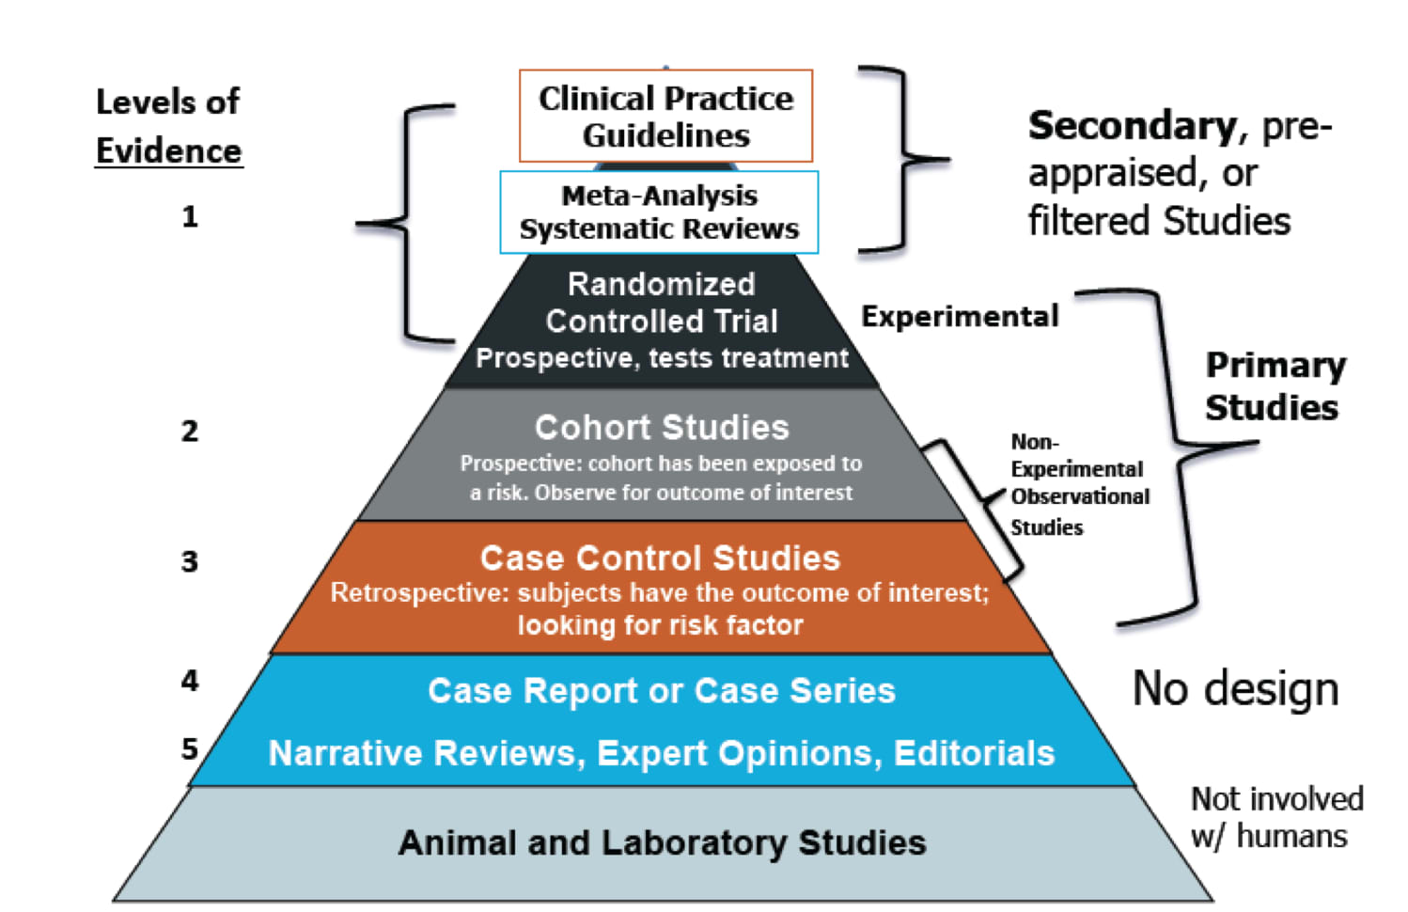
Level of Evidence provided by Study

Slide 23
Would this paper change your practice?
Not at this time.
NOAC’s are still relatively new and still expensive. Furthermore, the only approved reversal for Rivaroxaban andexanet alfa is not widely available in the event of a major bleeding event.
Furthermore, this paper has a lot of bias as many of the authors have received honoraria from Bayer and Novartis.

Slide 24
How would you design a better study, if money & resources were no object?
If I was to design this study, I would divide it between PAD and Carotid disease. Currently the study aims to consider both these diseases which makes the sample far too broad.
I would consider including other forms of NOAC such as Dabigatran into the arm as well.
Finally would consider a comparison against the double anti-platelet arm to see the risk of major adverse bleeding as well as the other outcomes measured.

Slide 25
Thank you

