Slide 1
Journal Presentation
Karthik Krishnan
Critical Appraisal : Dr. Yasine

Slide 2
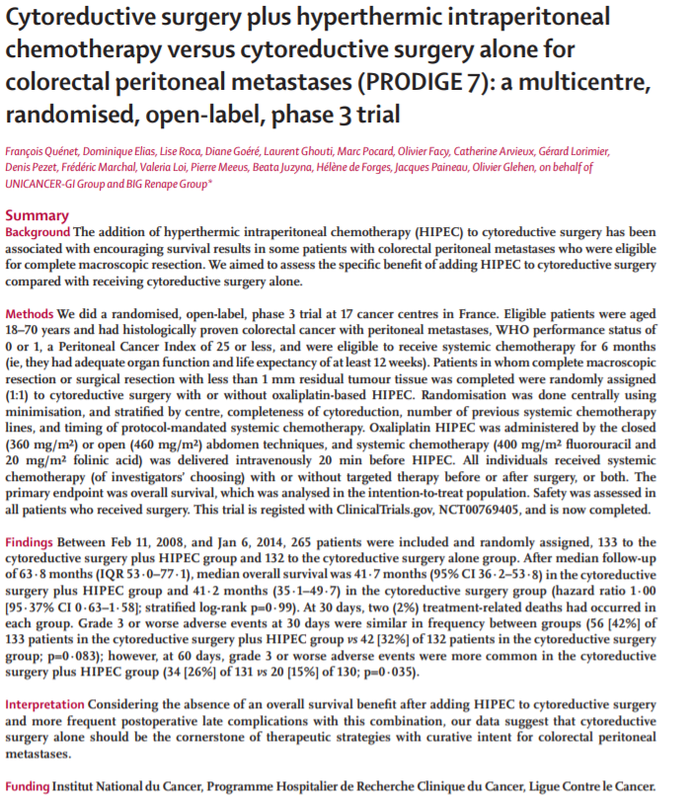

Slide 3
Cytoreductive surgery plus hyperthermic intraperitoneal chemotherapy versus cytoreductive surgery alone for colorectal peritoneal metastases (PRODIGE 7): a multicentre, randomised, open-label, phase 3 trial
TITLE
The title is clear, and there is a catchy acronym PRODIGE 7 for ease of reference. It’s verbose, but it describes the study in its entirety including the phase of clinical trial.
Perhaps the clinical trial phase could be omitted and instead an inclusion of duration of study.

Slide 4
Credibility of Journal & Timing of Publication
The paper is published in the Lancet Oncology 2021
The Lancet began publishing in 1823.
Q1 Journal for Medicine.
SJR Impact Factor 13 (2020)
The paper was published on January 18,2021
Study Recruitment Period between February 11, 2008 and January 6, 2014.
The study involves investigators from various French hospitals involving the department of oncology and surgery.

Slide 5
Does the paper address a clinically relevant issue?
The paper addresses a clinically relevant issue.
Disease progression in the form of synchronous peritoneal metastases accounts for about 7% of CRC. 4% of these cases have Peritoneal disease being their first and only metastatic localization.
Peritoneal disease are associated with significantly worse prognosis compared with non peritoneal metastases.

Slide 6
Does the abstract give sufficient background to support this, and is a clear measurable objective stated?
The abstract contents are clear.
The structure is appropriate:-
The background describes the relevance of the study.
The Methods explains the study design, the eligibility of recruits, the randomization details, as well as outcomes.
The findings of the study is well elaborated.
The conclusion of the study is summarised.
The funding provided is declared.

Slide 7
Primary & Secondary Outcomes
Primary Outcome – overall survival (point of randomization to death from any cause)
Secondary Outcomes –
* Relapse-free survival (interval between randomisation and first peritoneal/distant relapse or death from any cause)
* Peritoneal-free survival (interval between randomisation and first peritoneal relapse)
* safety and post operative morbidity

Slide 8
Is the methodology appropriate? Comment on study population, study design, statistical analysis
PRODIGE 7 was a randomised, open-label phase 3 trial done at 17 oncologic centres in France. Study population ranged from 18-70 year olds with a histologically confirmed CRC, peritoneal metastases which offered a wide range of heterogenous data.
The trial aimed to evaluate specific role of HIPEC when added to cytoreductive surgery in patients with peritoneal metastases of colorectal origin.
Clear inclusion and exclusion criterion are elucidated. The main exclusion criteria were extraperitoneal metastases, non-colorectal carcinomatosis and those with previous HIPEC treatment and grade 3 or worse peripheral neuropathy.
Randomization 1:1 assigned to receive either HIPEC or no further treatment after complete cytoreductive surgery. Only patients in whom there was R0 resection or less than 1mm of residual tumour tissue were included.

Slide 9
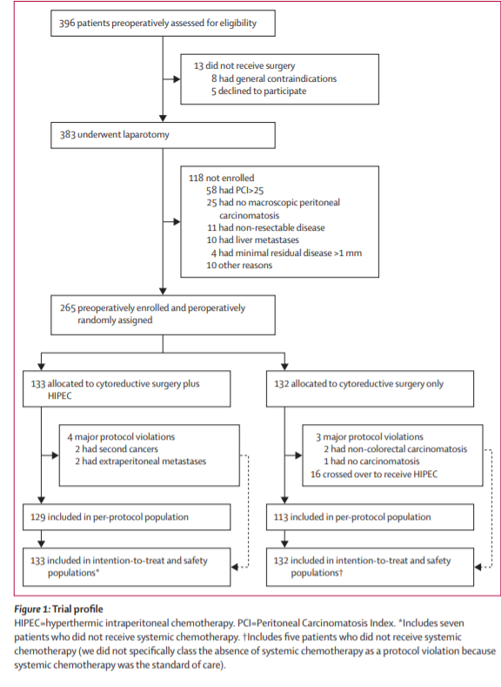

Slide 10
Eligibility of patients
Inclusion – Histologically confirmed CRC with Peritoneal Metastases.
  Peritoneal Cancer Index 25 or less
  WHO Performance Status of 0 or 1
  Adequate Haematological function (ANC >1.5, Platelet >100)
  Adequate Liver function
  Creatinine 1.25x ULN
Exclusion – Previously received HIPEC
  Extraperitoneal metastases
  Non CR carcinoma
  Grade III or worse peripheral neuropathy

Slide 11
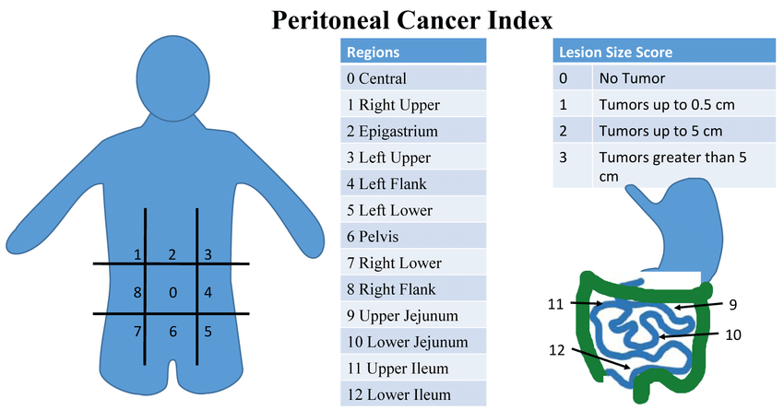
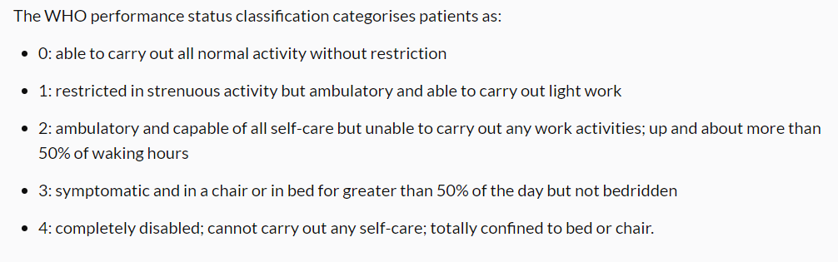

Slide 12
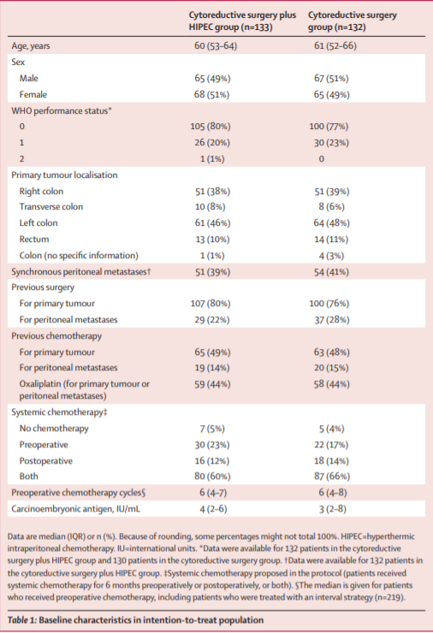

Slide 13
Results
A total 265 patients with colorectal cancer and peritoneal metastases were recruited
133 were randomly assigned to the cytoreductive surgery + HIPEC group
132 were randomly assigned ot the cytoreductive surgery alone group.
110 in the combination group and 109 in the cytoreductive only group were treated with preoperative chemotheraphy.

Slide 14
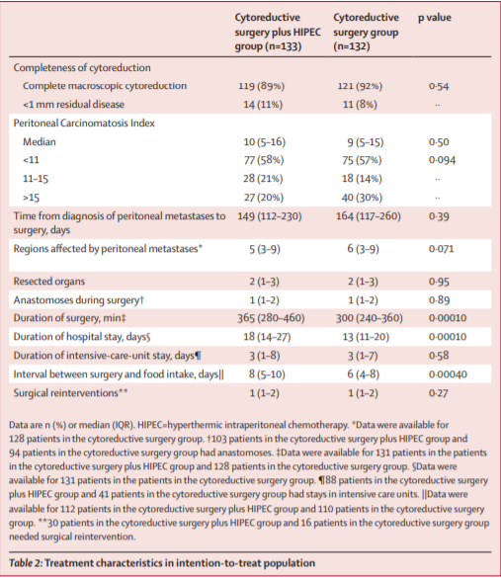

Slide 15
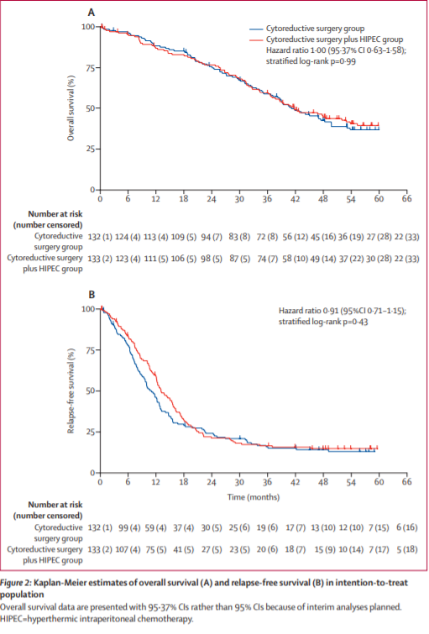

Slide 16
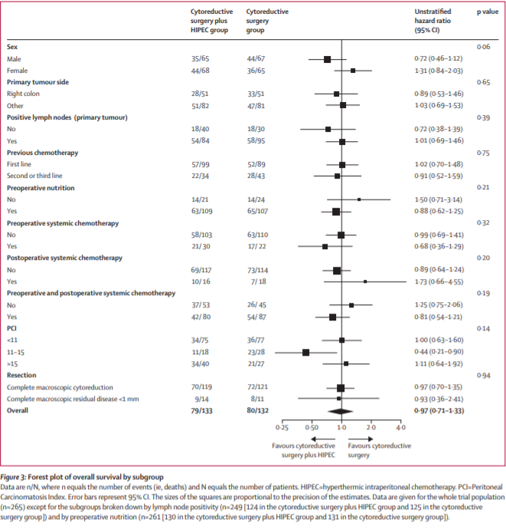

Slide 17
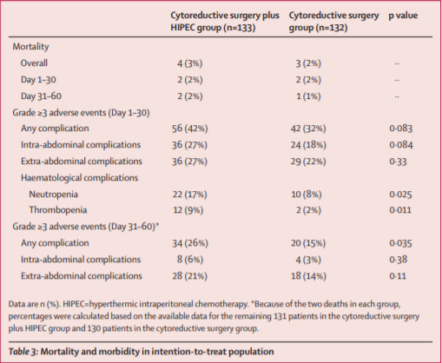

Slide 18
Conclusion
PRODIGE 7 trial showed NO EVIDENCE of an overall survival benefit with cytoreductive surgery plus HIPEC compared with cytopreductive surgery alone.
This study actually included a cytoreductive only group unlike other HIPEC studies.
In cytoreductive group, overall median survival was 41 months. The finding suggests that completeness of cytoreductive resection is the MOST IMPORTANT factor determining survival after surgical treatment of peritoneal metastases.

Slide 19
Is the conclusion in keeping with the results?
Yes, conclusion corresponds with the stated results.

Slide 20
Further information to obtain?
Details regarding the histological subtypes of tumour or specifics of the previous treatments of patients.
Details regarding the systemic chemotheraphy given to the patients with peritoneal metastases with details of the agents used and if they are standardized between the arms.
Details regarding time of diagnosis of peritoneal metastasis to randomization.
With regards to crossover patients (treatment of relapse by cytoreductive surgery + HIPEC), how was the statistical analysis handled?

Slide 21
Would this paper change your practice?
Yes. The paper shows that cytoreductive surgery remains to be the cornerstone of managing peritoneal metastases, with a combination of systemic chemotheraphy.
In patients with oligometastases involving peritoneal metastases, cytoreductive resection should be considered in addition to the chemotheraphy
HIPEC is not widely practiced locally, and this study shows that HIPEC on top of the usual intervention does not improve the survival outcome.

Slide 22
How would you design a better study, if money & resources were no object?
If I was to design this study, I would standardize all the systemic chemotheraphy given for all the patients to reduce confounding factors
If possible, the tumours should be divided based on their histological grading and the outcomes specifically analysed.
The morbidity is only recorded for 30 days post treatment. Would consider documenting morbidity up to 60 days.

Slide 23
Thank you

