Slide 1
Nur Zahrawaani Binti Jaafar
B691078
Date of Admission : 16/01/2019
Date of death : 28/01/2019

Slide 2
Background History
40/M/F – Otherwise Well
First Presentation : 12/11/2018 – 20/11/2018
Presenting Complain
  Intermittent Generalised Abdominal Pain for 8/12 (since April 2018). Initially tolerable, and relieved after BO.
  Altered Bowel Habit – constipation alternated with passing loose stool for 2 moths.
  Poor Appetite and Unintentional Weight Loss of 20 KG in 2 months (85-65KG)
  In May 2018 went to private medical centre for severe abdominal pain – treated as dyspepsia.
Notes:
Father had TB – Treated. During Pt’s Teenage Years
Maternal Aunt – Breast Malignancy

Slide 3
Initial Presentation
Came to Emergency department on 12/11/2018
Complain of epigastric pain for 5 days
  Colicky In Nature
  Radiate to LIF and became generalised
  Vomiting >3 episodes per day. Greenish Vomitus
  Able to BO Daily, soft stool, no blood.
  Otherwise no fever, no diarrhoea

Slide 4
Initial Presentation
O/E BP 103/66 PR 96 T: 37*C PA : Abdomen Soft. Distended. Hyperresonance on percussion. Fullness felt over suprapubic area. PR – Empty Rectum.
Ix | Result
HB | 11.1
WC | 6.8
PLT | 367
Urea | 8.7
Creat | 82
Na | 130
K+ | 3.8
Amylase | 22
VBG | Result
pH | 7.449
pC02 | 41.7
pO2 | 19.5
HC03 | 26.8
Lactate | 1.1

Slide 5
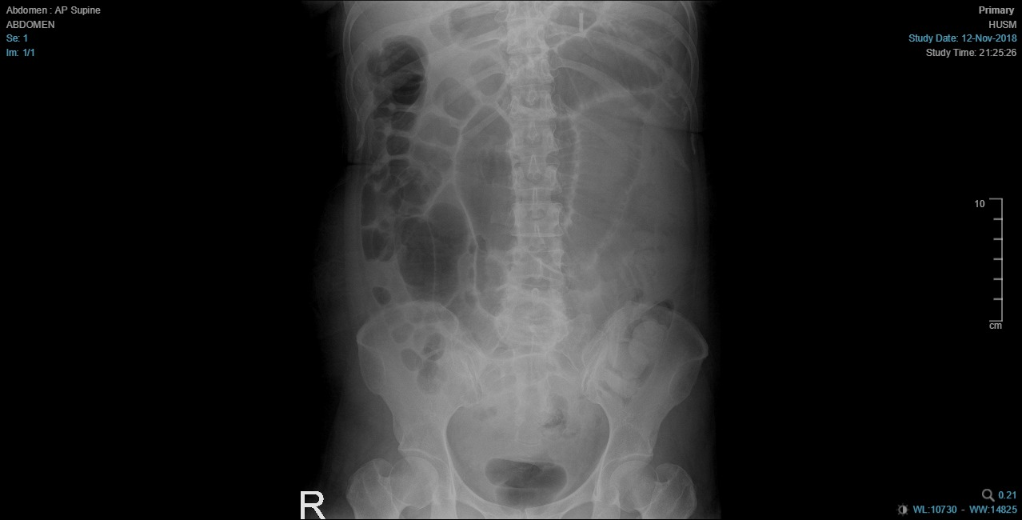
Initial Presentation

Slide 6
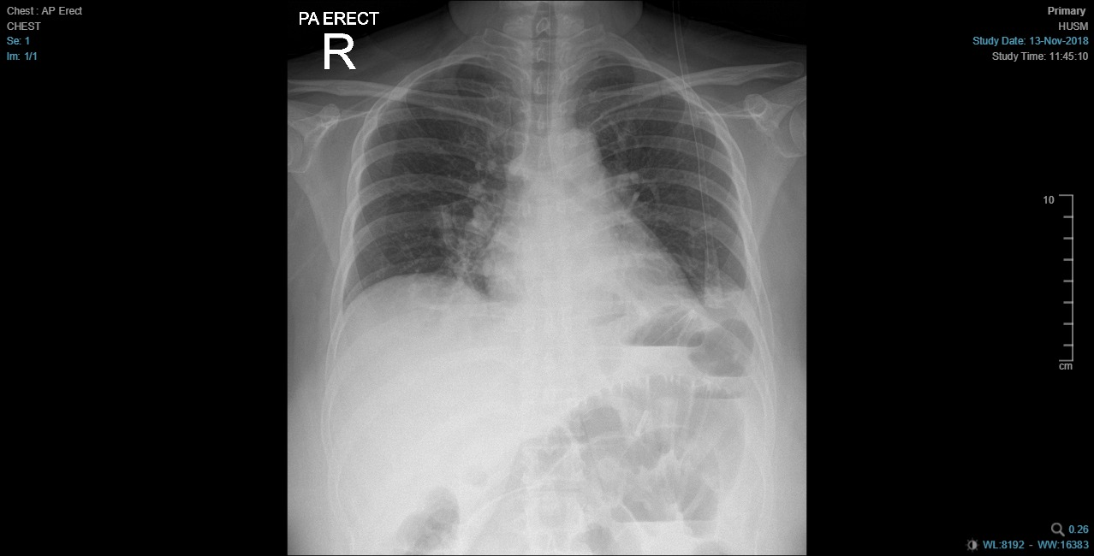
Initial Presentation

Slide 7

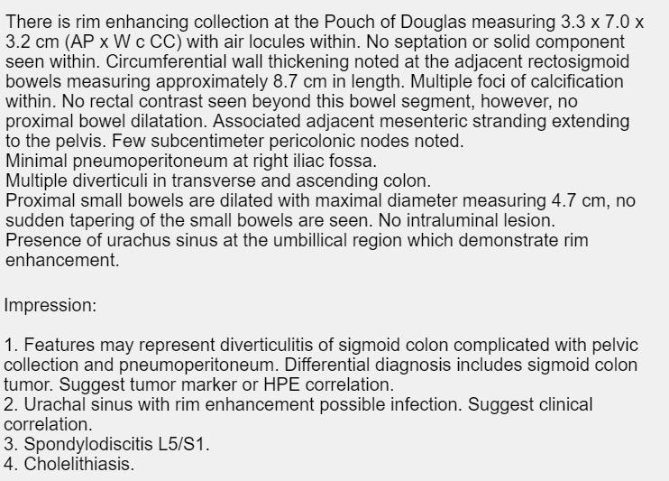
Initial Presentation
Admission Diagnosis : Subacute Intestional Obstruction TRO Cause
Admitted to 3U for further workup. CT Abdomen Pelvis with Contrast Performed the next day after covering with Prednisolone in view of Seafood allergy.

Slide 8
Initial Presentation
Treated as ?Perforated Diverticulum, TRO GI Malignancy
Started on Antibiotics – Cefobid and Flagyl
CEA taken
Planned for Colonoscopy at a later time.
Case discussed with Surgeon;
Impression Perforated Diverticulitis Hinchey’s 2
If fever or signs of sepsis, to escalate Abx to Tazosin and post case for diverting stoma with washout.

Slide 9
Initial Presentation
In view of increase in white count, from 7->11 and persistent tenderness over the abdomen, antibiotic escalated to IV Tazosin.
After escalation, able to initiate feeding, abdominal pain improved and eventually resolved.
No fever and otherwise well. Planned to complete antibiotics for 1/52
Allowed Discharge on 20/11/18 and planned for colonoscopy on 20/12/18.

Slide 10
Summary of IX
IX | 12/11/18 | 13/11/18 | 18/11/18
HB | 10.9 | 11 | 10.2
WC | 7.20 | 9.73 | 18.5
PLT | 360 | 355 | 330
CRP | 125 | 107 | >200
Amylase | 22
Blood C&S | NG | Sputum AFB X 1 Negative | HBs Ag Detected
CEA |  | 66.5
Albumin | 30 | 27 | 22

Slide 11
Second Admission 19-24/12/18
Elective Admission for Colonoscopy. However noted patient general condition appearing unwell, tachycardic, BP 112/68 PR 95. O/E patient tender over left iliac fossa on deep palpation. PR Showed lateral wall tenderness.
Noted WC 10.67 / HB 9.2 / PLT 74. CRP 42. CRP 42. Alb 23.
Ultrasound Urgent done – Thickened bowel wall at left iliac fossa, with associated minimal interloop fluid at this region.
Antibiotics cefobid and flagyl started, and planned for CT Abdomen the next day.
Colonoscopy deferred for the time being.

Slide 12
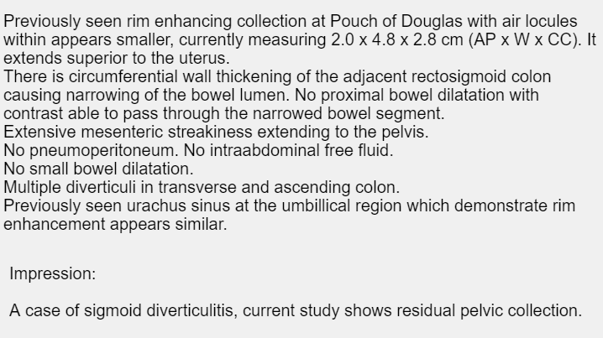
CT Scan

Slide 13
Second Admission
CT Scan findings discussed with Surgeon – Planned to be treated conservatively.
With antibiotics patients abdominal pain resolved, and abdomen was soft, tolerating orally, +PU/BO. Normotensive, however tachycardic 90-96 bpm.
Given 6 days of IV antibiotics, and converted to oral, to be completed for another week.
Panscope as outpatient planned on 17/01/2019 with admission a day prior to procedure.
Subsequently discharged with antibiotics.

Slide 14
Summary of IX
IX | 19/12/2018 | 23/12/2018
WC | 10.67 | 9.60
HB | 9.2 | 9.4
PLT | 74 | 532
CRP | 42 | 23
ALB | 23
NA | 131
K+ | 3.9
UREA | 2.9
CREAT | 49

Slide 15
Third Admission 16/01/2019 – 28/01/2019
Elective Admission for colonoscope. Has been having intermittent abdominal pain, with further loss of appetite and altered bowel habit.
BP 108/78, PR 96. O/E suprapubic tenderness, non-distended abdomen.
On the night of bowel prep, worsening of abdominal pain at lower part. Unable to sleep due to the pain. Claims difficulty passing flatus.
The next morning planned to postpone the procedure. Started on antibiotics, cefobid and flagyl.
BP 102/68, hr 100, Afebrile. O/E Tender at lower abdomen, no guarding. PR – No mass / Bogginess.
Urgent USG Done :- Focal Bowel Wall Thickening. No Obvious Collection. Cholelithiasis with no evidence of cholecystitis.

Slide 16
17/01/2019 – 21/01/2019
Case was discussed with Surgeon. Planned for diagnostic laparascopy and proceed, kiv bowel resection, kiv stoma on Tuesday Elective List 22/1/2019.
Planned to optimize the patient in the interim.
HB 8.9 / WC 10.74 / PLT 649 / ALB 20 / UREA 3.9 / CREAT 50 / K+ 3.3/ NA 133
One pint transfused on 17/1/2019 (Critical Shortage of A+) and another pint transfused the next day.
*Developed Urticaria after 100cc transfusion of second pint of packed cell. Treated with Piriton and hydrocort, otherwise uneventful.
The next day post transfusion BP 118/76, PR 69, T 37*c. Still had pain over suprapubic region, however, no peritonitis.
Throughout this period she was tolerating orally, ambulating, and given background IVD.
If she was to have worsening of pain, she was to be posted for emergency laparotomy.

Slide 17
IX Summary
IX | 16/01/19 | 17/01/19 | 19/01/19 | 21/01/19
HB | 8.9 | 8.4 | 10.7 | 11.5
WC | 10.74 | 11.3 | 10.43 | 12.96
PLT | 649 | 573 | 287 | 630
NA | 133 | 129 | 136 | 136
K+ | 3.3 | 3.9 | 3.2 | 3.6
UREA | 3.9 | 2.3 | 2.2 | 1.8
CREAT | 50 |  | 45 | 48
ALB | 20 |  |  | 22
P04 | 1.27 |  |  | 1.07
MG |  |  |  | 0.96
CA2+ | 1.80 |  |  | 1.88

Slide 18
Surgery
Date : 22/01/2019
Duration : 1200H – 1740H (5 hours 40 minutes)
Procedure : Laparascopic Converted to Open; Hartmann’s Procedure, Adhesiolysis and Appendicectomy
Pre-Op Diagnosis : Recurrent Complicated Colonic Diverticulitis
Post-Op Diagnosis : Sealed Perforation of Rectosigmoid Tumour (Clinical Stage T4N2MX)
Laparascopic Finding:
  Soft adhesion at Splenic flexure. Dense adhesion at left paracolic between bowel and omentum to the anterior peritoneal wall. Dense adhesion at pelvic region which could not be released laparascopically, therefore converted.

Slide 19
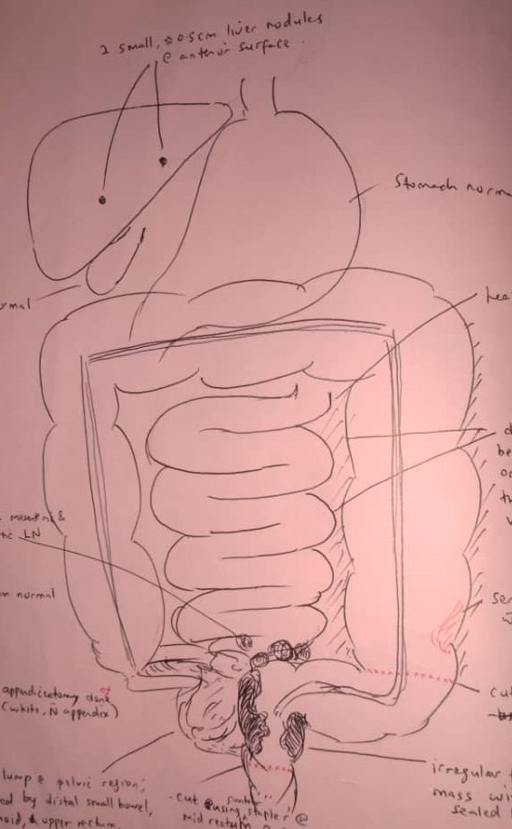
Laparatomy Findings:
Clump of distal small bowel, sigmoid, upper rectum, fibriae, fallopian tube and omentum at pelvis.
Upon releasing clump, noted sealed perforation at sigmoid, upper rectum and mid rectum with contained faecal contamination around pelvic region.
Able to get distal margin around 2 cm from tumour. Friable mid rectal-stump closed with contour stapler and defect closed double layer with vicryl and prolene suture. Leak Test – Negative.
Serosal tear at desending colon repaired with vicryl.
Multiple Mesenteric and Para-Aortic LN, hard and could not be released.
2 small nodules around 0.5cm at anterior surface of liver.
Gynae Team called on Table – Gynae organs inspected.
21F blake drain inserted at Pelvis

Slide 20
Intraoperative
ABG | 1305H | 1546H
pH | 7.456 | 7.380
pCO2 | 30.4 | 34.4
pO2 | 160 | 218
BE | -2.2 | -4.4
HCO3 | 23 | 21
Lac | 1.3 | 1.5
Intraoperative Fluids:
  Hartman 4 Pints 2L
  Gelafusine 2 pints 1L
  Normal Saline 2 pints 1L
Blood Products
  1 pint packed cell
BP Range 110-160/70-80 PR 90-110
Urine Output 900CC.
Blood Loss Not Documented

Slide 21
Post-Operative Phase
Post Operatively Nursed in 3U. Antibiotics escalated to IV Tazosin with Flagyl.
Reviewed 3H post operatively
BP 101/67 PR 119, SPO2 100% UNDER RA, Temp 37 *C
O/e Abdomen soft, not distended. Stoma Pink. Drain haemoserous in tubing.
FBC Stat – HB 11.5 -> 10.6 WC 17.76 PLT 431.
Noted at 11.50 PM Urine output @ 10pm 100cc, at 11 PM in tubing. On Maintenance 5 pints. Previously given 1 pint Hartman.
Bp 98/66, PR 108, T 37*c pH 7.433/pC02 35.6/p02 120/Lac 1.1/Hc03 24.5/BE-0.2 (NP02)
Given 2 pints of Gelafundin, and planned for another PC Transfusion. (0040H -> 0250H) and 10mg of Frusemide.

Slide 22
Post-Operative Phase
The Next Morning 23/1/2019
Urine output 15-20cc/hr overnight. Stoma Nil overnight. Drain 400cc.
BP 99/66 PR 109 U/O – 440cc Morning Shift. PA: Dressing not Soaked, mildly distended. Soft. Tender over op site, sluggish bowel sound.Maintainance IVD 5 pints, with 1.5g KCL in each pint.
10 am reviewed by surgeon. Blood noted in stoma bag. INR 1.57. Planned to transfuse 4 units of FFP. Allowed sips of clear fluid and prescribed chest physio.
Planned to transfer to SHDU for close monitoring in view of poor urine output.
CVL Inserted and sent to SHDU

Slide 23
SHDU 23/1/19
On Arrival to SHDU BP 110/70 PR 84 TEMP 37 SPO2 95% under NPO2
CVP Opening pressure 14
Pain Score 6/10
U/O 20-30CC/HR Increased to 70cc/hr after Lasix
Blake Drain 54cc (serous)
Stoma 5cc (mucous)
First Day Positive Balance 1198

Slide 24
SHDU 24/01/19
POD2
BP 117/68, PR 112, CVP 17. T – 36.7 *C U/O 20-25CC/HR +1198 Balance
PA : Soft, mild tenderness over opsite. Drain 54cc Haemoserous. Stoma not functioning, however appears viable.
HB 10.3 /WC 14 / PLT 228 / Alb17
Planned for Human Albumin 20%. Allowed Nourishing Fluid. Referred Dietician for ONS (Ensure). Transfuse 1 pint packed cell, with IV Lasix 20mg In between transfusion. 1G KCL in 4 pints maintenance.
PCA Off by APS
Urine Output Increase to 50-70cc/hr after transfusion and frusemide.

Slide 25
Summary of IX
ABG | 0625H | 1213H | 0340H
pH | 7.458 | 7.510 | 7.444
pCO2 | 40.0 | 34.8 | 40.5
pO2 | 78 | 97 | 118
BE | 4.2 | 4.4 | 3.5
HCO3 | 28.2 | 28.8 | 27.5
Lac | 1.5 | 1.0 | 0.85
 | NP02 | VM40% | VM40%

Slide 26
Summary of IX
IX | 22/01/19 | 23/01/19 | 24/01/19 | 25/01/19
HB | 10.6 | 11.5 | 10.3 | 11.2
WC | 17.76 | 16.15 | 14.0 | 11.7
PLT | 431 | 389 | 228 | 274
INR |  | 1.57 | 1.32 | 1.43
APTT |  | 45.0 | 36.90 | 42.0
PT |  | 18.6 | 16.20 | 17.30
Urea/Creat |  | 2.1/46 | 4.4/45 | 4.0/43
ALB |  | 12 | 17 | 19
P04 |  | 1.35 | 1.18 | 0.78
MG |  | 0.73 | 0.93 | 0.79
CA2+ |  | 1.75 | 1.80 | 1.70
K+ | 3.6 | 3.4 | 3.3 | 3.2

Slide 27
SHDU 25/01/19
Around 0245H patient complained of abdominal pain. Generalised, pain score 6/10. Pain had started after cessation of PCA Morphine
BP 120/80 PR 70 T 36.2*c
O/E Abdomen soft, tender over lower abdomen. Stoma Minimal Haemoserous.
Served dynastat and patient was subsequently able to sleep with improving abdominal pain.

Slide 28
SHDU 25/01/2019
ABG | 0700H
pH | 7.45
p02 | 125
pC02 | 40
BE | 4
HCO3 | 28
Review by MO at 0945H
Intermittent abdominal pain over Op site. Otherwise tolerating nourishing fluid, no vomiting.
BP 115/78 PR 71 T 36.7*C U/0 30CC/Hr. CVP 12. (+ve balance 1775)
PA :Wound clean and dry. No Pus. Stoma Not functioning yet. Minimal Mucous. Drain 300cc Billious.
Given Hartman Bolus – Urine Output Improve. VM02 40% Reduced to NP02.
KIV For CT SCAN after discuss with Surgeon

Slide 29
SHDU 25/01/19
Discussed with Surgeon, For CT Abdomen with Oral and IV Contrast
CT SCAN Done 1600H
  No Extravasation of Contrast
  Liver Lesion Segment 2&4
  B/L Pleural effusion with pneumonic changes
  Small collection over drain site – intramuscular in nature
  CBD Not dilated, Gallstone in Gallbladder
  Dilated Stomach and Jejenum (5cm)
  Plan for RT insertion, free flow and 4 hourly estimate. Continue Antibiotics. Maintain urine output at least 0.5cc/hr (40-50cc/hr)

Slide 30
SHDU 25/01/2019
9 PM Review By Surgeon
BP 107/74, PR 110, T 37*C CVP 10, Urine Output 25-30cc/hr
PA : Soft, tender over right iliac fossa and lumbar region.
Drain : 500cc Small bowel Content. RT Free Flow – 300cc.
Plan – Repeat AXR, aim CVP 8-12. Human Albumin 20%. Post case CM for Exploratory Laparatomy and Proceed. For 4 units FFP before surgery. To resuscitate patient overnight.

Slide 31
SHDU 26/01/2019
Review by Surgical MO 0030H
Noted Patient Tachycardic, and tachypnoic
BP 102/70, PR 110, T 37*C, U/0 25CC/HR
PA : Tender over lower abdomen. No Peritonitis. Auscultation Reduce a/e B/L LZ. Drain 200cc small bowel content. CVP 10.5
Repeated AXR – Dilated Small Bowel. No contrast in stoma seen. Contrast Seen in Pelvic Region.
Antibiotics escalated to IV Meropenem. Given IV Lasix 20mg stat (Urine Output Increase 80-100cc/hr)

Slide 32
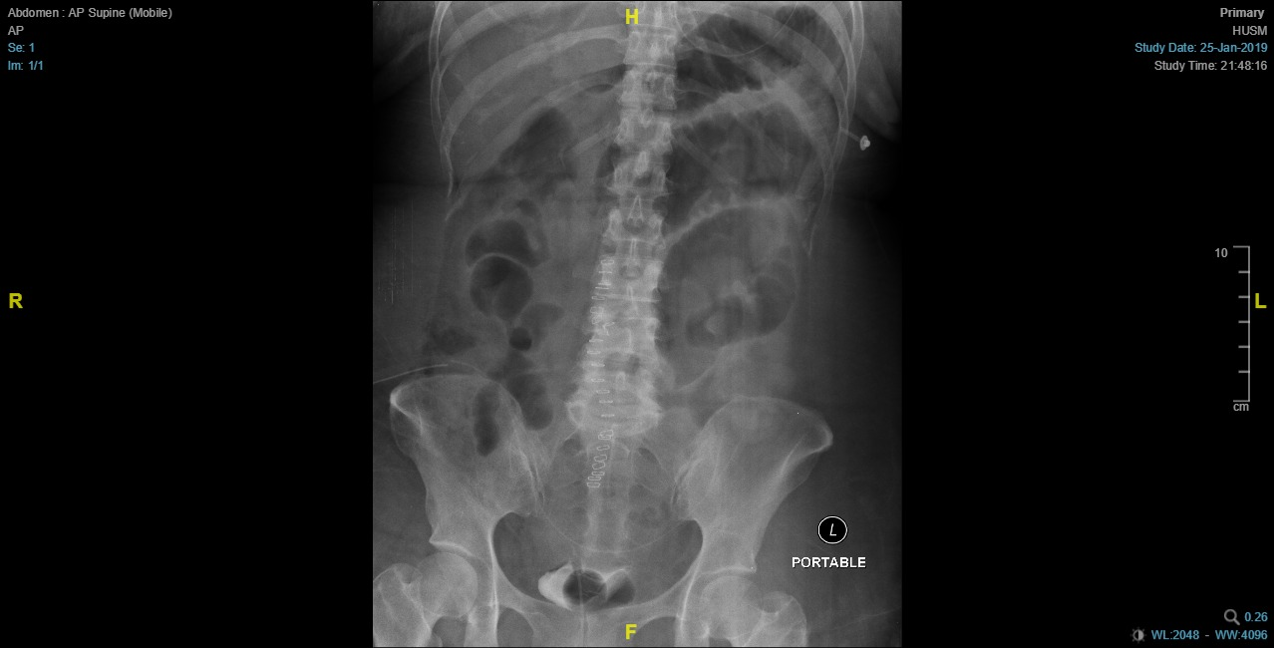

Slide 33
SHDU 26/01/2019
POD4 on VM02. Seen by MO at 0815H
Tachycardic last night HR 110-120. BP 124/69. This morning at 8 am HR 130
CVP at 5 am 11. However rechecked at 10AM; 1.
Abdomen remains soft, no guarding. Stoma not functioning. Lungs reduce air entry bilateral lower zone. RT Free flow 300cc, drain 500cc bilious. Urine Output overnight 70-100cc/hr.
Imp: Sepsis 2* Perforated Bowel
To Post for Exploratory Laparatomy KIV Proceed. FFP 4 units prior to surgery.
Patient developed urticaria during second FFP Transfusion. Given Hydrocort and Piriton and completed remainder FFP Transfusion.

Slide 34
26/01/19 Results
Ix | Result
HB | 14.4
WC | 7.46
PLT | 257
Urea | 3.4
Creat | 41
Na | 138
K+ | 3.3
PT | 20.60
INR | 1.79
APTT | 42.80
Alb | 21
ABG | Result
pH | 7.424
pC02 | 31.5
pO2 | 67.9
HC03 | 23
BE | -2.9
LAC | 3.3
VM40%

Slide 35
SHDU 26/1/19
At 1320H, informed by anaest team, in view of increasing tachycardia, tachypnoea, with increased O2 requirement (VM50% 15L/Min) high risk for PE. Well Score 7.
In view of this finding, anaest team insist on doing CTPA prior to calling the case.
CTPA done at 1645H. Verbal Report at 1750H – No PE. Transfused another 2 units FFP in view of INR 1.7. Post Second unit FFP, developed urticaric rash at OT Airlock (1930H). Given IV Hydrocort.

Slide 36
Surgery
Date : 26/01/2019
Duration : 0825H – 1035H(2 Hours and 10 minutes)
Procedure : Exploratory Laparatomy, Small Bowel Perforation Repair and Peritoneal Lavage
Pre-Op Diagnosis : TRO Small Bowel Perforation Post Hartmann Procedure
Post-Op Diagnosis : Small Bowel Perforation Post Hartmann Procedure
Finding:
  There is subcutaneous collection of faecal material upon opening the incision. About 600cc faeculant fluid intraperitoneally with loose interloop slough over small bowel. Faeculent collection and slough more over the right side of the abdomen.
  There is a 0.5 x 0.5cm perforation at mesenteric border of small bowel about 40cm from ileocaecal junction. Repaired with Vicryl 3/0 in 2 layers. Jacuzzi test done – No Leak.
  Small Bowel proximal to perforation site dilated. Appendix stump, rectal stump intact. No leaks.

Slide 37
Intraoperative
ABG | 1953H | 2123H
pH | 7.439 | 7.388
pCO2 | 37.6 | 37.7
pO2 | 80.6 | 89.4
BE | 1.3 | -2.3
HCO3 | 25.7 | 22.7
Lac | 2.4 | 2.3
Intraoperative Fluids:
  Albumin 5% 250ML
  Sterofundin 2 pints 1L
  Normal Saline 2 pints 1L
Blood Products
  2 pint packed cell
  4 units FFP
BP Range 110-140/50-90 PR 110-150
Urine Output 3200CC
Blood Loss 1L, Faecal Contamination 1L,
Peritoneal Fluid 1L
On Noradrenaline 8mg, 1cc/hr -> 4cc/hr

Slide 38
Post-Operative
ABG 0158H | Result
pH | 7.279
pC02 | 25.1
pO2 | 122
HC03 | 14.3
BE | -14.1
LAC | 6.0
SIMV
Post Operatively transferred back to SHDU.
When returned to SHDU – Norad 8MG @ 10cc/hr
Urine output Minimal 5-10cc/hr, CVP 12
Bp 100/80 PR 150-160, Temp 36.8*C

Slide 39
Post-Operative 27/01/2019
Inotropic requirement periodically increased from Midnight till 6 am. Noradrenaline 8mg from 10cc/hr -> 25cc/hr.
Following day urine output nil from 6 am. Prior to that about 10cc/hr.
CVP 22. BP 70/40 PR 150, T 36.8*c, CBS 5.5 RT 100CC light green, Stoma minimal blood clots, Drain 100cc Haemoserous
PA: Not distended. No Guarding. Dressing Dry.
Imp : Multiorgan Failure 2* Severe Sepsis with CIN
Ix | Result
HB | 13.8
WC | 8.61
PLT | 197
Urea | 3.6
Creat | 74
Na | 132
K+ | 7.3
PT | 38.9
INR | 3.85
APTT | 42.80
Alb | 31
ABG 0530H | Result
pH | 6.882
pC02 | 24.8
pO2 | 116
HC03 | 5.9
BE | -25.8
LAC | 17
SIMV | 1

Slide 40
Post-Operative
Started HC03 infusion, added dopamine. Refer Nephro for CRRT. Given lytic cocktail (K+ 4.5)
Urine output Nil. Planned by Nephro to continue hydrating patient. However, still no improvement so planned for CRRT once patient transferred to SICU.
Patient transferred to ICU @ 1130H.
  Noradrenaline increased to 16mg, 12-15cc/hr
  Dobutamine 500mg 2.5ml/hr
  Urine output remain Nil
  Bp 90-100/50-65 pr 140-160

Slide 41
ABG PROGRESS IN SHDU
ABG 0530H | Result
pH | 6.882
pC02 | 24.8
pO2 | 116
HC03 | 5.9
BE | -25.8
LAC | 17
SIMV | 1
ABG 0808H | Result
pH | 6.995
pC02 | 34.8
pO2 | 262
HC03 | 9
BE | -22.9
LAC | 16
SIMV | 1
ABG 0930H | Result
pH | 7.063
pC02 | 38.4
pO2 | 135
HC03 | 10.6
BE | -17.8
LAC | 11.2
SIMV | 1
ABG 1230H | Result
pH | 7.214
pC02 | 37.2
pO2 | 64.4
HC03 | 14.8
BE | -11.8
LAC | 9.9
SIMV | 0.6

Slide 42
ICU Phase
Coagulopathy corrected in ICU, Femoral Line Inserted. SLEDD performed.
3rd Inotrope, Vasopressin Started, however BP 85/48 pr 122
ABG Persistent acidosis, pH 7.279, BE -18 Hc03 12. Coagulopathy INR 2.6 APTT 72.
Challenged with Fluid Bolus, repeated hypotensive episodes during SLEDD. Completed SLEDD 0230H however persistent hypotension.
Critical condition explained to family members, poor prognosis explained. DIL Issued, Family Opted for No Chest Compression.
Succumbed on 28/1/19 at 0445H
Cause of Death : SEVERE SEPSIS 2* TO SMALL BOWEL INJURY POST HARTMANN’S PROCEDURE FOR RECTOSIGMOID CA T4N2M1

Slide 43
SUMMARY OF IX @ ICU
Ix | Result
HB | 13.4
WC | 13.09
PLT | 147
Urea | 4.1
Creat | 74
Na | 142
K+ | 4.3
PT | 78.6
INR | 10.09
APTT | 240
Alb | 19
ABG 1627H | Result
pH | 7.371
pC02 | 30.2
pO2 | 64
HC03 | 19
BE | -7.2
LAC | 9
SIMV | 0.6
ABG 1902H | Result
pH | 7.326
pC02 | 26.4
pO2 | 121
HC03 | 16
BE | -11.4
LAC | 11.5
SIMV | 0.7
ABG 0022H | Result
pH | 7.279
pC02 | 18.1
pO2 | 179
HC03 | 12.1
BE | -17.5
LAC | 16
SIMV | 0.7

Slide 44
DISCUSSION
CEA from First Presentation was Significantly High. However Still treated with the impression of diverticulitis. Delay in Diagnosis?
CT Scan in the First 2 Admission were suggestive of Diverticulitis. Red herring?
When Identified BILE in the Pelvic Drain, Is there a Delay by planning for CT Scan? Furthermore CT Scan did not show any evidence of leak / patient in Ileus
Further delay and second insult to kidneys by doing CTPA. Eventually patient had renal shutdown possibly due to CIN

