Slide 1
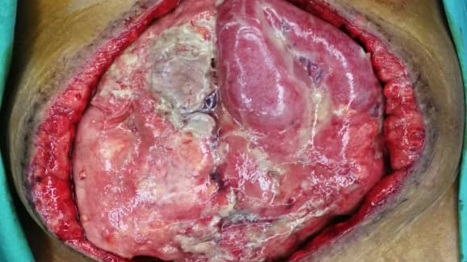
Negative Pressure Wound Therapy For The Open Abdomen
Interventional Procedures Guidance
National Institute for Health and Care Excellence
Karthik Krishnan

Slide 2
The Open Abdomen
Relatively new and increasingly common strategy for management of Abdominal Emergencies in both Trauma and General Surgery.
Has shown to reduce mortality associated with conditions such as Abdominal Compartment Syndrome, Bowel Perforation and Internal Organ Laceration.
Management of Complex Open Abdominal Wound brings about several challenges, and one such method advocated is Negative Pressure Wound Therapy
NICE Interventional Procedures Guidance makes recommendation on the safety and Efficacy of the procedure.

Slide 3
Indications
Negative Pressure Wound Therapy (NPWT) for the open abdomen may be used to manage open abdominal wounds (laparastomy) in which the gut and other intraperitoneal organs are exposed.
The patients can be divided into 3 groups;
1) Patients who have had Surgery that did not involve the GIT and in whom delayed primary closure is planned within about 1 week (e.g. Damage-Control Surgery for Trauma or Repair of Ruptured Abdominal Aneurysm) 2) Patients who have had GIT surgery for the management of Abdominal Sepsis associated with severe GI Disease (Anastomotic dehiscence, visceral perforation or IBD) or severe Pancreatitis 3) Patients who have had abdominal wound dehiscence Intestinal Fistulae may occur in any of these groups, either before or after use of NPWT is considered.

Slide 4
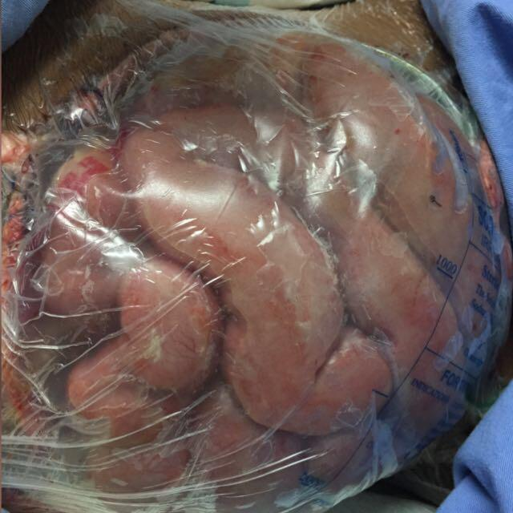
Current Treatment
Open abdomens may be managed in a number of different ways, including application of Bogota Bag, systems with a “zipper” allowing lavage or various types of dressings.
NPWT is an alternative to these methods. All of these techniques may be used as a prelude to delayed primary closure of the abdomen. Alternatively, split-thickness skin grafts, mesh repair, muscle flaps or a combination of these may be used to close the abdomen.

Slide 5
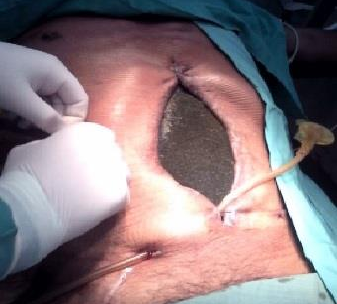
Procedure
Aims of NPWT include removing infected material and helping nursing care by reducing escape of fluid; its use may also influence the possibility of delayed primary closure.
NPWT uses a sealed suction system to remove exudate and infected material from the abdominal cavity. The techniques vary, but the underlying principle is that the abdominal contents are covered with a foam sponge or other porous dressing (e.g. gauze) with a membrane between the sponge/dressing and the abdominal contents.

Slide 6
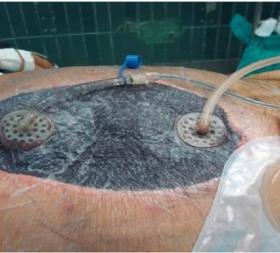
Procedure
The entire wound and surrounding skin are covered with adhesive transparent membrane, which is perforated by a drainage tube attached to the suction system. This applies negative pressure and removes fluid, at the same time preventing escape of the fluid, because the membrane adheres to the skin all the way around the wound.
A sensing device (a pad placed on top of the foam dressing) may be used to ensure that the prescribed amount of negative pressure is being applied to the wound.

Slide 7
Efficacy
Meta-analysis of 4303 Patients with Reported Delayed Primary Fascial Closure Rates

Slide 8
Efficacy
A non-randomised comparative study of 578 patients

Slide 9
Prosthetic Replacement
A non-randomised comparative study of 578 patients

Slide 10
Safety
Meta-analysis of 4303 Patients with Reported Delayed Primary Fascial Closure Rates

Slide 11
Safety
A non-randomised comparative study of 578 patients

Slide 12
Complication
Meta-analysis of 4303 Patients with Reported Delayed Primary Fascial Closure Rates

Slide 13
Complication
A non-randomised comparative study of 578 patients

Slide 14
Intestinal Failure (Defined by the need for Parenteral Nutrition > 28 days)
A non-randomised comparative study of 578 patients

Slide 15
Abscess Formation
Meta-analysis of 4303 Patients with Reported Delayed Primary Fascial Closure Rates

Slide 16
Intervention to Control Bleeding
A non-randomised comparative study of 578 patients

Slide 17
Recommendation
Current evidence on the safety and efficacy of NPWT for the open abdomen is adequate to support the use of this procedure provided that normal arrangements are in place for consent, audit and clinical governance.
NPWT should only be carried out by healthcare professionals with specific training in the procedure. It should be done in accordance with the manufacturer’s instruction when commercial products are used
NICE encourages further research into the role of NPWT for the open abdomen. Patient selection should be documented and research should report on efficacy outcomes such as impact on wound care and healing rates, and duration of hospital stay.

