Slide 1
Metastatic Colorectal Ca Molecular Profiling
Karthik Krishnan

Slide 2
Introduction
Commonly diagnosed malignancy
Chemotheraphy remains the backbone of treatment, however the landscape of treating metastatic CRC is being altered based on molecular blueprint and heterogeneity.
Colon cancer sidedness has proven to hold prognostic implications, and results from molecular research demonstrates the need to profile each metastatic Colorectal Cancer patient.

Slide 3
Molecular Phenotyping
RAS Mutation
BRAF Mutation
MSI,TMB,PD-L1
HER2 amplication
NTRK Fusions

Slide 4
RAS Mutation
Mutation in any of 3 RAS Oncogenes
KRAS
NRAS
HRAS
Presence of KRAS or NRAS Mutation correlates with worse outcomes and resistance to anti-EGFR therapy with/without chemotheraphy.
PRIME trial showed patients with KRAS/NRAS disease, addition of panitumumab to FOLFOX resulted in superior median PFS.
RAS Mutation can be used as predictive biomarkers for therapeutic resistance to upstream EGFR.
KRAS WT vs KRAS (Mutated) – Kras mutation status is a candidate marker for predicting survival in patients with mCRC treated with Cetuximab. Even more pronounced benefit in patients with early radiological response.
*Cetuximab and Panitumumab are monoclonal antibodies directed against epidermal growth factor receptor (EGFR)

Slide 5
BRAF Mutation
BRAF mutation – mCRC do not respond to anti-EGFR monotheraphy. Have a shorter PFS and OS compared to BRAF WT tumours.
8-10% of mCRC contain BRAF Mutation, a gene encoding signal transduction protein in MAPK pathway. BRAF V600E – the target mutation. BRAF inhibition alone has limited efficacy in treatment, so Vemurafenib (TKI) is rarely effective.
BEACON study treated patients with Triplet therapy vs Double Therapy. (BRAF inhibitor + EGFR + MEK inhibitor) vs (EGFR + BRAF Inhibitor). Control group Chemo arm + Cetuximab. Study showed OS in Doubled and Triplet was similar.
ANCHOR Trial evaluating Triplet Therapy in first-line setting

Slide 6
MSI, TMB, PD-L1
Microsatellite Instability(MSI) is caused by mutations in dMMR genes such as MLH1, MSH2, MSH6, PMS2 (10-15% sporadic CRC). These tumours have poor response to chemotherapy regimes, and result a worse prognosis for mCRC.
PD-L1 – regulates cytotoxic Th1 IR. Block PD-1 pathway with antibodies (pembrolizumab/nivolumab) to activate adaptive IR against Tumour cells.
Combination therapy shows good outcome (CheckMate,Keynote Trial)
Nivolumab and Ipilimumab (Antibiody targeting CTLA-4 recptor) with anti-PD-1 antibody showed greater effifacy than monotheraphy.

Slide 7
HER2 Amplification
Typically in Breast and Gastric cancer. Of late HER2 amplication emerged as therapeutic target in mCRC.
HERACLES trial enrolled KRAS WT with HER2+ mCRC treated with HER2 monoclonal antibody Trastuzumab and TKI Lapatinib. 32% response rate.
Ongoing clinical trials investigating HER2 targeted therapies vs Standard Chemotheraphy. Also novel antibody-drug conjugate trastuzumab-deruxtecan showed promising response rate (45%)

Slide 8
NTRK Fusions
NTRK Fusions - > oncogenic overexpression – activate downstream signaling.
Highly selective TRK inhibitor Larotrectinib with durable 1 year response.
Alka and STARTRK-1 trial testing safety and efficacy of entrectinib – well tolerated and duable clinical response lasting 2 years.

Slide 9
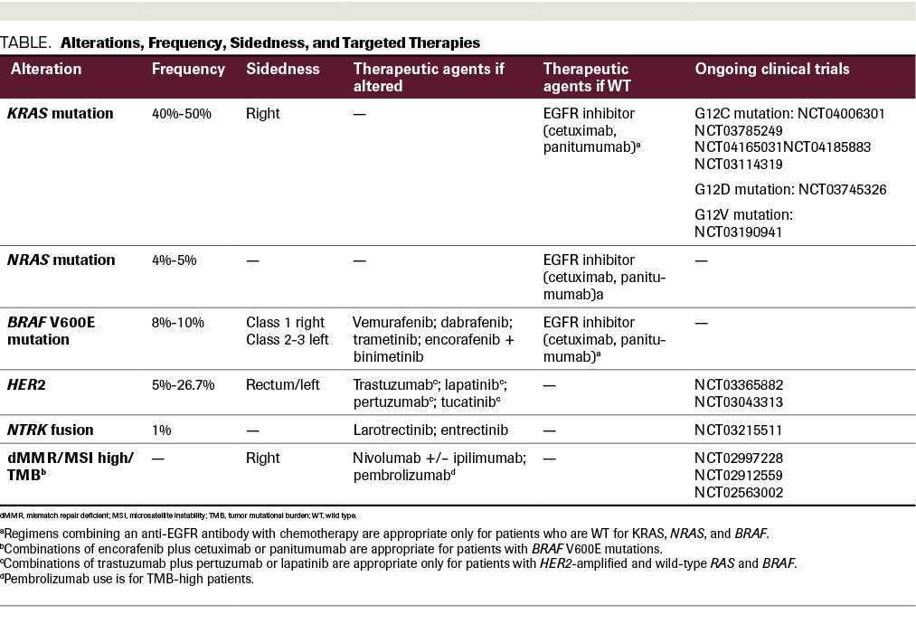
Summary

Slide 10
Conclusion
Chemotherapy has provided reliable initial treatment
Molecular profiling is creating new therapeutic options to give patients hope and increased overall survival.

