Slide 1


KELULUT HONEY AS AN ALTERNATE SOURCE OF CARBO-LOADING IN ABDOMINAL SURGERY INVOLVING THE DIGESTIVE SYSTEM A RANDOMIZED BLINDED COMPARATIVE STUDY
B. Karthik Krishnan
Department of Surgery
Hospital Universiti Sains Malaysia

Slide 2
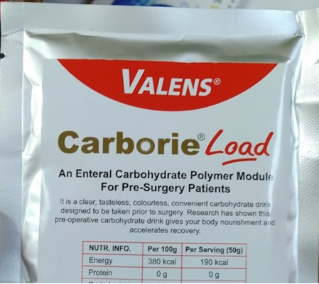
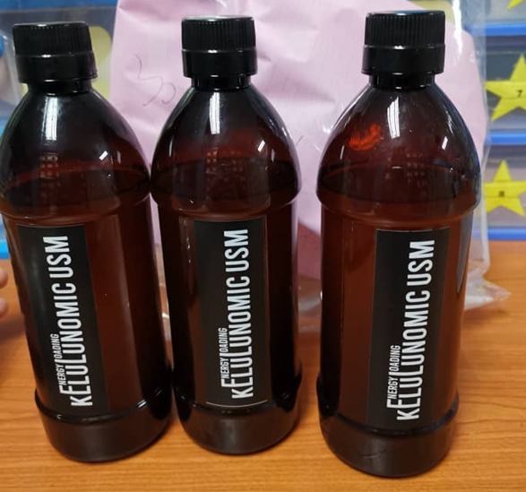
INTRODUCTION
Carbohydrate loading prior to elective surgery has been incorporated into the Enhanced Recovery after Surgery (ERAS) protocol. Commonly, a Maltodextrin extract is utilized for this purpose.
Here, our team explores the viability of using Honey – a naturally occurring substance known to have antibacterial, anti-inflammatory as well as wound healing properties as a carboloading solution compared to a commercially available solution, Carborie®

Slide 3
Objectives
Determine and compare the effect of Kelulut Honey on Insulin Resistance and Residual Gastric Volume and compare with Carborie®
To compare post-operative outcomes (Length of stay, pain control, return to physiological function, complication severity) between patients receiving Kelulut Honey and Carborie®

Slide 4
Study Design
Prospective, single centre, randomised, double blinded comparative study, conducted in HUSM.
64 patients undergoing elective intra-abdominal surgery involving the digestive system above the age of 18 was recruited.
Inclusion Criteria | Exclusion Criteria
Consenting Adult (Age ≥18) | Known Diabetics
Elective Intra-abdominal surgery | Fasting Glucose Level > 7mmol/L
 | ASA >3
 | On Steroid Treatment
 | Recent Infection (3 months)
 | Preoperative unintentional weight loss (>10% of usual body weight/6 months)
 | Known allergies to Maltodextrin / Honey

Slide 5
Results
A total of 120 patients were assessed for eligibility. 72 patients were found to fulfil recruitment criteria, of which 64 patients consented to participate in this study and were randomized into either Carborie® (A) or Honey (B) group. There were 32 patients per group, however one of the participants in the Carborie® group was unable to tolerate the solution and therefore was excluded from the study.
No adverse event was reported among all the study participants.

Slide 6
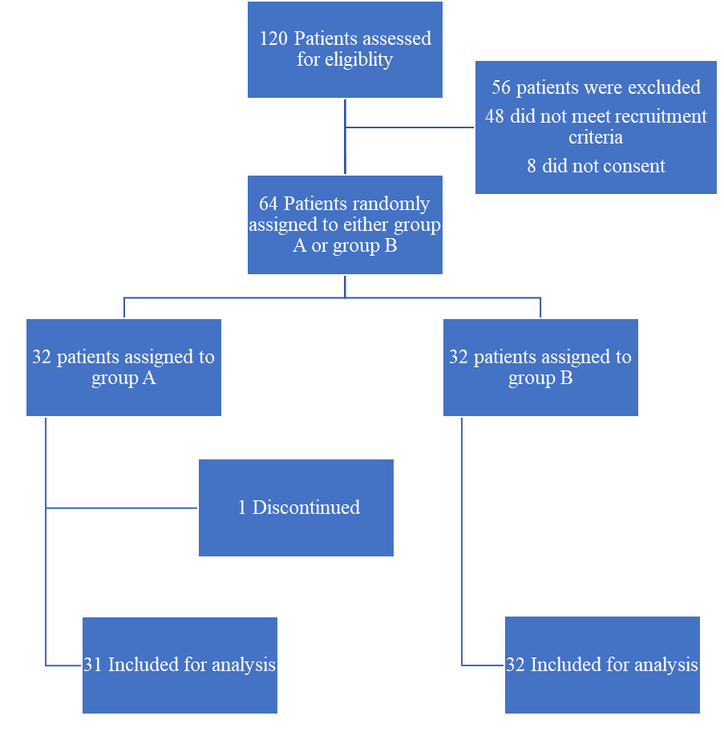
Consort Flowchart

Slide 7
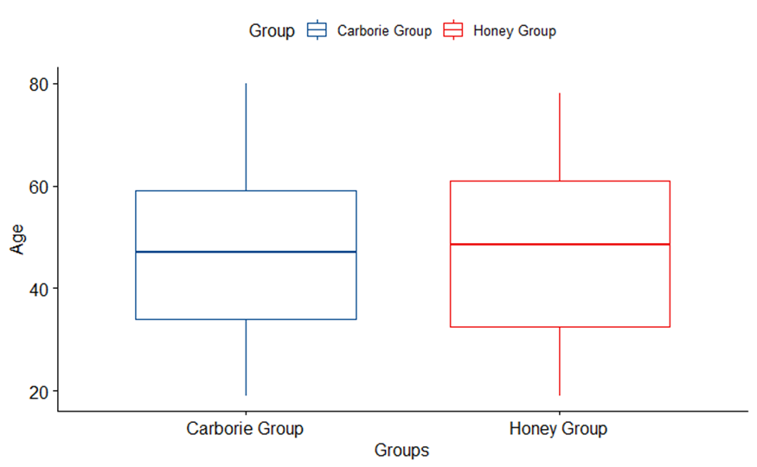
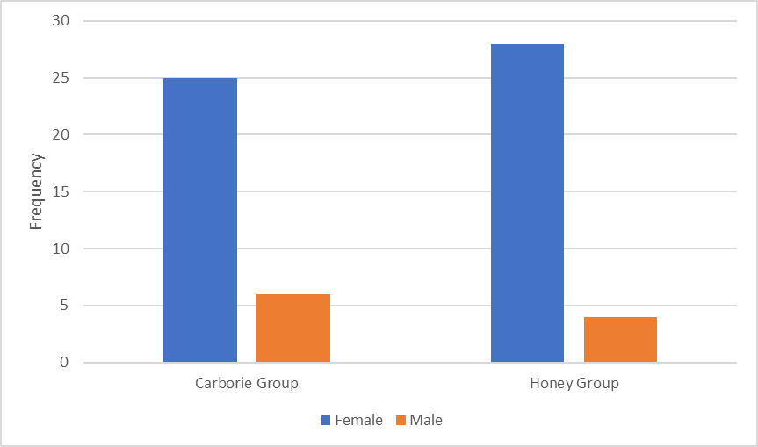
The mean age of participants 47.3 (SD=16.6). 84% of the study participants were female with an average BMI of 27.2 (SD=6.2). More than half of the participants had at least one comorbidity.

Slide 8
Patient Comorbidities & Surgeries
Common Comorbidities
Common Surgeries

Slide 9
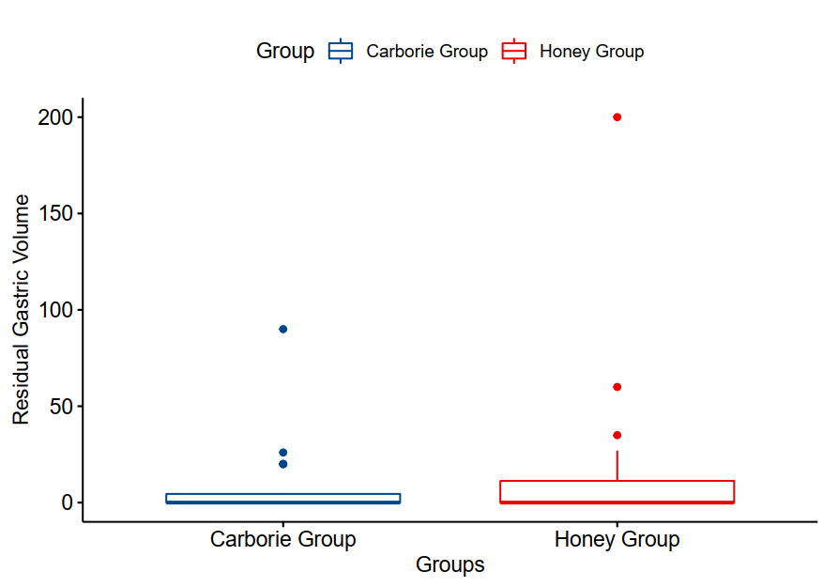
Residual Gastric Volume
Comparison of residual gastric volume between the two groups showed no significant difference.

Slide 10
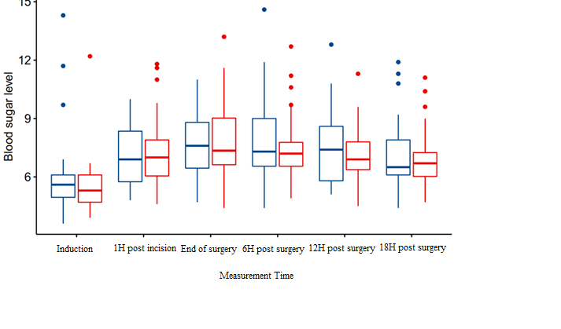
Blood Glucose Analysis
Per protocol analysis for blood glucose levels for pre, intra, and post-operative period for 24 hours was done. Data analysis shows no significant difference throughout the measurement time between the two groups.

Slide 11
Return to Physiological Function

Slide 12
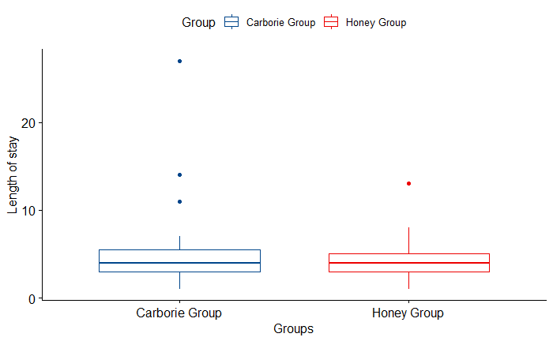
Length of Stay

Slide 13
Conclusion
The study shows there is no significant difference between the two groups to evaluate effects on insulin resistance and residual gastric voume when used as carbohydrate loading solution preoperatively.
From this, we can extradite that Kelulut Honey is safe to be used for pre-operative carbohydrate loading and it is fair to expect for the patient to receive similar benefit of carbo-loading from using the commercially available conventional carboloading product such as Carborie®.

Slide 14
Limitations
The study is confined to a single centre, and the population selection is limited to the local population. Given that the location is in Kubang Kerian, Kelantan where the local population is largely made up of Malay populace, and the composition of patients from different races are minimal.
The study only involved patients undergoing elective abdominal surgery involving the digestive tract, with a high heterogenecity of the types of surgeries that were performed.
For standardization, the same batch of Kelulut Honey was used for this purpose. It is not possible to predict the outcome from honey acquired from different species of bees as these factors are not explored in the analysis.

Slide 15
Conclusion
Kelulut Honey is safe to be used as an alternative to conventional carbohydrate loading and its efficacy matches that from commercially available carbohydrate loading solutions, such as Carborie®.
This is important because the commercial product is one that has been tested to augment the preferred outcome by following the Enhanced Recovery After Surgery Protocol.
If an alternate carboloading solution is able to attain similar results with the conventional product, then it can be postulated that the alternative is a viable one. Therefore we conclude, that a similar outcome can be achieved using Kelulut Honey as a carbohydrate loading solution.

