Slide 1


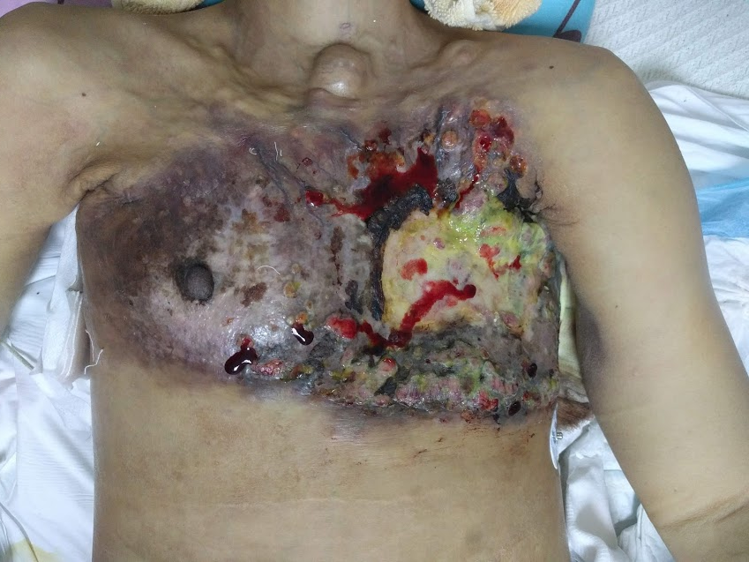
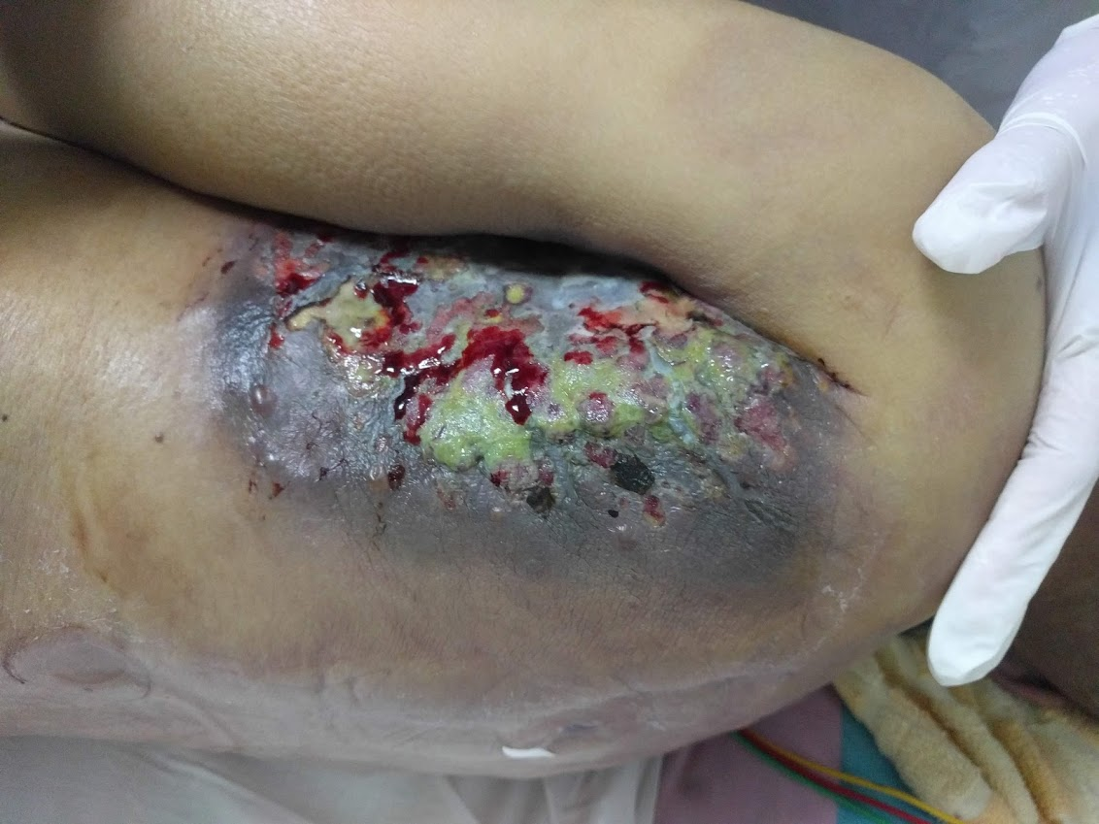
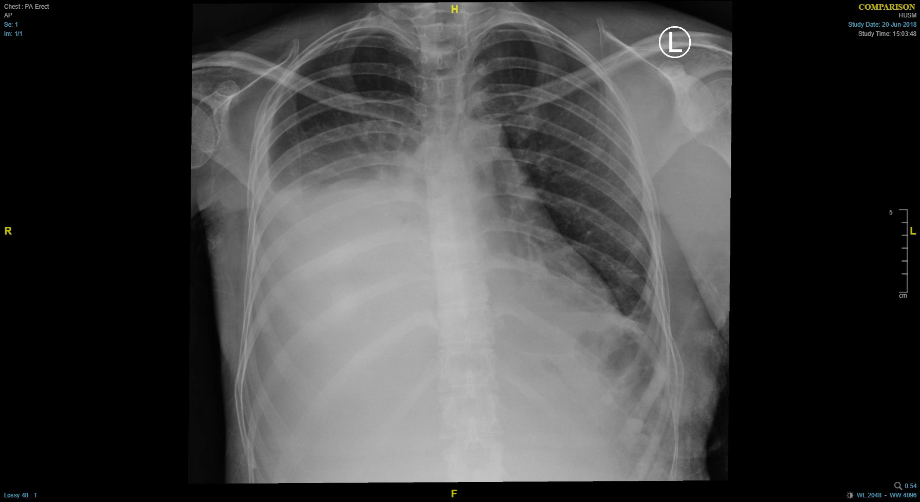
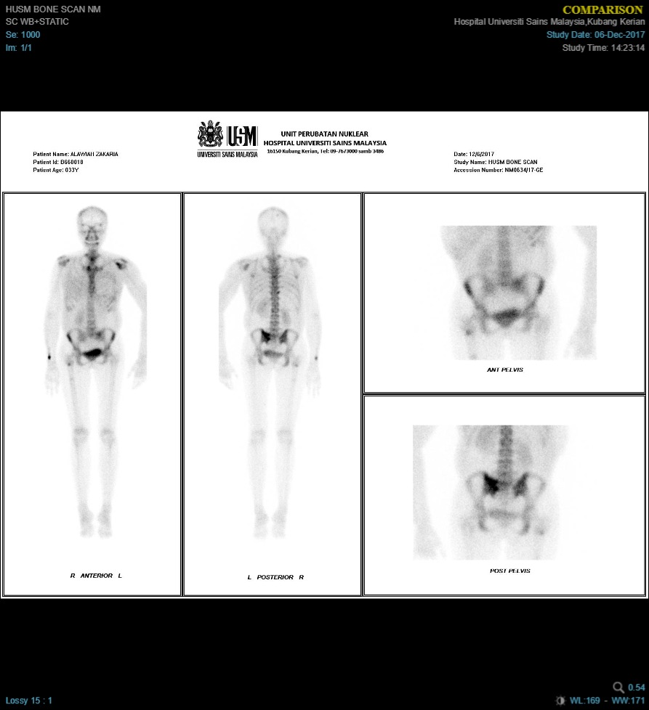
A Rare Manifestation of Breast Cancer; Carcinoma En Cuirasse
Karthik K., AK Siti Hafzan, Maya Mazuwin Y, Siti Rahmah M
Department of General Surgery, School of Medical Science, Universiti Sains Malaysia, Kubang Kerian, Kelantan
1
Introduction
Breast cancer is now the most common form of cancer in Malaysia, accounting for incidence as much as 17.7% of all locally reported cases. Locally, there is noted to be an increased incidence from the age of 40-44 and a peak incidence at 55-59 years of age. Up to 43% of patients present and are diagnosed at a very late stage (3&4). We report a rare manifestation of breast cancer in a young 34 year old woman which lead to carcinoma en cuirasse.
Case Report
A case of a 34 year old woman, who was initially diagnosed in 2016 with Invasive Breast Cancer (ER/PR –ve, Cerb 3+Ve) She was subjected to 6 cycles of neoadjuvant chemotherapy however, refused for surgery and had opted for traditional remedies. Subsequently, she had defaulted follow-up.
She presented a year later with complains of shortness of breath, lethargy as well as bleeding from the tumour site. Examination revealed ulceration of her breast tumour as well as multiple skin ulceration and nodular lesions over the chest. These lesions were tender, often oozed pus and blood. Imaging revealed that her disease had advanced, and she now had multiple metastatic sites in the bone, liver and right breast with right sided pleural effusion.
In view of her condition, she was prescribed palliative chemotherapy. An Ultrasound guided pleural tapping was performed, which drained a milky white substance, revealing Chylothorax. Antibiotics were started, and the cutaneous lesions were subjected to dressing.
She was palliated in the ward, given comfort care, as she had refused further treatment. She had eventually succumbed to her illness, almost 2 years after initial diagnosis.
The image above and below shows the extensive cutaneous spread of the disease. They appear as multiple nodular lesions over the chest with contact bleeding. The spread extends beyond the axilla and to the back. There primary tumour has also ulcerated the skin and formed a fungating mass.
Discussion
Carcinoma En Cuirasse is a rare cutaneous metastases from breast cancer or less commonly from the stomach, kidneys, or lungs to skin(1). Cutaneous metastases of internal neoplasias have a 0.8 to 8 percent incidence.(2) It is manifested through papulonodular lesions, erysipeloid, or sclerodermiform infiltration. For dissemination, a metastases requires a lymphatic or haematogenous pathway.
In the lymphatic pathway, the neoplastic cells reach the skin directly (through the thoracic duct-subclavian vein-general circulation, with subsequent cutaneous permeation, or by retrogradely, due to obstruction of the lymphatic lumen by tumour embolus and subsequent centrifugal deviation to skin(3).
The haematogenous pathway involves tumour dessimination through venous vessels to the left heart cavity. It is less frequently via arterial pathway due to the higher intraluminal pressure as well as arterial wall structure(3).
The prognosis of patients with cutaneous metastases depends on the type and biological behaviour of the underlying primary tumour and its response to treatment. Skin metastases are usually associated with advanced stages(4).
Systemic chemotherapy is the most commonly used treatment whereas the specific protocol depends on the histopathologic type of the primary tumour and staging of the patient. Surgical excision, radiotherapy, intralesional chemotherapy or immunotherapy can be used when solitary lesions develop or in the late stages of the disease in order to improve the quality of life of the patient (4,5).
The patient was suspected to have pleural effusion. Ultrasound guided drainage had revealed a milky white substance, indicating Chylothorax and invasion of the primary tumour into the thoracic duct.
Conclusion
Cancer metastasis represents the most devastating aspect of malignancy since mortality of tumour patients is mainly related to the metastatic behaviour of the primary neoplasm. In cases of carcinoma en cuirasse, it is a rare manifestation of extension metastases of the primary tumour. Given the pathway of dissemination, it mostly appears at an advanced stage of the disease, bringing a poor overall prognosis and challenging to manage. As breast cancer becomes more prevalent, it is imperative that screening programs are widely performed to diagnose breast cancer in its infancy to improve the outcome and prevent difficult complications such as Carcinoma En Cuirasse.
References
1. Bhat R, Khaitan BK. Skin manifestations in internal diseases. In: Valia RG, Valia AR, editors. IADVL Textbook of Dermatology. 3rd ed. Mumbai: Bhilani Publishing House; 2008. pp. 1347–409
2. Ruben Azcune et al. Cutaneous metastases of internal carcinomas, our experience in 94 cases. Dermatologia Argentina 2008. Pp. 44-51
3. Román C, Armijo M. El proceso metastático. II: Diseminación tumoral directa, linfática y hemática (1a. parte). Actas Dermatosifi liogr 1999; 90:277-290.
4. C. Mordenti, K. Peris, M. Concetta Cutaneous metastatic breast carcinoma: A study of 164 patients. Acta Dernativeb AOA Vik 9,2999 oo, 143-148
5. E. K. Dawson, T. M. Davie – Mammary Carcinoma with cutaneous carcinosis of erysipelatodes type. Research Labaratory of Royal College of Physicians, Edinburgh. PP 247- 258
A bone scan reveals that there are metastases evident at the thoracic vertebrae, left scapulae, sternum and right femur.

